Slide 1


Practical course on FAIR Data Stewardship in Life Science
Module 1.2 - What is Open Science
Gina Pavone, CNR-ISTI 0000-0003-0087-2151
Emma Lazzeri, GARR 0000-0003-0506-046X

Slide 2
How did we get to this point?

Slide 3
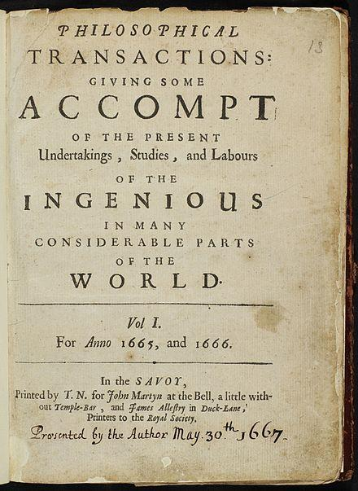
The birth of the scientific journals
1665, the first journal entirely dedicated to science
Objectives of the first journals:
improving communication between scientists
picture from: https://en.wikipedia.org/wiki/Philosophical_Transactions_of_the_Royal_Society
https://www.youtube.com/watch?v=yrIJ48KsKUw

Slide 4
Copyright is an invention
Before print
Poets repeat the song of the muses
"Scientia donum dei est, unde vendi non potest"
Roman law and the res qui tangi possunt
Science is understood as a common good
The regime of privilege
exclusive authorization conferred by political power
the object is not intellectual property but the actions of the press and book trade
it is a form of political control over the production and dissemination of knowledge (censorship)
http://btfp.sp.unipi.it/dida/fpa/index.xhtml

Slide 5
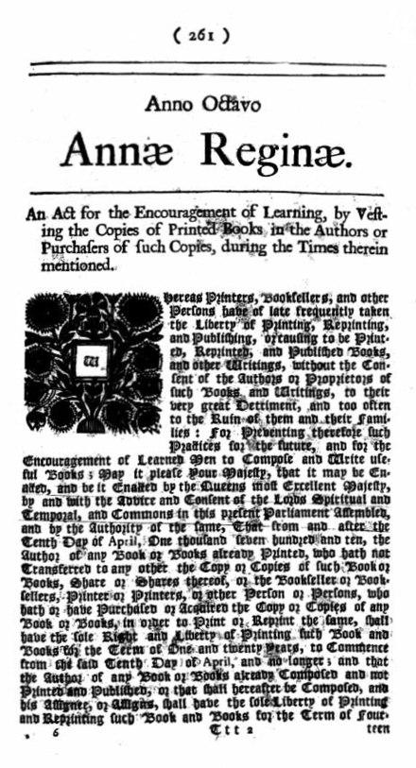
The birth of copyright
1707 the British parliament enacted the Statute of Anne, the first copyright statute.
It granted legal protection for 14 years during which only the author and the printers to whom they chose to license their works could publish the author's creations
https://en.wikipedia.org/wiki/Statute_of_Anne
Notes:
The statuted marked the first time that copyright was attributed primarily to the author, rather than the publisher. But it was supported by the printers' guild (the Stationes’ Company) because they were unable to regain the printing privileges they had with the licencing press act in 1662. “Over the next 10 years the Stationers repeatedly advocated bills to re-authorize the old licensing system, but Parliament declined to enact them. Faced with this failure, the Stationers decided to emphasise the benefits of licensing to authors rather than publishers, and the Stationers succeeded in getting Parliament to consider a new bill.” https://en.wikipedia.org/wiki/Statute_of_Anne

Slide 6
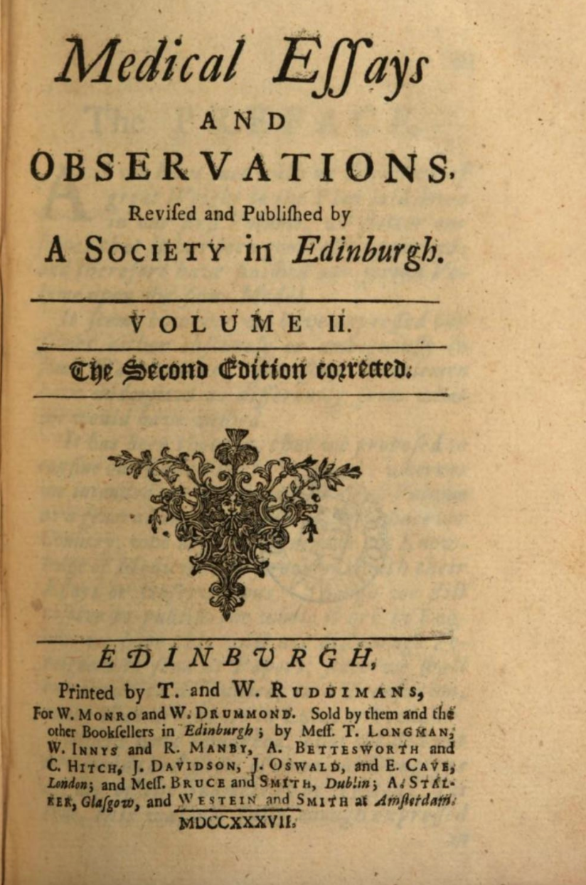
The birth of peer review
The embryonic stage also in the first scientific journals (authorization by the Royal Society: control on a privilege)
in 1731 Medical Essays and Observations published by the Royal Society of Edinburgh
“Memoirs sent by correspondence are distributed according to the subject matter to those members who are most versed in these matters. The report of their identity is not known to the author.”
https://blog.f1000.com/2020/01/31/a-brief-history-of-peer-review/
https://www.youtube.com/watch?v=yrIJ48KsKUw
Notes:
“Memoirs sent by correspondence are distributed according to the subject matter to those members who are most versed in these matters. The report of their identity is not known to the author.” Note here that “members” are not necessarily “external” referees; they are members of the society itself.

Slide 7
Scholarly communication
“the system through which research and other scholarly writings are created, evaluated for quality, disseminated to the scholarly community, and preserved for future use”
(ACRL, Principles and Strategies for the Reform of Scholarly Communication 1, 2003).
Formalised publishing practices are just a subset of a larger pool of various communication practices (emails, social media, blogs, press, etc.), both between scholars and between scholars and the public.
SC “includes both the dissemination and access to scholarship and research in a variety of formats and states of completion, such as published books or journal articles, research results and data sets, and drafts of papers”
(S. Husain S, M. Nazim, Analysis of Open Access Scholarly Journals in Media & Communication. DESIDOC Journal of Library and Information Technology. 2013; 33(5), p. 405–11)

Slide 8
What is
Open Science?
Well, many many things...

Slide 9

A change in the approach

Slide 10
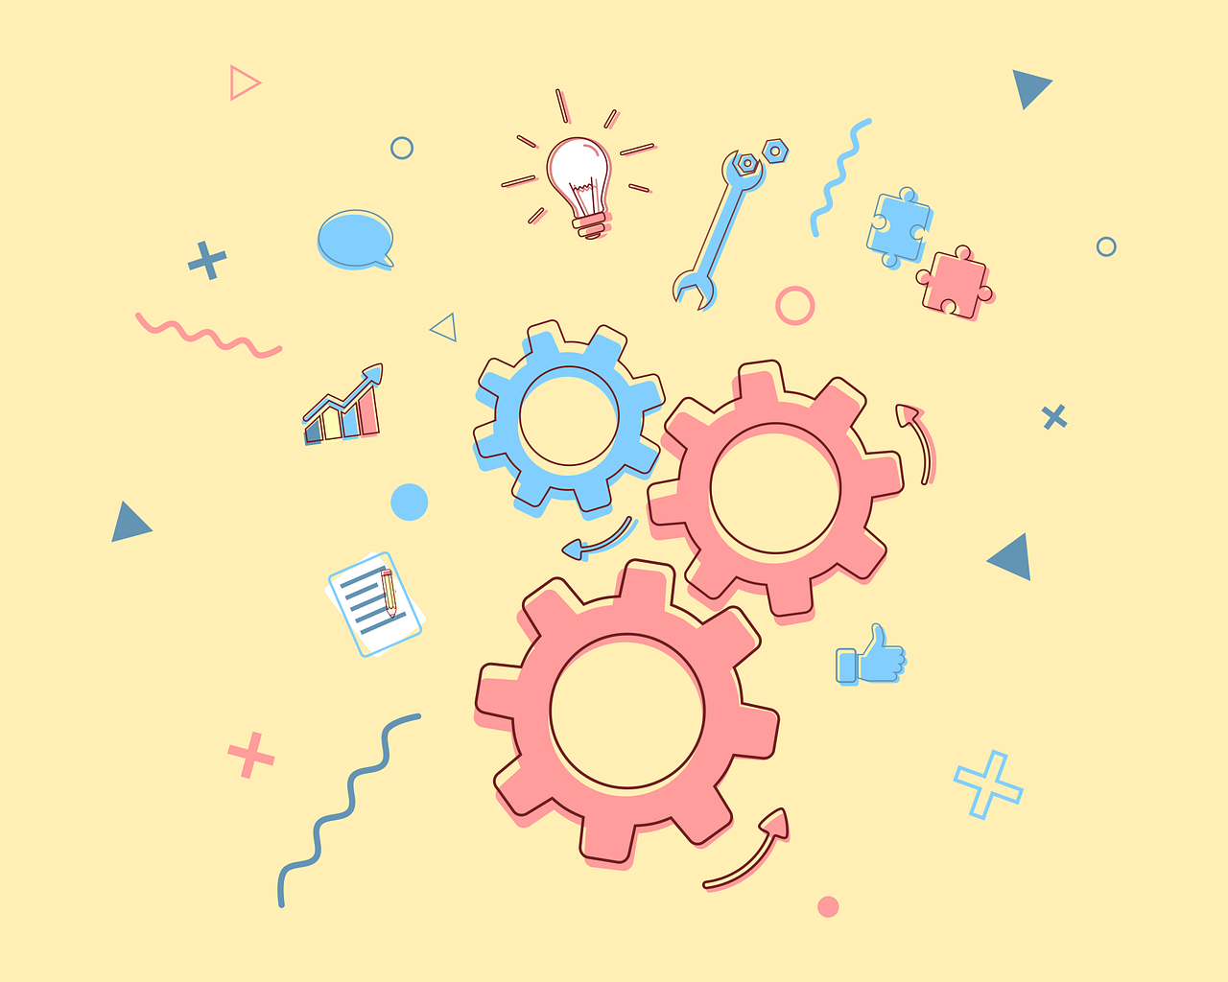
Competition
Collaboration and
sharing

Slide 11
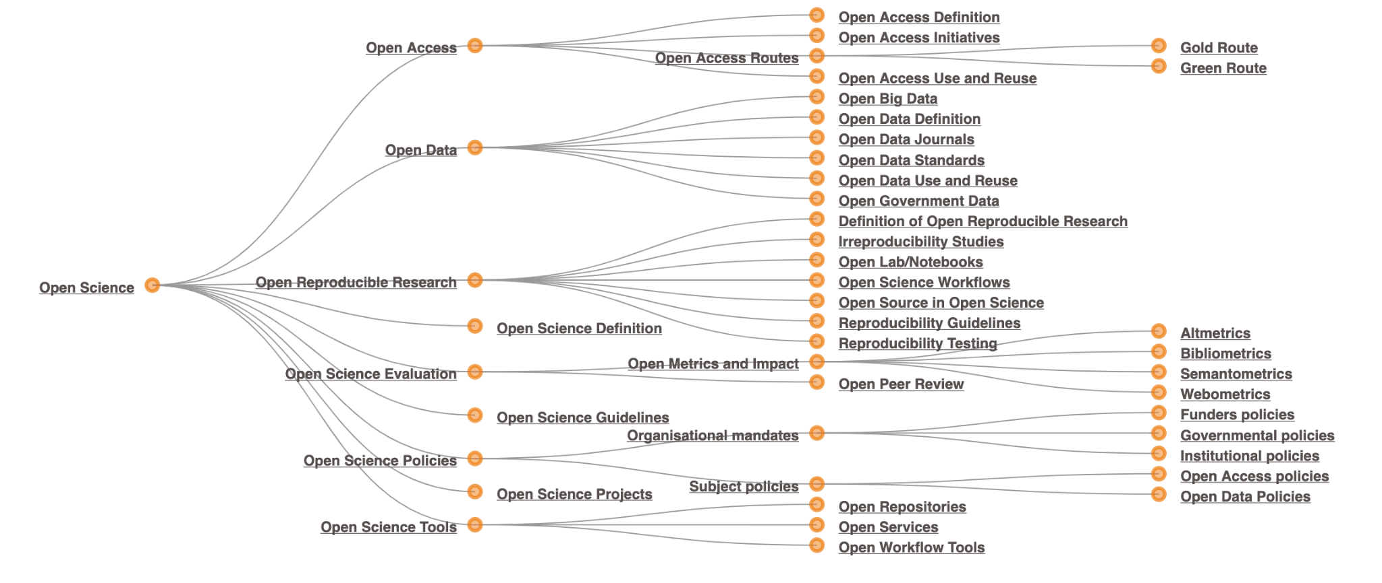
Open Science is an “umbrella word”

Slide 12
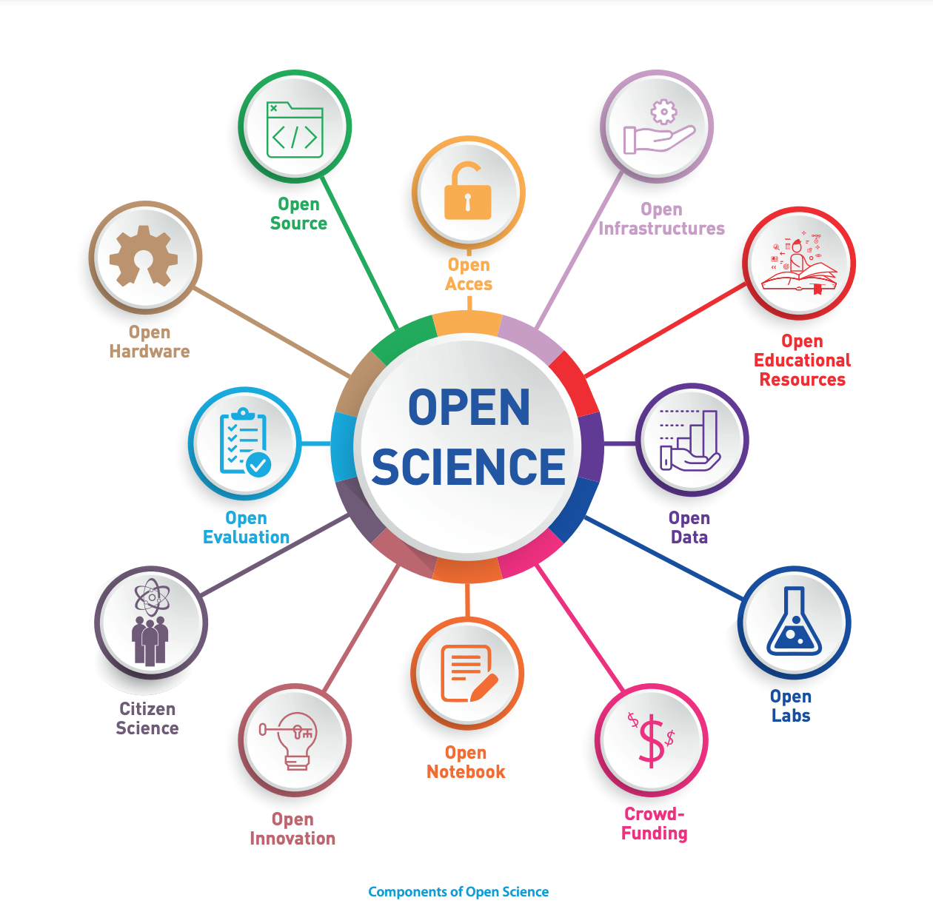
Open Science components
Open as much as possible
each step of the research activity
Unesco Open Science brochure
Notes:
Another way to show the many components that are included in Open Science

Slide 13
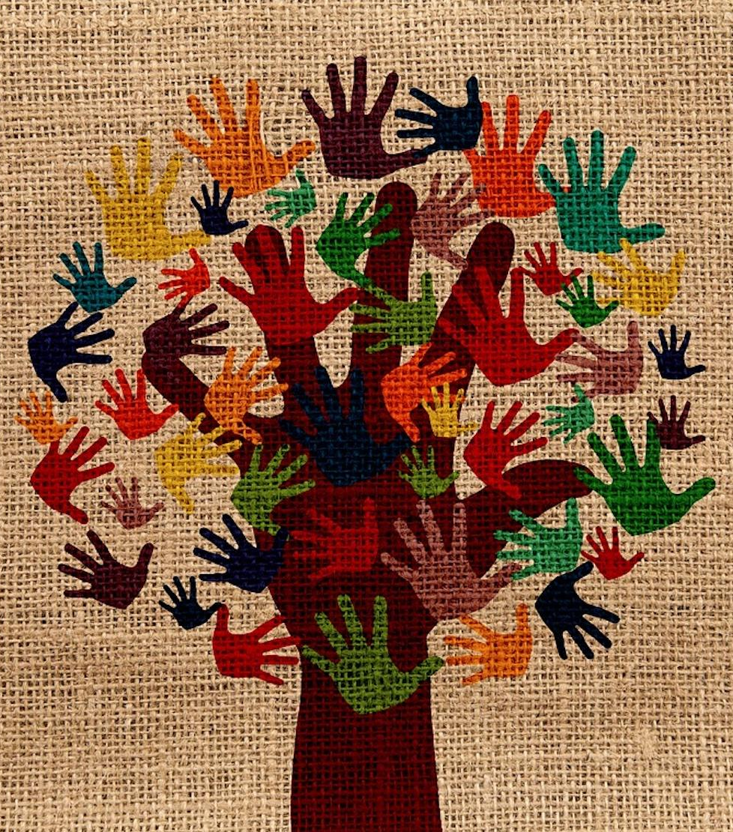
Research Integrity
Transparency
Collaboration
Inclusion
Image by Gerd Altmann from Pixabay

Slide 14

Non only publication
Science is also:
data
software
protocols
negative results
lab notes
project deliverables
and much more…
Photo by Kilimanjaro STUDIOz on Unsplash
Notes:
There are many many parts of the scientific work which are not actually being evaluated

Slide 15
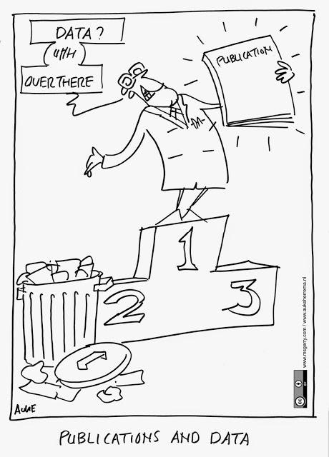
Data are first class research objects
Control
Validation
Follow-up
New research
Education
...
cartoon credit: https://www.fosteropenscience.eu/
Notes:
There are many many parts of the scientific work which are not actually being evaluated

Slide 16
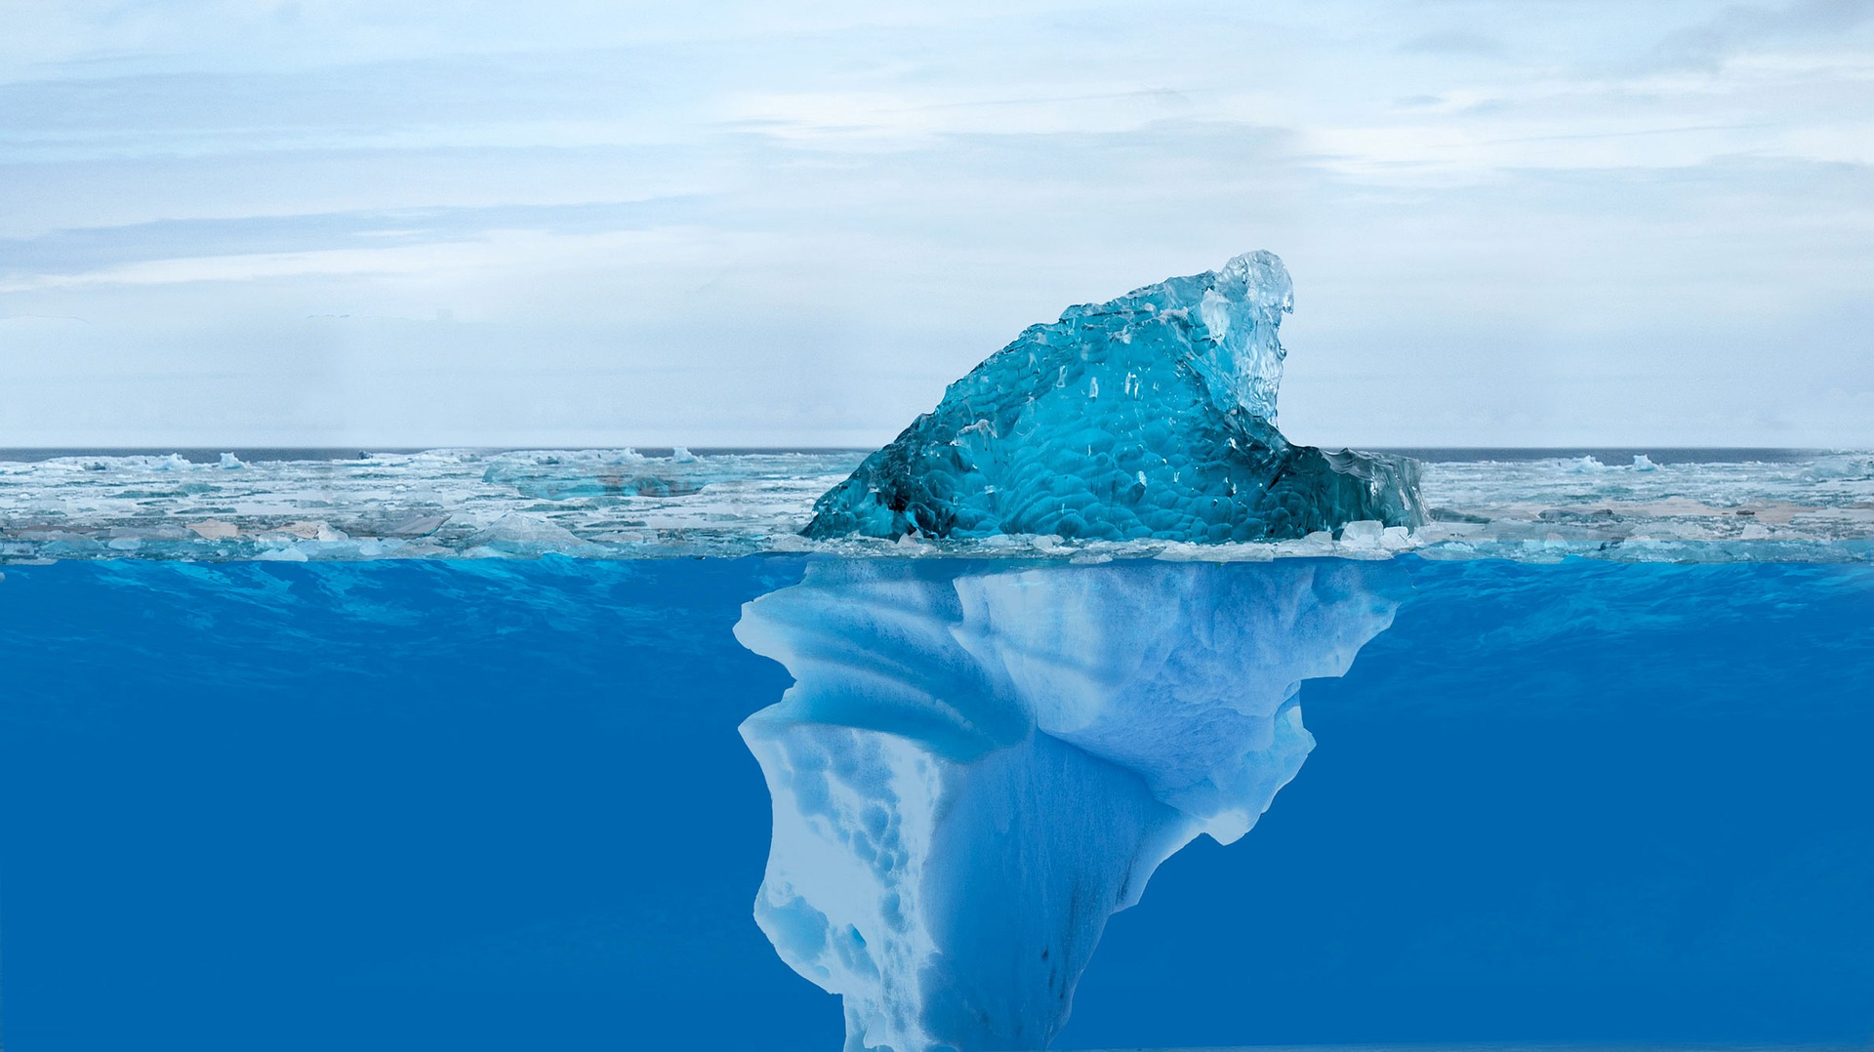
Research actions, skills and outputs other than publications:
if not shared they simply do not exist and do not enter the research lifecycle

Slide 17
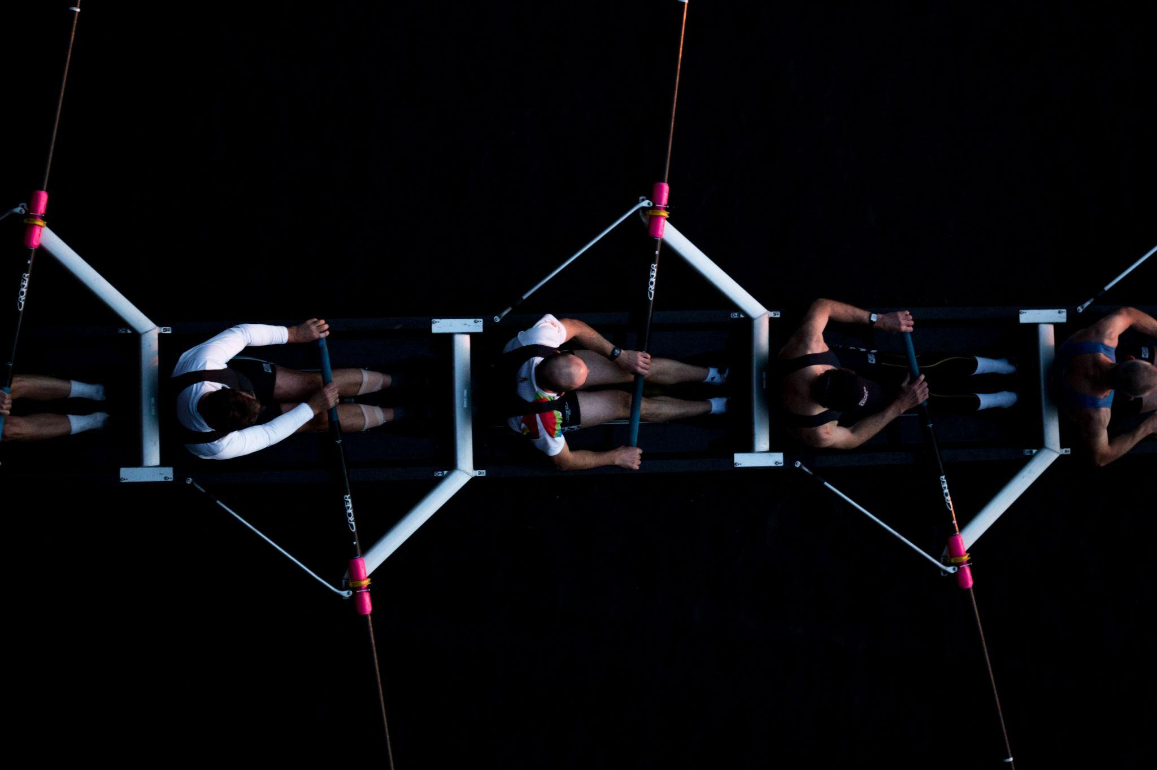
Open Science is about collaboration!
Photo by Josh Calabrese on Unsplash

Slide 18

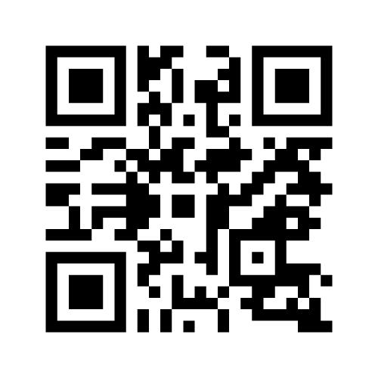
And now,
have your say!
www.menti.com
Voting code: 5722 0579

Slide 19







This presentation is part of a project that has received funding from the European Union’s Horizon 2020 research and innovation programme under grant agreement Nos 857650 (EOSC-Pillar), 824087 (EOSC-Life), and 676559 (ELIXIR-EXCELERATE), and was supported by the Italian Computing and Data Infrastructure (ICDI).
This presentation is released under a CC-BY 4.0 licence. To cite this presentation, please copy and paste:
Pavone, Gina, Lazzeri, Emma, Carta, Claudio, Chiara, Matteo, & Quaglia, Federica. (2022, March 11). Practical course on FAIR Data Stewardship in Life Science. Zenodo. https://doi.org/10.5281/zenodo.6323375.

