Slide 1


Practical course on FAIR Data Stewardship in Life Science
Module 1.3 - The problem with research assessment
Gina Pavone, CNR-ISTI 0000-0003-0087-2151
Emma Lazzeri, GARR 0000-0003-0506-046X

Slide 2

Why?
Photo by Evan Dennis on Unsplash

Slide 3
Publish or perish!

Slide 4
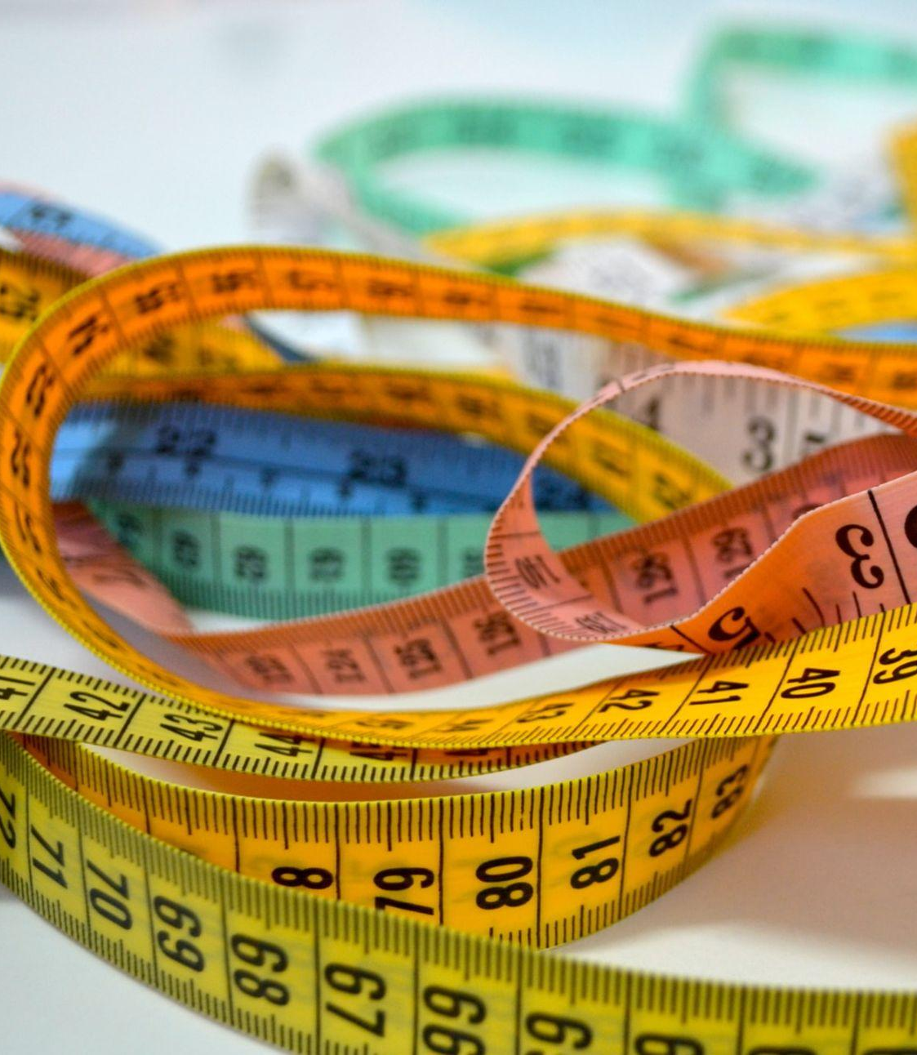
Research evaluation
Based on bibliometric indexes or,
for non-bibliometric sectors, on selected «fascia A» list of journals
Photo by patricia serna on Unsplash

Slide 5
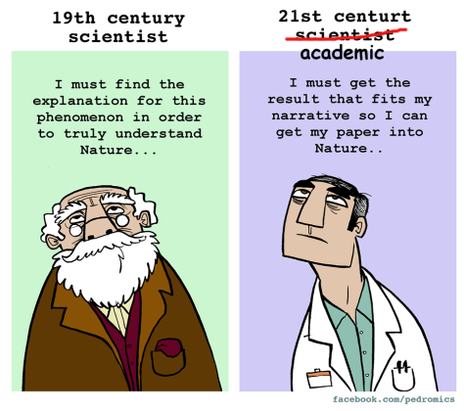
Researcher’s
survival kit?
many many publications
high citation rate
“important” venus (read: high IF)
But this does not in itself imply excellence in research!
Notes:
Do we want this?

Slide 6
What are we evaluating?
Researchers are evaluated by looking at the Impact Factors of the Journals where they publish papers
Commercial publishers are responsible for assessing ranking (Impact Factor) of the Scientific Journals

Slide 7
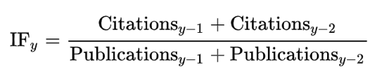
The two most important bibliometric indexes
Journal Impact Factor
For a given year, the two-year jif is the ratio between the number of citations received in that year for publications in that journal that were published in the two preceding years and the total number of "citable items" published in that journal during the two preceding years
H-index
For a researcher:
the maximum value of h such that the given author has published h papers that have each been cited at least h times.
As an example, an h-index of 10 means that among all publications by one author, 10 of these publications have received at least 10 citations each.
Notes:
Impact Factor is a measure of the frequency with which the average article in a journal has been cited in a particular year. H-index tries to estimate productivity and impact of a research.

Slide 8
Citation index criticism
Early career researchers are penalised
The citation context is not considered (e.g. negative citation)
They are influenced by the limitation of the citational databases (which are all owned by big scientific publishers and not publicly available)
It can be manipulated by both authors and reviewers (self and cross citations)
It does not take into account the number of authors in a paper and their contribution
It does not take into account research multidisciplinarity (i.e. citation conventions differ widely among different fields)
It does not facilitate science freedom
DORA, 2013, https://sfdora.org/read/
McKiernan, et al, 2019. https://elifesciences.org/articles/47338
Niles, et al, 2019. https://www.biorxiv.org/content/10.1101/706622v1
Alder, et al, 2008. https://www.mathunion.org/fileadmin/IMU/Report/CitationStatistics.pdf

Slide 9
“Researchers will do anything to publish papers in some journals, including even creating fake authors”
“ [...] publishing papers in certain journals is the only way to earn grants, tenure, and promotions”
Gaming the Metrics: Misconduct and Manipulation in Academic Research https://direct.mit.edu/books/book/4598/Gaming-the-MetricsMisconduct-and-Manipulation-in

Slide 10
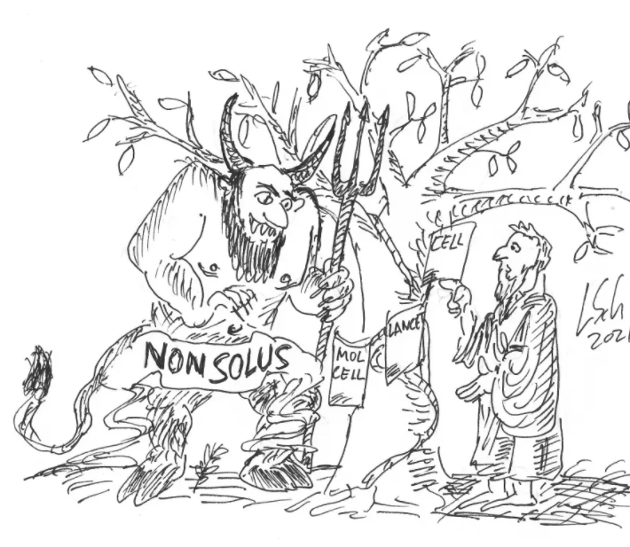
Not only researchers’ fault
A major publisher (Elsevier) buys a well known scientific journal: The Journal of Biological Chemistry (JBC). This is what happens:
online articles reformatted and images available in low resolution only
in that type of journal that means less readable, less easy to double-check images
resistance to correction/retraction
https://forbetterscience.com/2021/10/12/how-jbc-sold-its-soul-to-the-devil/?fbclid=IwAR3OMFpos_8hDdGhmV-6tE_xzMgYrEYoPLF3sC9LOrKrJ9sDoRu6qShjS7k

Slide 11
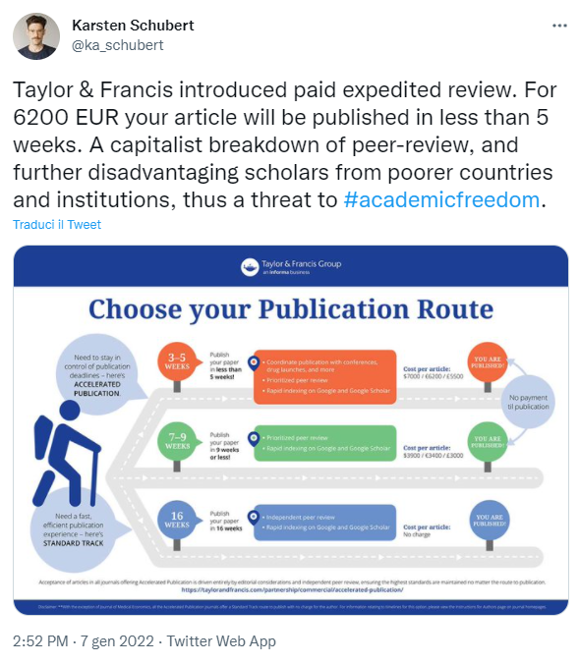
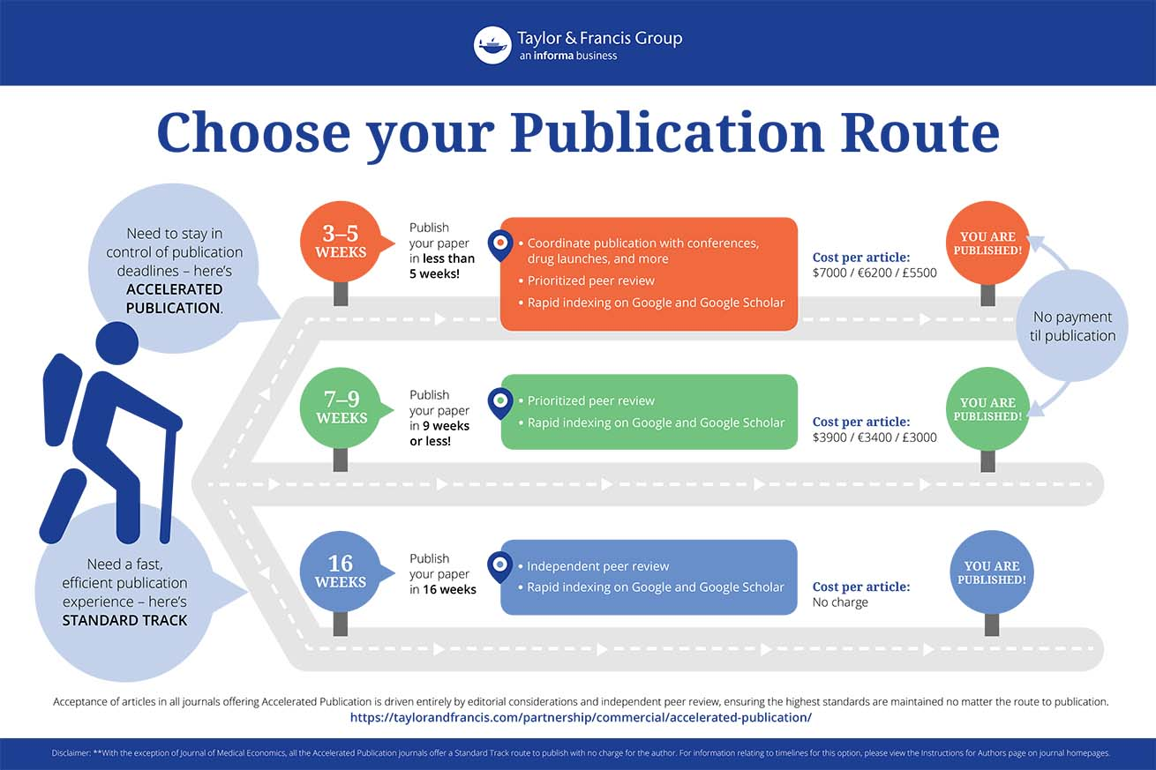
It’s all about business
not about science excellence
https://twitter.com/ka_schubert/status/1479450996535447553
https://taylorandfrancis.com/partnership/commercial/accelerated-publication/

Slide 12
Yet to many still take
for granted that “prestigious journal = good paper”
Think on the example of hydroxychloroquine in COVID-19 research: high-profile, peer-reviewed journal articles were retracted!

Slide 13
But….good news!
Things
are changing!

Slide 14
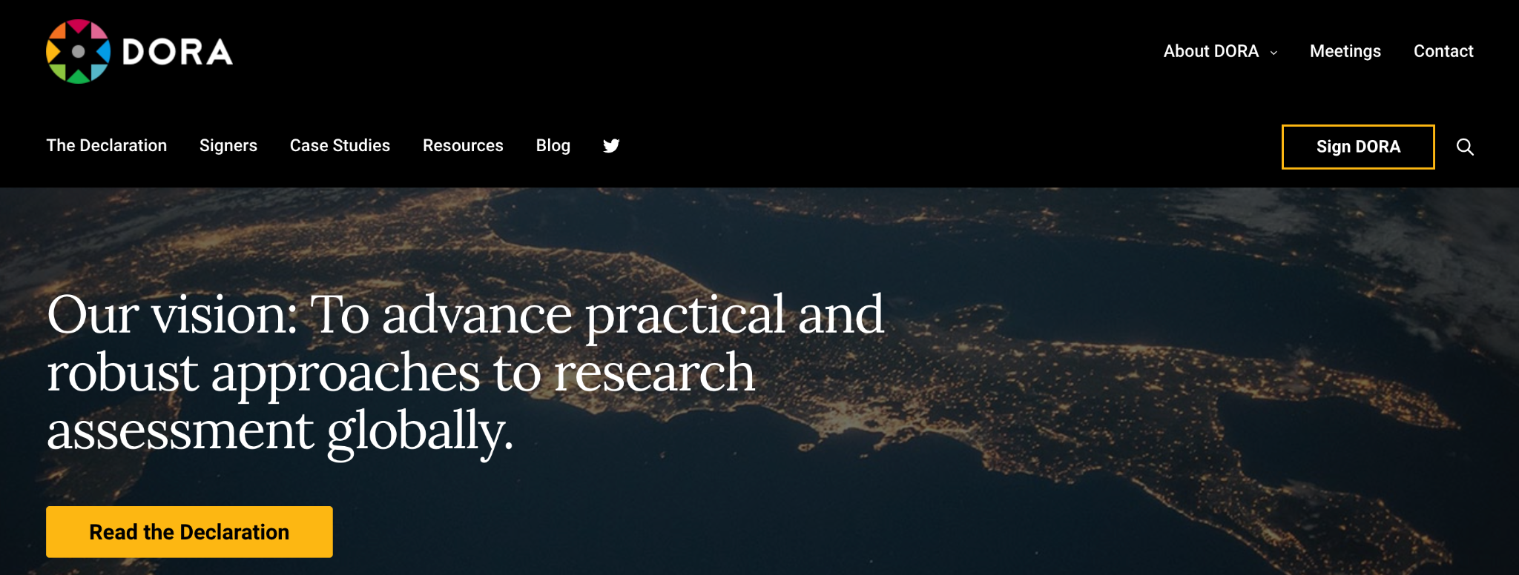
The Declaration on Research Assessment (DORA)
https://sfdora.org/

Slide 15
“There is a pressing need to improve the ways in which the output of scientific research is evaluated by funding agencies, academic institutions, and other parties”.
https://sfdora.org/

Slide 16
Basic principles of DORA recommendations:
the need to eliminate the use of journal-based metrics, such as Journal Impact Factors, in funding, appointment, and promotion considerations;
the need to assess research on its own merits rather than on the basis of the journal in which the research is published;
https://sfdora.org/read/

Slide 17
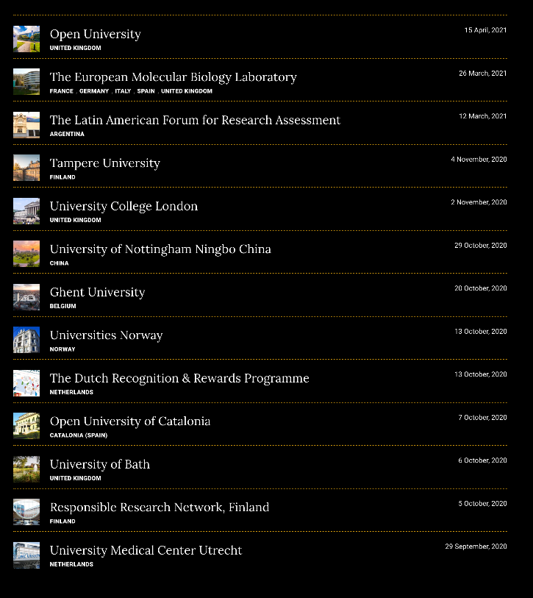
And again…
good news!
The DORA case studies: a list of institutions that have already introduced changes in academic career assessment
https://sfdora.org/dora-case-studies/

Slide 18
EC on research assessment
What is going on in Europe
Consultation
Bilateral meetings
01
with stakeholders from March to November 2021
between EC and member state representatives
(for Italy: MUR and ANVUR)
03
Research
assessment
Report
Stakeholder
Meeting
02
November 2021, publication of the report “Towards a reform of the research assessment system”
04
with RFOs, RPOs, agencies for evaluation,, associations, learned societies. For Italy: MUR and ANVUR

Slide 19
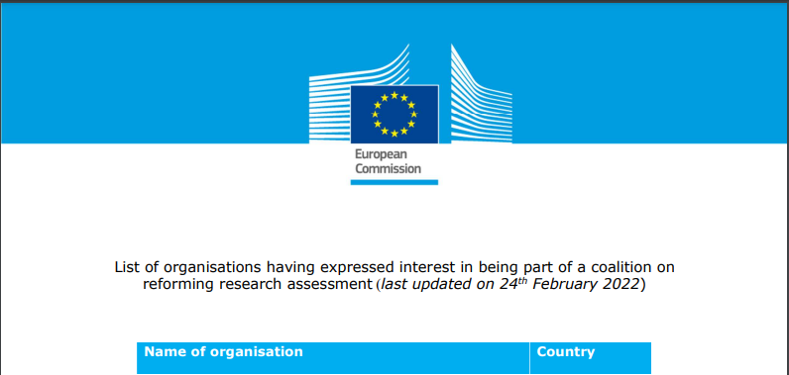
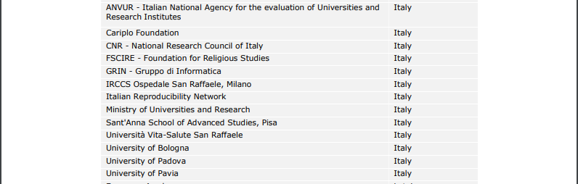
Over 260 institutions and initiatives (13 Italian) joined the coalition to reform Research Assessment
https://ec.europa.eu/info/files/list-organisations-having-expressed-interest-being-part-coalition-reforming-research-assessment_en

Slide 20
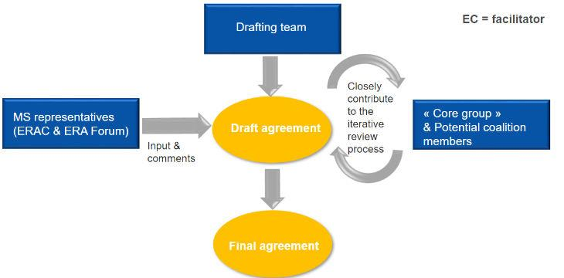
The core group has already started drafting the agreement representing the diversity of the research community across Europe
https://ec.europa.eu/info/news/process-towards-agreement-reforming-research-assessment-2022-jan-18_en

Slide 21


And now,
have your say!
www.menti.com
Voting code: 5722 0579

Slide 22







This presentation is part of a project that has received funding from the European Union’s Horizon 2020 research and innovation programme under grant agreement Nos 857650 (EOSC-Pillar), 824087 (EOSC-Life), and 676559 (ELIXIR-EXCELERATE), and was supported by the Italian Computing and Data Infrastructure (ICDI).
This presentation is released under a CC-BY 4.0 licence. To cite this presentation, please copy and paste:
Pavone, Gina, Lazzeri, Emma, Carta, Claudio, Chiara, Matteo, & Quaglia, Federica. (2022, March 11). Practical course on FAIR Data Stewardship in Life Science. Zenodo. https://doi.org/10.5281/zenodo.6323375.

