Slide 1


Practical course on FAIR Data Stewardship in Life Science
Module 1.4 - EC Policies on Open Science
Gina Pavone, CNR-ISTI 0000-0003-0087-2151
Emma Lazzeri, GARR 0000-0003-0506-046X

Slide 2
Open Science as
the new normal
Open Science in Horizon Europe funding programme

Slide 3
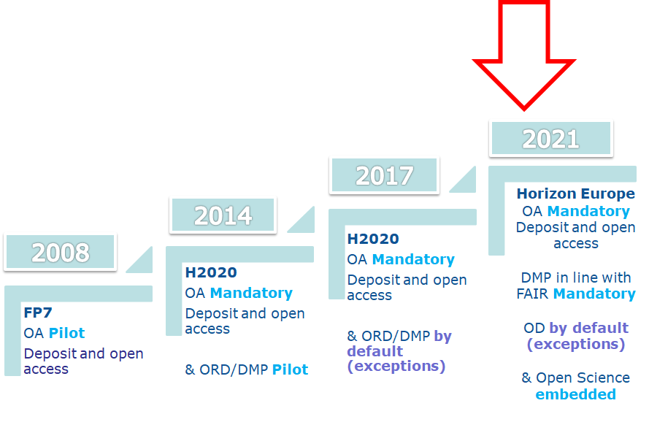
The European Commission and the road to Open Science
Courtesy of Victoria Tsoukala, PhD - DG RTD Open Science (Unit G4) - PUBMET 2019, Zadar, September 19th, 2019

Slide 4

Open Science in
Horizon Europe - publications
Mandatory OA for all publications resulting from the project
Deposit of OA version immediate upon publication (no embargo)
All authors must retain sufficient rights - right retention strategy
Non-reimbursable costs for hybrid journals (subscription + author-paid OA option)
Use of trusted repository for deposit and long term preservation
Link to other research outputs needed to validate published results
Photo by Gabriella Clare Marino on Unsplash

Slide 5

Open Science in
Horizon Europe - data
End of Open Data Pilot (no opt-out)
Mandatory FAIR data management
Mandatory DMP for all projects
OA by default, with exceptions that can be justified in the DMP and accepted by the Project Officer /Reviewers
Use of trusted repository for deposit and long term preservation
Photo by Nana Smirnova on Unsplash

Slide 6
Os in the Horizon Europe
project proposal

Slide 7
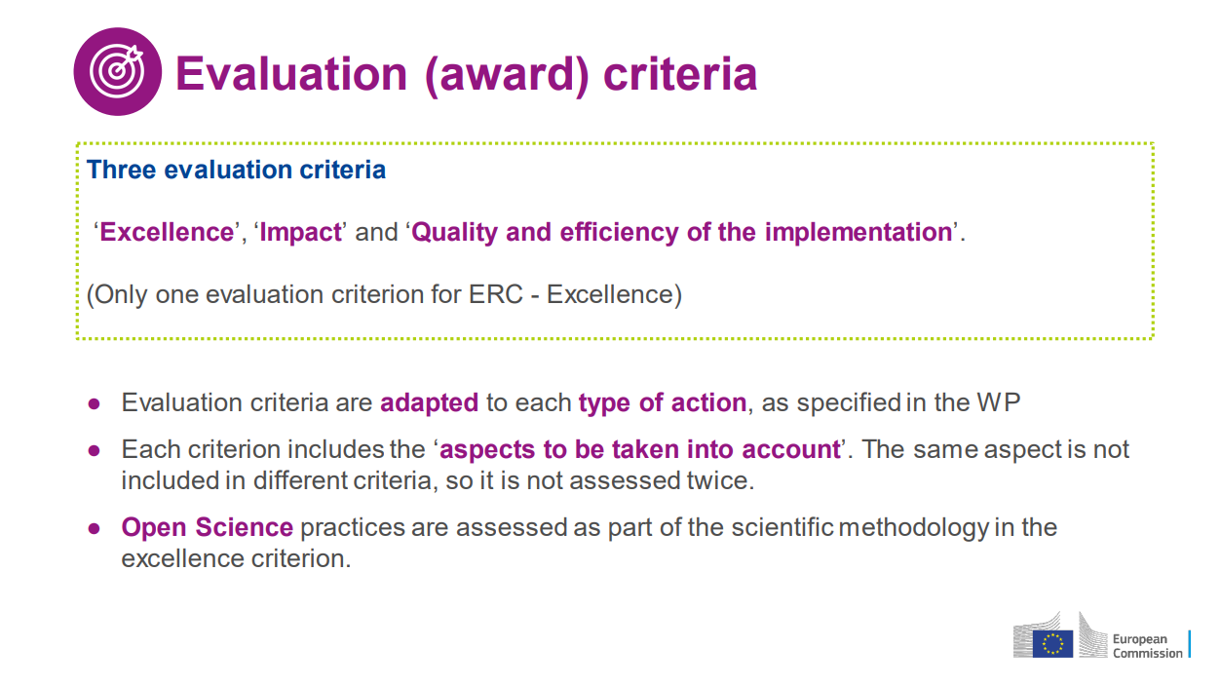
THE EU RESEARCH & INNOVATION PROGRAMME 2021 – 2027 HORIZON EUROPE PROPOSAL EVALUATION Standard Briefing Version 2.0 25.06.2021

Slide 8
Open Science in HE project proposal evaluation
In Horizon Europe the project proposal is evaluated according to Open Science perspective
1
2
3
What
How
Who
Results should be managed according to FAIR principles and "as open as possible, as closed as necessary“ principle
In the methodology it is to be proved how Open Science practices are integrated in the project
Single researchers and the consortium are evaluated for their capability to support Open Science practices

Slide 9
Os in excellence and
quality of implementation sections
In Horizon Europe, open science practices are considered in the evaluation of proposals, under ‘excellence’ in particular under methodology and under the ‘quality and efficiency of implementation’ award criterion. Proposers should address open science practices in the relevant section on open science under methodology.
See Horizon Europe programme guide: https://ec.europa.eu/info/funding-tenders/opportunities/docs/2021-2027/horizon/guidance/programme-guide_horizon_en.pdf
Horizon Europe moves beyond open access to open science

Slide 10


Mandatory and recommended OS practices
In HE both mandatory and recommended OS practices will be evaluated in the project proposal phase.
“Proposers will have to provide concrete information on how they plan to comply with the mandatory open science practices. Failure to sufficiently address this, will result in a lower evaluation score.
Recommended open science practices are incentivised through their evaluation at the proposal stage.
Photo by Wesley Armstrong on Unsplash
Image by Philip Uglow from Pixabay
Horizon Europe Programme guide: https://ec.europa.eu/info/funding-tenders/opportunities/docs/2021-2027/horizon/guidance/programme-guide_horizon_en.pdf

Slide 11
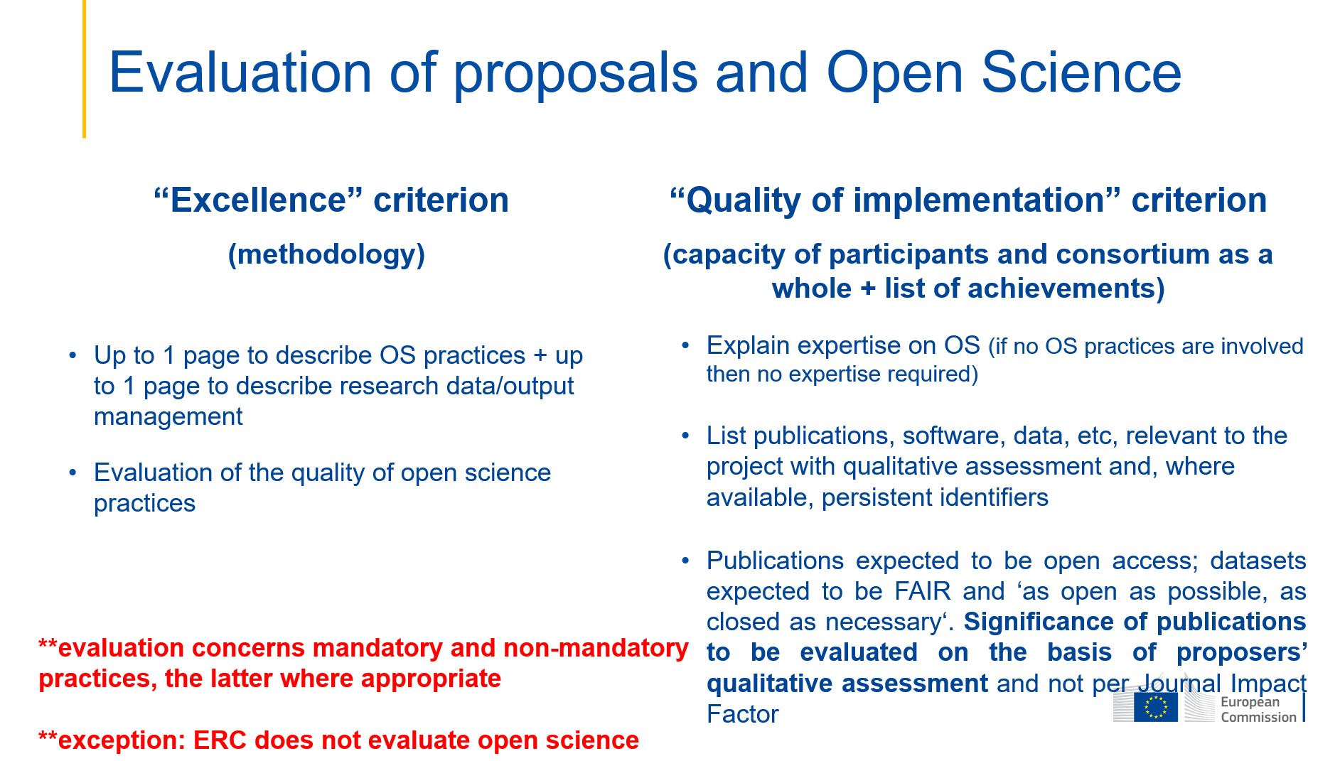
Courtesy of Victoria Tsoukala, April 21, 2021, Webinar: A successful proposal for Horizon Europe: Scientific-technical excellence is key, but don’t forget the other aspects

Slide 12
‘Excellence’, part B (Project proposal – Technical description)
“proposers should describe how open science practices (mandatory and recommended, as appropriate) are implemented as an integral part of the methodology and show how their implementation is adapted to the nature of their work, therefore increasing the chances of the project delivering on its objectives.
If open science practices are not applicable to the proposal, justifications should be provided sp that, if evaluators agree, open science will not be taken into consideration in the evaluation.
What to describe in the methodology section
See Horizon Europe programme guide: https://ec.europa.eu/info/funding-tenders/opportunities/docs/2021-2027/horizon/guidance/programme-guide_horizon_en.pdf
Notes:
Please note that this question does not refer to outreach actions that may be planned as part of communication, dissemination and exploitation activities. These aspects should instead be described below under ‘Impact’.

Slide 13

What to include in the methodology section
Open Science Practices
Research data Management and management of other research outputs
FAIR aspects of RDM
Curation and storage/preservation costs; person/team responsible for data management and quality assurance.
Embedded in the Methodology

Slide 14
‘Capacity of participants and consortium as a whole’ , part B
“Proposers should describe how the consortium brings together the necessary disciplinary and interdisciplinary knowledge.
Proposers should show how this includes expertise and/or track record in open science practices, relevant to what is planned for the project.
Os in the description of the consortium
See Horizon Europe programme guide: https://ec.europa.eu/info/funding-tenders/opportunities/docs/2021-2027/horizon/guidance/programme-guide_horizon_en.pdf

Slide 15
Part A of the proposal
“Proposers are asked to list up to five relevant publications, widely used datasets or other achievements of consortium members that they consider significant for the action proposed.
Publication should be OA (if they are not, deposit them retroactively) and data should be FAIR and ‘as open as possible, as closed as necessary’.
The significance of publications will not be evaluated on the basis of the Journal Impact Factor of the venue they are published in, but on the basis of a qualitative assessment provided by the proposers for each publication.
Os in the application form of the proposal
See Horizon Europe programme guide: https://ec.europa.eu/info/funding-tenders/opportunities/docs/2021-2027/horizon/guidance/programme-guide_horizon_en.pdf

Slide 16
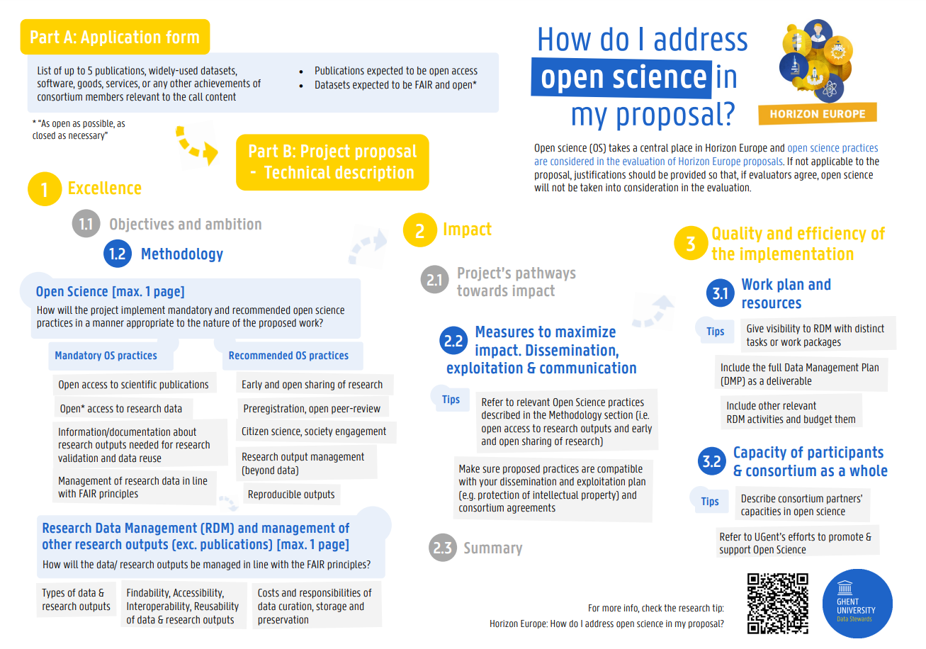
https://osf.io/dp6je/
Giglia, Elena. (2021, May 27). Guida all'Open Science in Horizon Europe. Zenodo. https://doi.org/10.5281/zenodo.5589722
Giglia, Elena. (2021). A guide to Open Science in Horizon Europe (Version 3). Zenodo. https://doi.org/10.5281/zenodo.5588123

Slide 17
Os in Horizon Europe
during the project lifetime

Slide 18
Open Science practices in Horizon Europe
early and open sharing of research (i.e. preregistration, registered reports, pre-prints, or crowd-sourcing)
research output management including research data management
measures to ensure reproducibility of research outputs
open access to research outputs (e.g. publications, data, software, models, algorithms, and workflows) through deposition in trusted repositories
participation in open peer-review
involving all relevant knowledge actors including citizens, civil society and end users in the co-creation of R&I agendas and contents (such as citizen science)

Slide 19
Open Access to scientific publications in HE - 1
Beneficiaries must ensure OA to peer-reviewed scientific publications relating to their results. In particular, they must ensure:
at the latest upon publication, deposition of the AAM or VoR in a trusted repository + immediate open access via the repository under CC BY or equivalent (CC BY-NC/CC BY-ND are allowed for long-text formats)
information via the repository about any research output/tools/instruments needed to validate the conclusions of the scientific publication
Metadata must be open under CC 0 or equivalent, in line with the FAIR principles and provide information about the licensing terms and persistent identifiers, amongst others.

Slide 20
Trusted repository
Certified repositories (e.g. CoreTrustSeal, nestor Seal DIN31644, ISO16363) or disciplinary and domain repositories commonly used and endorsed by the research communities and internationally recognised.
General-purpose or institutional repositories that:
  assign persistent unique identifiers to contents
  contents are accompanied by quality metadata to enable discovery, reuse and citation (ie provide information about provenance and licensing; metadata are machine- actionable and standardized).
  facilitate mid- and long-term preservation of the deposited material.

Slide 21
Open Access to scientific publications in HE - 2
Beneficiaries (or authors) must retain sufficient intellectual property rights to comply with the OA requirements
Publication in venue of choosing but publication fees are reimbursable only if publishing venue is full open access (publication fees in hybrids not reimbursed)

Slide 22








OA to publications on HE
Immediate Open Access
Open Access Journals:
Doaj.org
Check if Article Processing Charges are required
Always deposit
Researcher decide where to publish
Immediate Open Access to
allowed Open Access version
Self-archiving in a
repository
Subscription based Journals
Open Research Europe
By default you have:
deposit in Zenodo
open peer review
inclusion of underlying data/tools
Check publishers policies on https://v2.sherpa.ac.uk/romeo/

Slide 23
Research data management in HE
Beneficiaries must manage the digital research data generated in the action responsibly, in line with the FAIR principles and:
establish + regularly update a data management plan (‘DMP’) for generated (and/or collected) data; by mo 6 of project; with submission or latest by grant agreement in cases of public emergency (e.g. COVID projects)
as soon as possible and within the deadlines set out in the DMP, deposit the data in a trusted repository (federated in the EOSC if required in the call conditions) + ensure OA under CC BY, CC 0 or equivalent, following the principle ‘as open as possible as closed as necessary’
provide information via the repository about any research output/tools/instruments needed to re-use or validate the data
Metadata must be open under CC 0 or equivalent (to the extent legitimate interests or constraints are safeguarded), in line with the FAIR principles and provide information about the licensing terms and persistent identifiers, amongst others.

Slide 24
Additional Open Science practices in HE - 1
Some calls may have additional obligations on OS practices they must comply with
Beneficiaries must provide (digital or physical) access to data or other results needed for validation of the conclusions of scientific publications, provided legitimate interests safeguarded and unless (open) access already provided at publication (mainstreamed through general annexes of WP; does not currently apply to ERC)

Slide 25
Additional Open Science practices in HE - 2
If imposed by the call conditions in case of a public emergency, beneficiaries must (if requested by the granting authority) immediately deposit any research output in a repository + provide open access to it under CC BY, CC 0 or equivalent.
As an exception, if the access would be against the beneficiaries’ legitimate interests, beneficiaries must grant non-exclusive licenses — under fair and reasonable conditions — to legal entities that need the research output to address the public emergency + commit to rapidly and broadly exploit the resulting products and services at fair and reasonable conditions.
This provision applies up to four years after the end of the action.

Slide 26
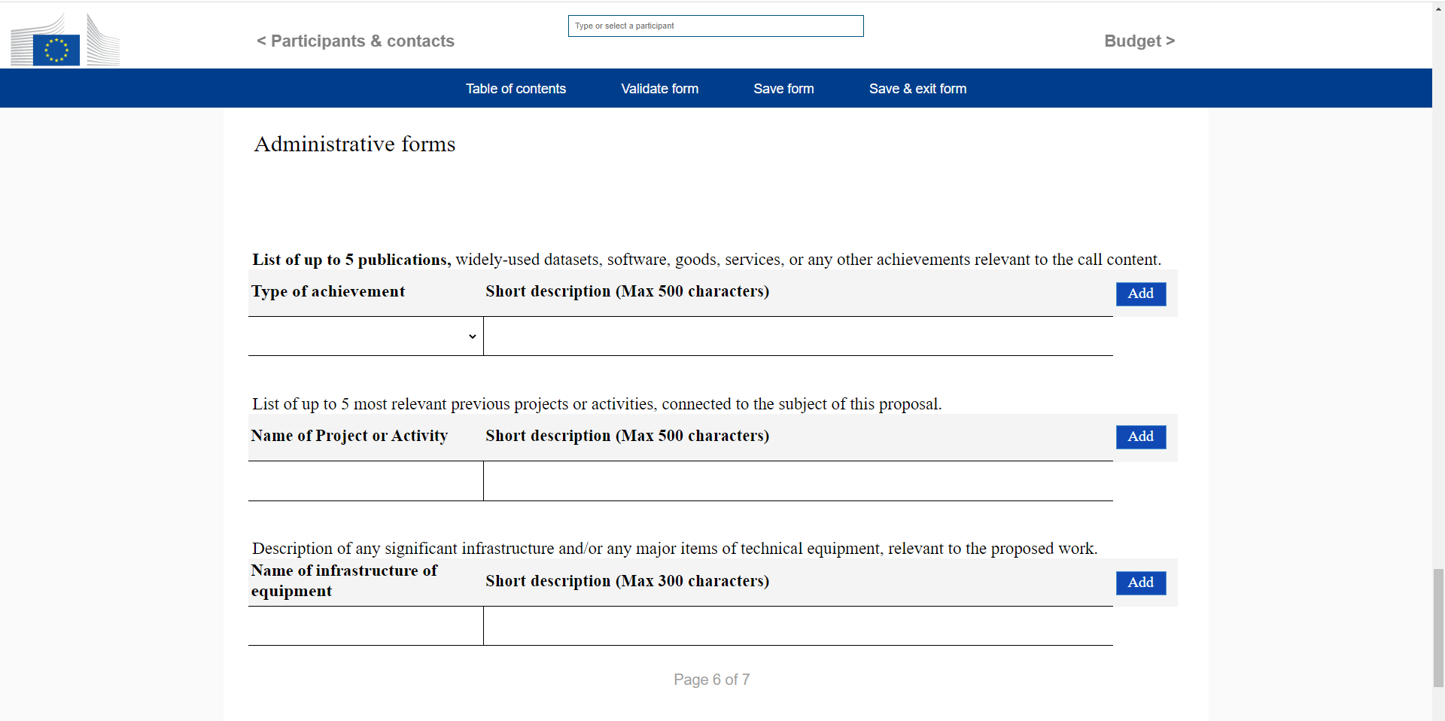
Exercise - Achievement Impact
When drafting a proposal for Horizon Europe, you are asked to list of up to 5 publications, widely-used datasets, software, goods, services, or any other achievements relevant to the call content.
The significance of publications are not evaluated on the basis of the Journal Impact Factor of the venue they are published in, but on the basis of a qualitative assessment provided by the proposers for each publication.
Try to compile a single achievement qualitative assessment for your proposal!
https://forms.gle/V779q4sAqNYkAtcG6

Slide 27


And now,
have your say!
www.menti.com
Voting code: 5722 0579

Slide 28







This presentation is part of a project that has received funding from the European Union’s Horizon 2020 research and innovation programme under grant agreement Nos 857650 (EOSC-Pillar), 824087 (EOSC-Life), and 676559 (ELIXIR-EXCELERATE), and was supported by the Italian Computing and Data Infrastructure (ICDI).
This presentation is released under a CC-BY 4.0 licence. To cite this presentation, please copy and paste:
Pavone, Gina, Lazzeri, Emma, Carta, Claudio, Chiara, Matteo, & Quaglia, Federica. (2022, March 11). Practical course on FAIR Data Stewardship in Life Science. Zenodo. https://doi.org/10.5281/zenodo.6323375.

