Slide 1

Practical course on FAIR Data Stewardship in Life Science
Module 2.2 - Open Research Europe
Gina Pavone, CNR-ISTI 0000-0003-0087-2151
Emma Lazzeri, GARR 0000-0003-0506-046X

Slide 2
Open Research Europe
•It is not a Journal, it is a publishing platform
•The aim is to give researcher a venue where to publish the results of their research funded by the EC, irrespective of the perceived level of interest or novelty
•Confirmatory or negative results, as well as null studies are suitable
•The scope of the Peer Review is not to reject or accept a result but to improve its publication thanks to a collaboration effort among experts
•The Reviewer role is to assess whether the research is technically sound and of academic merit.
•Only H2020 and Horizon Europe results are eligible (for the moment)
•Open Peer Review based: Reviewers names and comments are public, reviewer contribution gets DOI (reward!), comments from scientific community always possible
•Fully compliant with Horizon Europe Open Science requirements, support for FAIR data to validate results presented in the contribution published
The publishing platform for European Commission funded research
Soon on ANVUR lists!

Slide 3
Courtesy of: Michael Markie @MMMarksman
Publishing Director, F1000 Research
@OpenResearch_EU

Slide 4
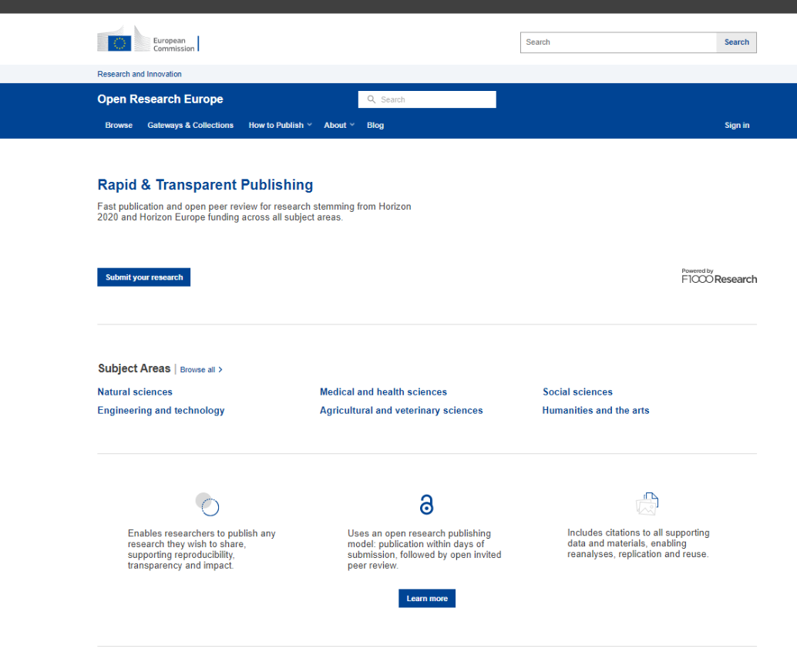
Open Research Europe (ORE)
Public Procurement – 5.8 Million EUR contract signed in March 2020 with F1000 Research for 4 years
Global Young Academy, LIBER and Eurodoc as collaborators/subcontractors for communication and sustainability
OpenAIRE are a partner to help with syndication and communication of ORE
https://open-research-europe.ec.europa.eu/

Slide 5
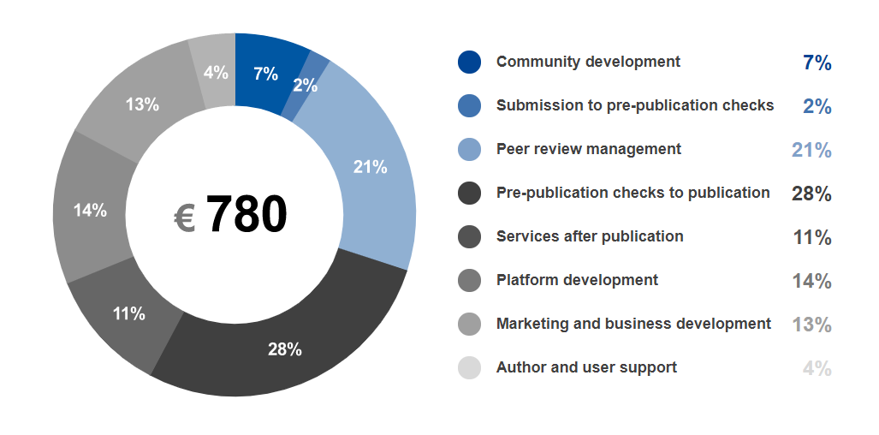
Price Transparency
Transparent about the costs and importantly the breakdown for the price that the Commission pays per article.
https://open-research-europe.ec.europa.eu/for-authors/article-processing-charges

Slide 6
The platform as a publishing service
New generation metrics
Each article will have a dedicated metrics page
Explicit, accessible and transparent on business processes and publication policies
All published on the site for everyone to see
Aligned with the EC policy and principles
Takes burden from researchers as it is fully compliant
Following example of other funders
Such as the Wellcome Trust (Wellcome Open Research) and others

Slide 7
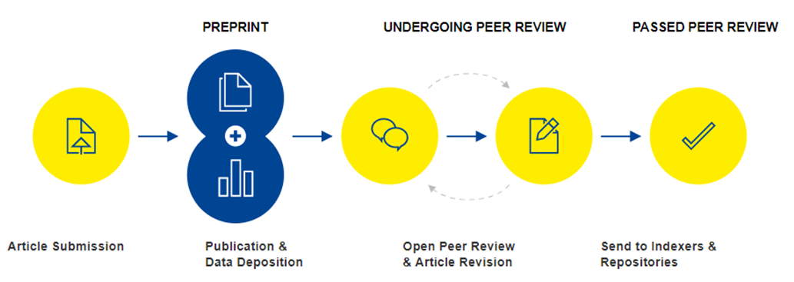
Open Research Publishing Model

Slide 8
Prepublication checks
Upon Submission
Assess author eligibility
Check article scope
Check for plagiarism
Pre-publication Checks
Comprehensive checks on reporting, editorial & ethical guidelines
Check for data availability
Support authors in making data and software FAIR
Production
Converted to text and data-mining formats (PDF, HTML, XML)
Proofs and editing if necessary
Quality checks on citations, references, image resolutions & multimedia
Ensure persistent identifiers are assigned and resolve correctly

Slide 9
Open Research Publishing Model

Slide 10



Data and Software Availability
Open Research Europe requires that, where possible, the source data underlying the results are made available at publication (FAIR).
However, the sharing of research data must:
Protect the confidentiality, security and privacy of individuals
Respect the terms of consent by individuals who are involved in research
Be consistent with Horizon legal, ethical and regulatory frameworks
Guard against unreasonable costs
https://open-research-europe.ec.europa.eu/for-authors/data-guidelines

Slide 11
Open Research Publishing Model

Slide 12
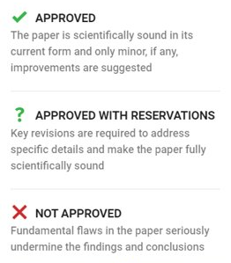


Open Peer Review
Open Identities
Reviewers must provide name and affiliation
Must identify conflicting interests
Open Reports
Reviewer reports will be published alongside the article
These are citable and have viewing metrics
Open Review Status
Reviewers assign a status

Slide 13
Open Research Publishing Model

Slide 14

Passing Peer Review
Authors can respond to reviewers and revise their articles based on the comments
Revisions are made through new versions of the article that are linked together (versions are limitless)
Authors need to achieve a certain ‘threshold’ of reviewer status to pass peer review and be indexed:
2 ‘Approved’ Status
2 ‘Approved with reservations’ and 1 ‘Approved’ Status

Slide 15
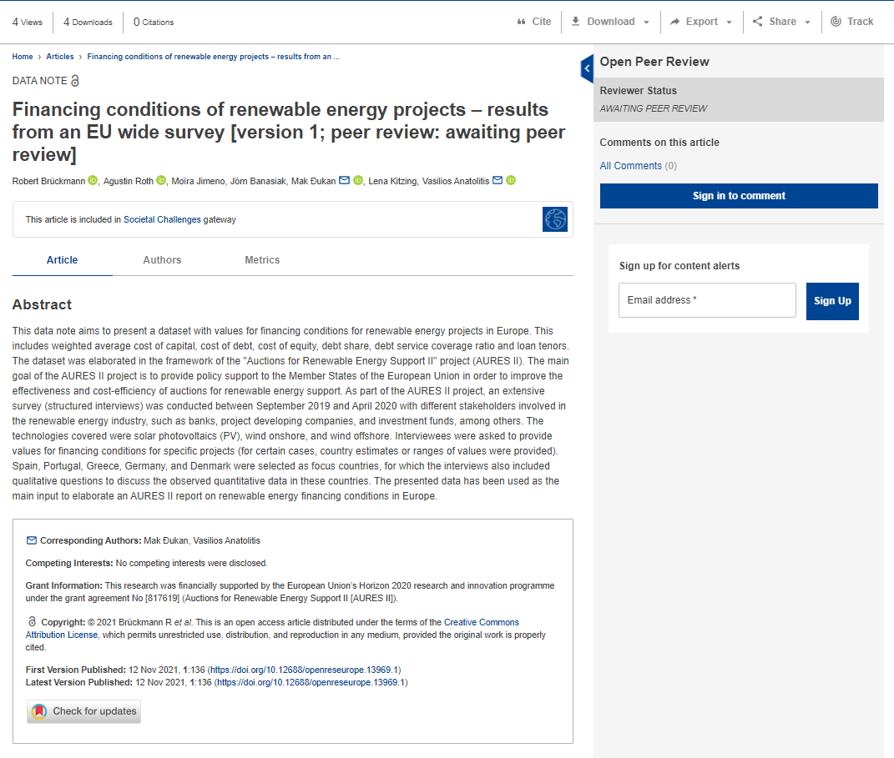
Preprint example

Slide 16
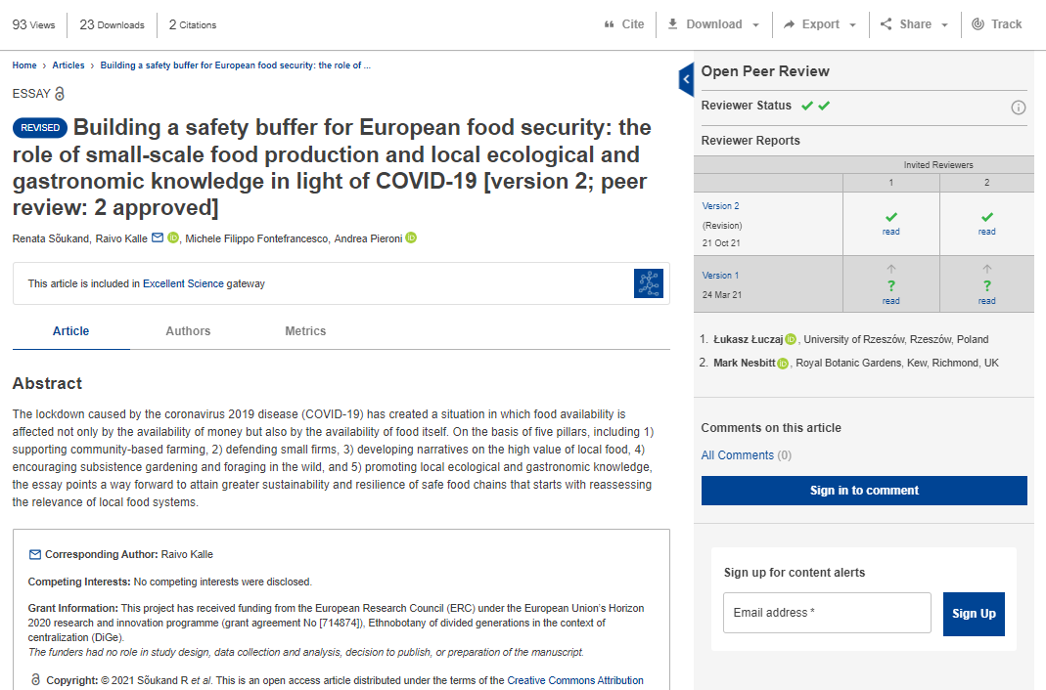
Open peer review example 1
Visibility & credit for reviewers:
Co-reviewing
ORCID ids
DOIs for reports

Slide 17
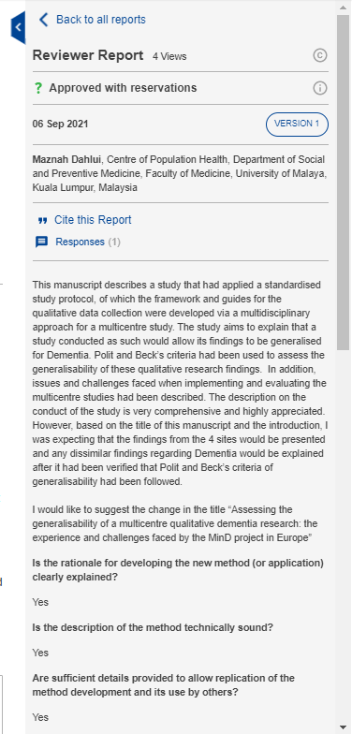
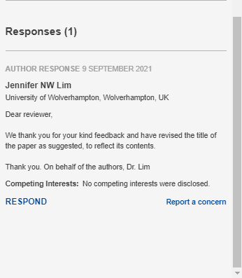
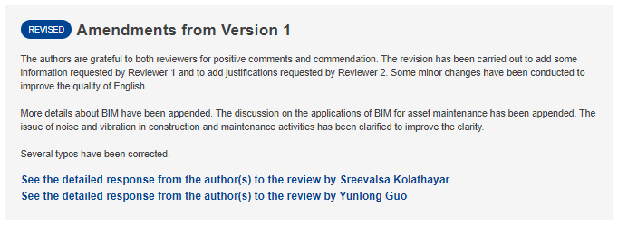
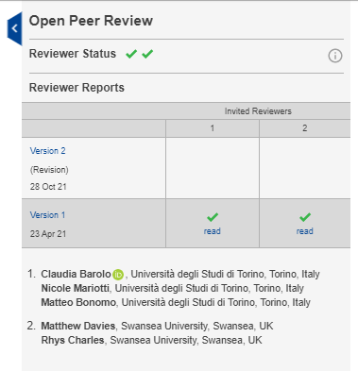
Open peer review example 2

Slide 18
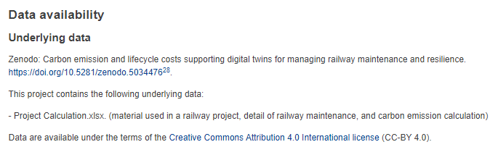
Open data example

Slide 19
Supporting research across all disciplines
Editorial guidelines and policies specifically for:
  - Science, Technology & Medicine (STM)
  - Social Sciences
  - Humanities
Data guidelines and policies in line with EC policies
We will be supporting many different article types to support disciplinary areas
Content will be searchable by subject areas and by H2020 programme areas.
STM | SS | Humanities
Research Article | Research Article | Research Article
Brief Reports | Essay | Essay
Data Notes | Review | Review
Method Articles | Case Studies
Software Tool Articles | Brief Reports
Study Protocols | Data Notes
Registered Reports | Method Articles
Reviews | Software Tool Articles
Systematic Reviews | Study Protocols
Clinical Practice Articles | Registered Reports
Case Reports | Systematic Reviews
Case Studies

Slide 20
Interoperability and syndication on ORE
From launch:
Zenodo – pushing full text articles and metadata to them via the Zenodo API (once articles have passed peer review).
EPMC – via Crossref we will send life sciences ORE preprints and update them to the full articles once they pass peer review
Over the 4 years of ORE contract with F1000:
OpenAIRE – we will be working with OpenAIRE to push ORE content and syndicate with institutional repositories
Institutional Repositories – as part of the sustainability task we will work with LIBER and OpenAIRE to identify and support APIs to directly send content.
Indexing databases – we will apply to all subject specific databases as soon as possible (DOAJ, Scopus, etc.)
Notes:
European PubMed Central

Slide 21
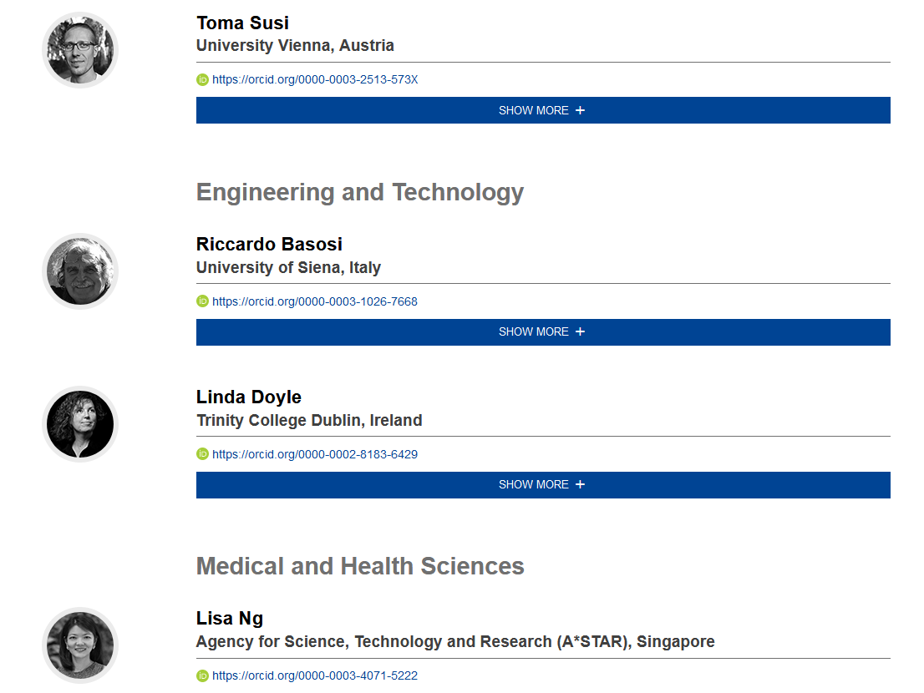
Scientific Advisory Board
Diverse Board, membership covers:
  n=25
  covers STM, Social Sciences and Humanities
  Europe (& beyond)
  researchers across career stages
  diversity
Their role:
  Constructive input and guidance on publishing policies
  Strategic direction and sustainability
  Advising on challenging issues that may arise
https://open-research-europe.ec.europa.eu/advisors

Slide 22


And now,
have your say!
www.menti.com
Voting code: 5722 0579

Slide 23







This presentation is part of a project that has received funding from the European Union’s Horizon 2020 research and innovation programme under grant agreement Nos 857650 (EOSC-Pillar), 824087 (EOSC-Life), and 676559 (ELIXIR-EXCELERATE), and was supported by the Italian Computing and Data Infrastructure (ICDI).
This presentation is released under a CC-BY 4.0 licence. To cite this presentation, please copy and paste:
Pavone, Gina, Lazzeri, Emma, Carta, Claudio, Chiara, Matteo, & Quaglia, Federica. (2022, March 11). Practical course on FAIR Data Stewardship in Life Science. Zenodo. https://doi.org/10.5281/zenodo.6323375.

