Slide 1

Practical course on FAIR Data Stewardship in Life Science
Module 3.2 - FAIR principles
Gina Pavone, CNR-ISTI 0000-0003-0087-2151
Emma Lazzeri, GARR 0000-0003-0506-046X

Slide 2
FAIR principles

Slide 3




The FAIR Principles
Others can easily find your data
It is clear who, when and how can access your data (does not mean open)
Your data can be integrated with other data and/or they can be easily used and read by machines.
Your data can be reused by others in new research
Findable
Accessible
Interoperable
Reusable
These slides are inspired by Martínez-Lavanchy, P.M., Hüser, F.J., Buss, M.C.H., Andersen, J.J., Begtrup, J.W. (2019). 'FAIR Principles'. In: Holmstrand, K.F., den Boer, S.P.A., Vlachos, E., Martínez-Lavanchy, P.M., Hansen, K.K. (Eds.), Research Data Management (eLearning course). doi: 10.11581 / dtu: 00000049
Link to the original video: https://vidensportal.deic.dk/RDMelearn

Slide 4
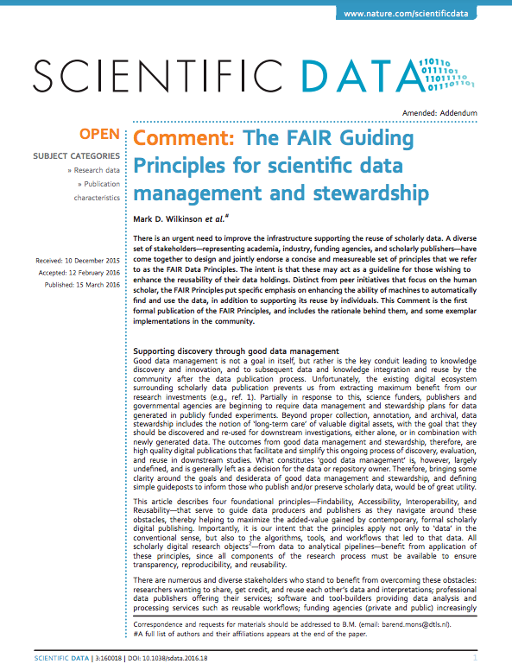
The FAIR Principles
FAIR indicate a list of principles that can help you in making your data ready for Open Science
They are principles, not standards!
They were designed to enable optimal use of research data and methods
A group of different experts designed the FAIR principles between 2014 and 2016
They identified a set of 15 principles

Slide 5
By applying the FAIR principles
It will be easier for you to produce high quality data
You will maximise the impact of your research
You will improve the recognition within and behind your research community
You will be compliant with the European Commission requirements

Slide 6
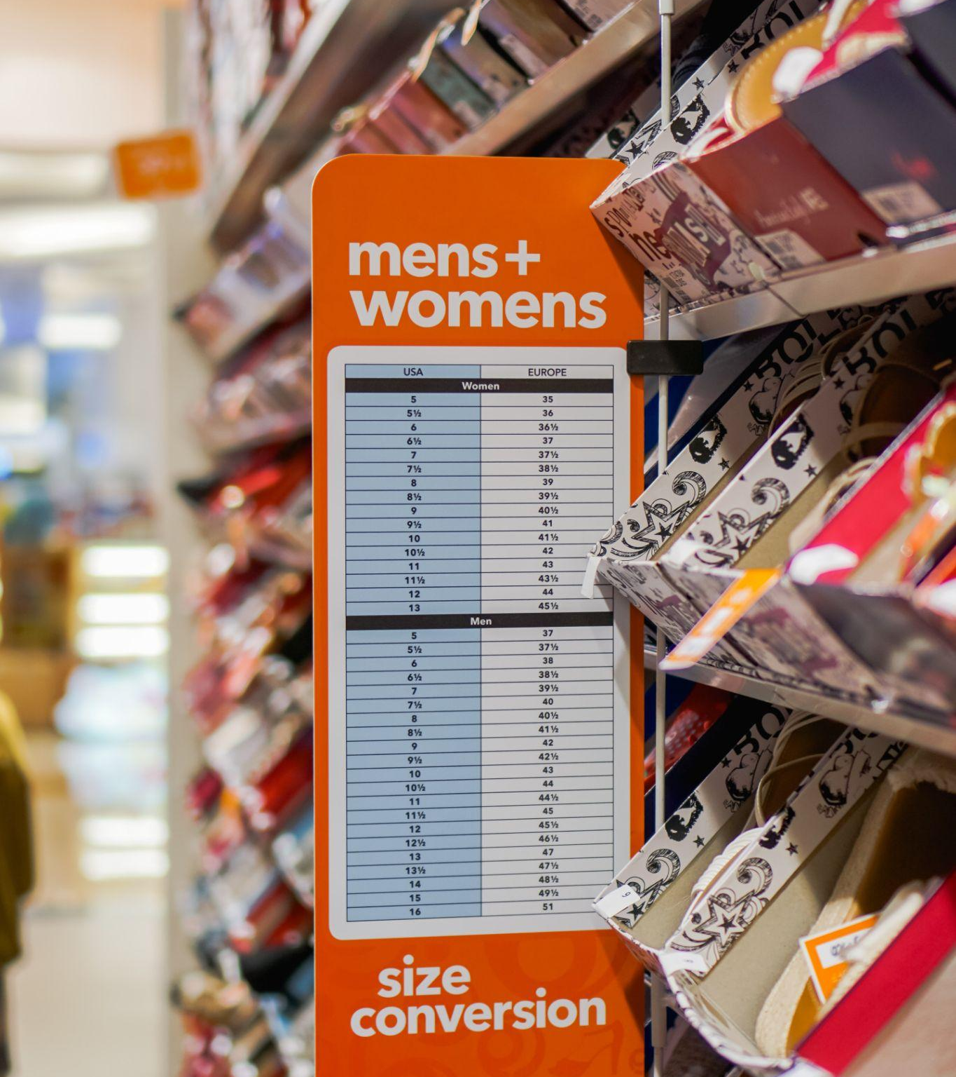
No one size fits all
The application of the FAIR principles strongly depends on the specific discipline and on the way the single researcher works

Slide 7
Good practices
to make your data
FAIR

Slide 8
FAIRification basics
Documentation
Gives the context to make your data understandable by others
Metadata
Make your data easy to find
Data formats
Make your data simple to combine to other data and machine readable.
Access to data
It means to decide who will have access to your data and how
Persistent identifiers
Persistent links to data that allows other to find and cite (give credit to) your data.
Licenses
Are used to tell others how they can reuse your data.

Slide 9
Documentation
Specifies the context that led to the creation/collection of your data to make them understandable
At the beginning of a new (project) activity, you need to clearly define with your colleagues the strategy to structure and document your data.
Document every detail of data collection/generation:
  Methods
  Tools
  Software
  Processes (who worked with the data? What did he/she did with the data? What are the relation to other data and/or publications?)
  Metadata

Slide 10
Findable
The first step in (re)using data is to find them.
Metadata and data should be easy to find for both humans and computers.
Machine-readable metadata are essential for automatic discovery of datasets and services, so this is an essential component of the FAIRification process.
F1. (meta) data are assigned a globally unique and persistent identifier
F2. data are described with rich metadata
F3. metadata clearly and explicitly include the identifier of the data it describes
F4. (meta)data are registered or indexed in a searchable resource

Slide 11
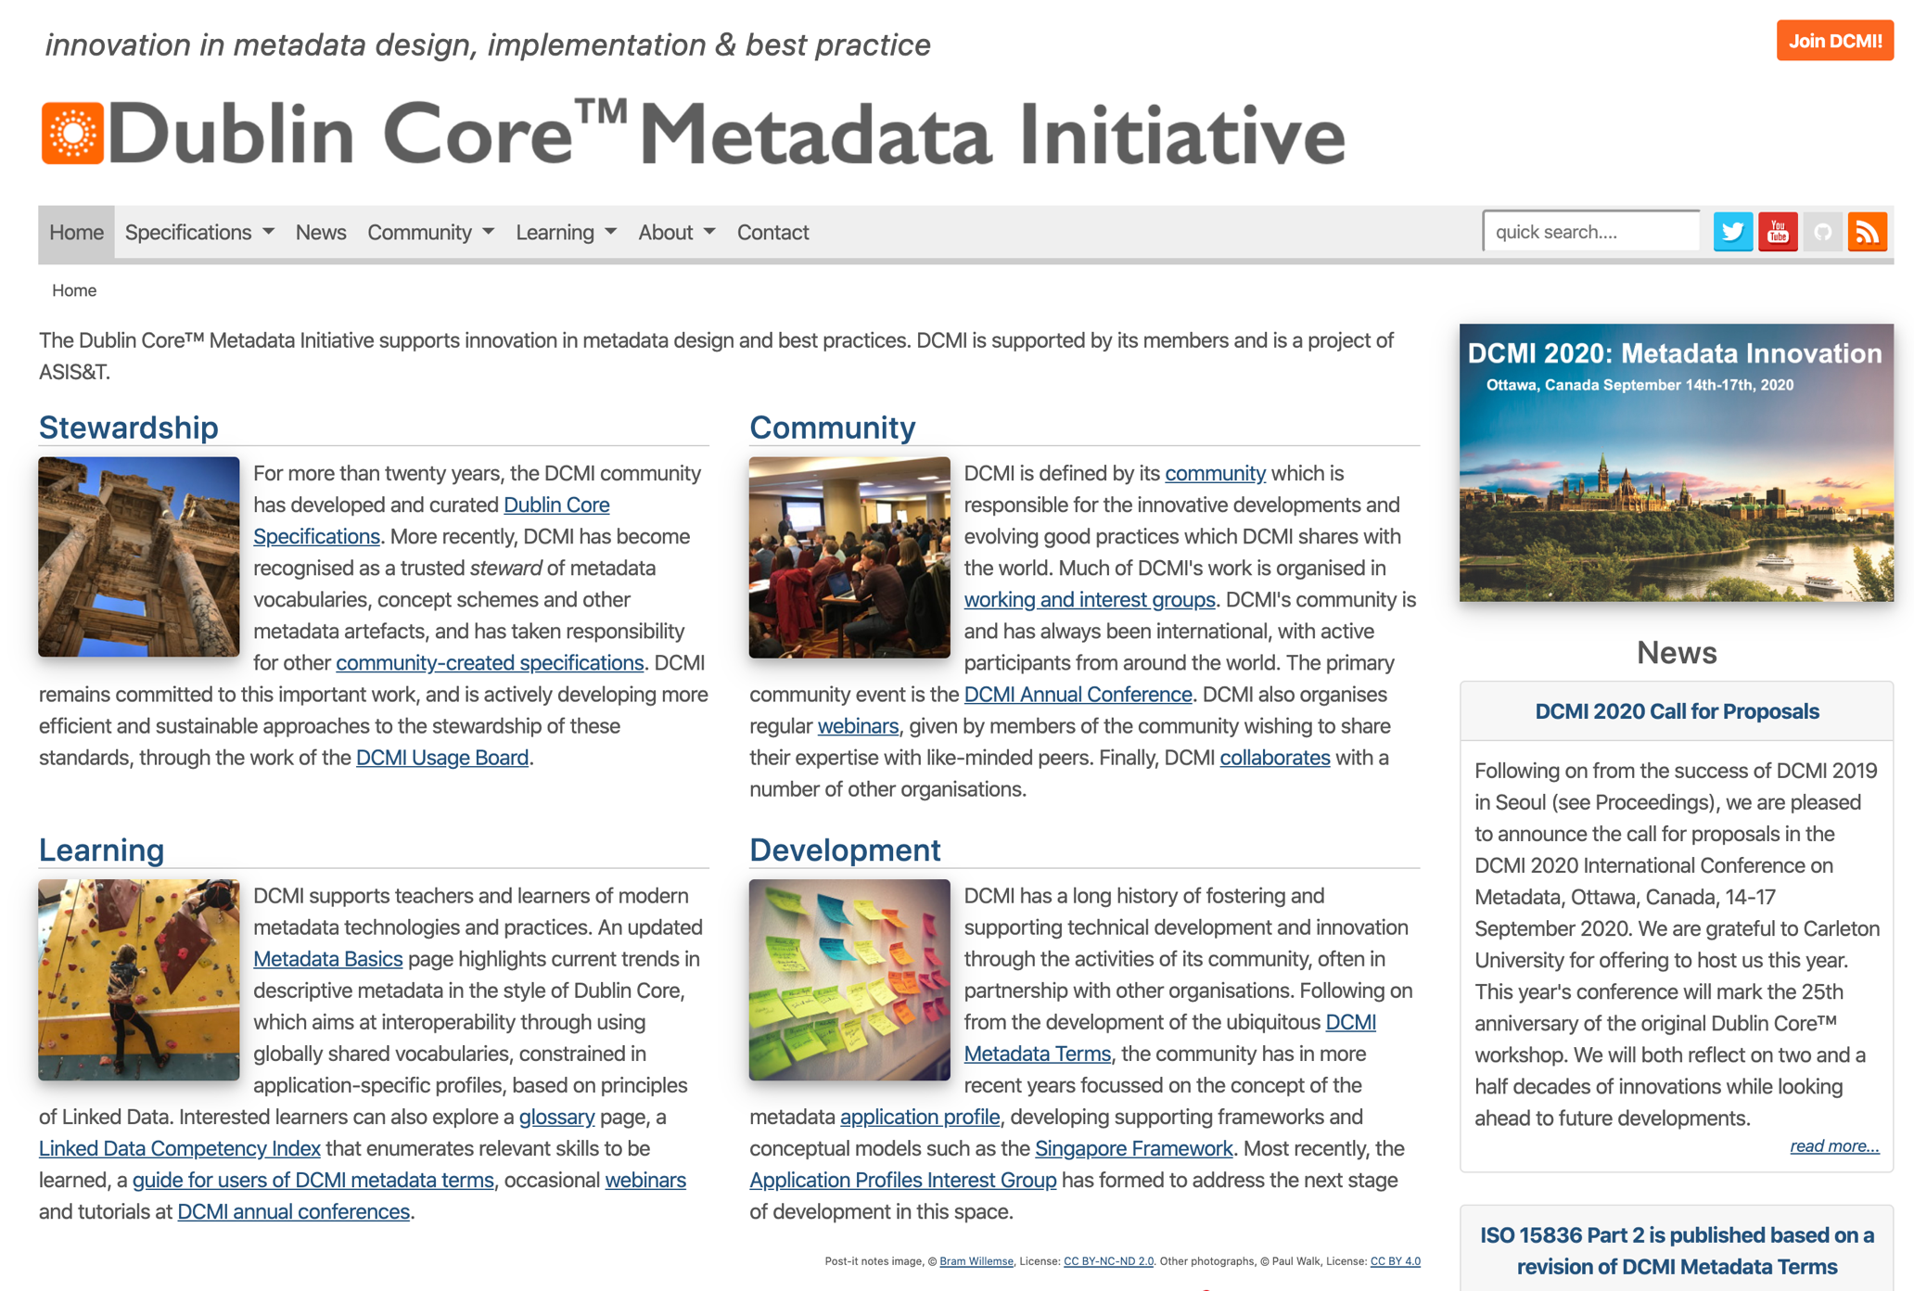
Metadata
Data describing data
Very important for:
  Access
  Comprehension
  Process
Use your discipline specific standards: you will spend less time curating and interpreting data and more time to actually make science!

Slide 12
Accessible
Once the user finds the required data, she/he needs to know who/when/how can access it, eventually including authentication and authorisation.
How do you give access to your data?
Through a Repository
How do I choose the right repository?
Directory of Open access repositories:
www.opendoar.org
Registry of Research Data Repository
https://www.re3data.org/
A1. (meta)data are retrievable by their identifier using a standardized communications protocol
A1.1 the protocol is open, free, and universally implementable
A1.2 the protocol allows for an authentication and authorization procedure, where necessary
A2. metadata are accessible, even when the data are no longer available
Notes:
protocol i.e. http(s) or ftp. A1.1 To maximise data reuse, the protocol should be free (no-cost) and open (-sourced) and thus globally implementable to facilitate data retrieval. Anyone with a computer and an internet connection can access at least the metadata. HTTP, FTP, SMTP, … A1.2 This is a key, but often misunderstood, element of FAIR. The ‘A’ in FAIR does not necessarily mean ‘open’ or ‘free’. Rather, it implies that one should provide the exact conditions under which the data are accessible. Hence, even heavily protected and private data can be FAIR.

Slide 13
Types of repositories
Thematic or disciplinary repositories
Designed for specific contents, curated by specific communities: ArXiv, bioarXiv, PMC…
http://oad.simmons.edu/oadwiki/Disciplinary_repositories
Institutional or national repositories
Maintained and curated by single institutions/countries. Typically only authors based in the specific institution/country can deposit, everyone can access
Literature Repositories
Reserved to text deposit (articles, reports, books, …). Metadata reflect the repository contents.
https://v2.sherpa.ac.uk/opendoar/
Data repositories
Designed to deposit data. They often are disciplinary and have specific metadata to describe the type of data they preserve. https://www.re3data.org/
Catch-all repositories
All research products can be deposited (data, literature, presentations, poster, images, software, …). Example: Zenodo
Who does curate/deposit in the repository?
What are the
repository contents?

Slide 14
Interoperable
Data usually needs to be integrated with other data.
In addition, data needs to interoperate with applications or workflows for analysis, storage, and processing.
Use community standard or best practice
Make good use of ontologies and vocabularies
I1. (meta)data use a formal, accessible, shared, and broadly applicable language for knowledge representation.
I2. (meta)data use vocabularies that follow FAIR principles
I3. (meta)data include qualified references to other (meta)data
Notes:
I1 Understandable to humans (no dead languages), besides data should be readable for machines without the need for specialised or ad hoc algorithms, translators, or mappings. I2 The controlled vocabulary used to describe datasets needs to be documented and this documentation need to be easily findable. I3 specify if one dataset builds on another data set, if additional datasets are needed to complete the data, or if complementary information is stored in a different dataset.

Slide 15
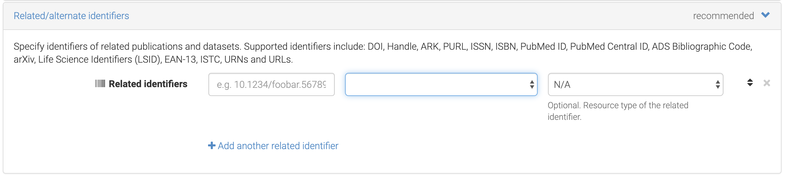
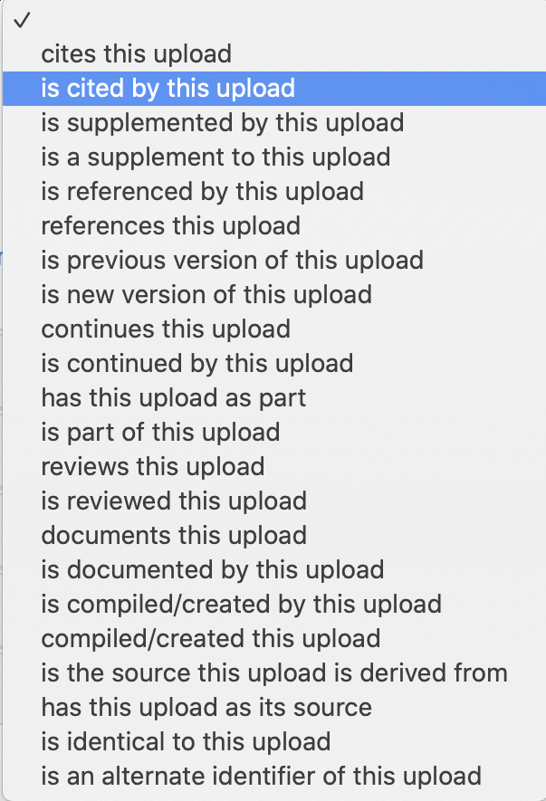
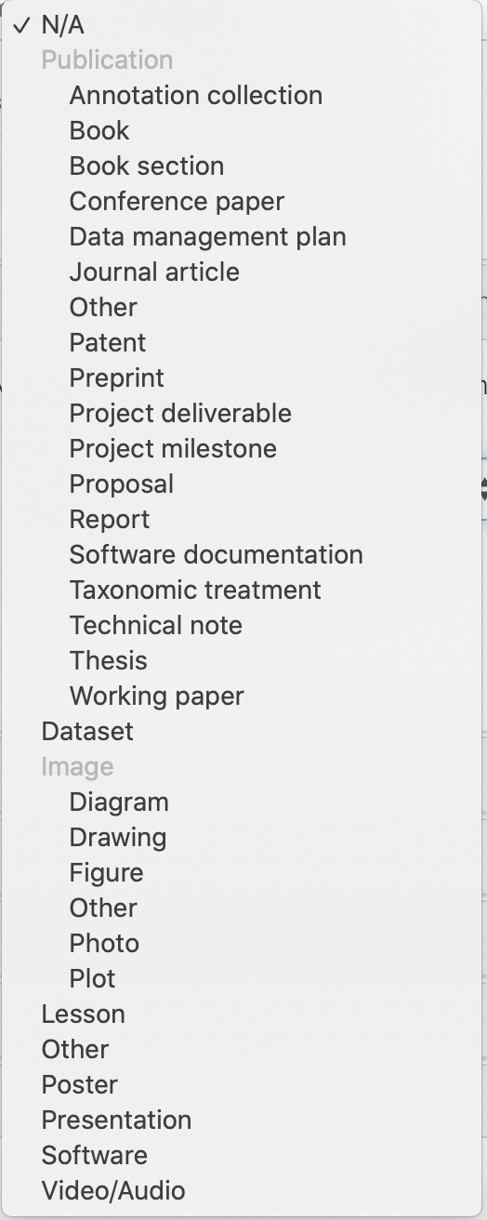

Slide 16
Reusable
The ultimate goal of FAIR is to optimise the reuse of data.
To achieve this, metadata and data should be well-described so that they can be replicated and/or combined in different settings
Data should be linked to other resources and outcomes that clarify their context
Key elements for reuse:
Licenses
Tell others how they can reuse your data!
Provenance
Where is your data coming from? What is the source of your data?
R1. (Meta)data are richly described with a plurality of accurate and relevant attributes
R2. (Meta)data are released with a clear and accessible data usage license
R3. (Meta)data are associated with detailed provenance
R4. (Meta)data meet domain-relevant community standards

Slide 17
Formats
To make your data understandable to others (humans and machines) you need to use adequate standards and formats
Formats may refer to:
  File format (.txt, .docx, .jpeg, etc)
  Metadata (Doublin core, discipline specific standards)
  Data organisation/visualisation
Use specific ontologies and vocabularies to make your data easy to read
Use your discipline specific standards: you will spend less time curating and interpreting data and more time to actually make science!

Slide 18


And now,
have your say!
www.menti.com
Voting code: 5722 0579

Slide 19







This presentation is part of a project that has received funding from the European Union’s Horizon 2020 research and innovation programme under grant agreement Nos 857650 (EOSC-Pillar), 824087 (EOSC-Life), and 676559 (ELIXIR-EXCELERATE), and was supported by the Italian Computing and Data Infrastructure (ICDI).
This presentation is released under a CC-BY 4.0 licence. To cite this presentation, please copy and paste:
Pavone, Gina, Lazzeri, Emma, Carta, Claudio, Chiara, Matteo, & Quaglia, Federica. (2022, March 11). Practical course on FAIR Data Stewardship in Life Science. Zenodo. https://doi.org/10.5281/zenodo.6323375.

