Slide 1
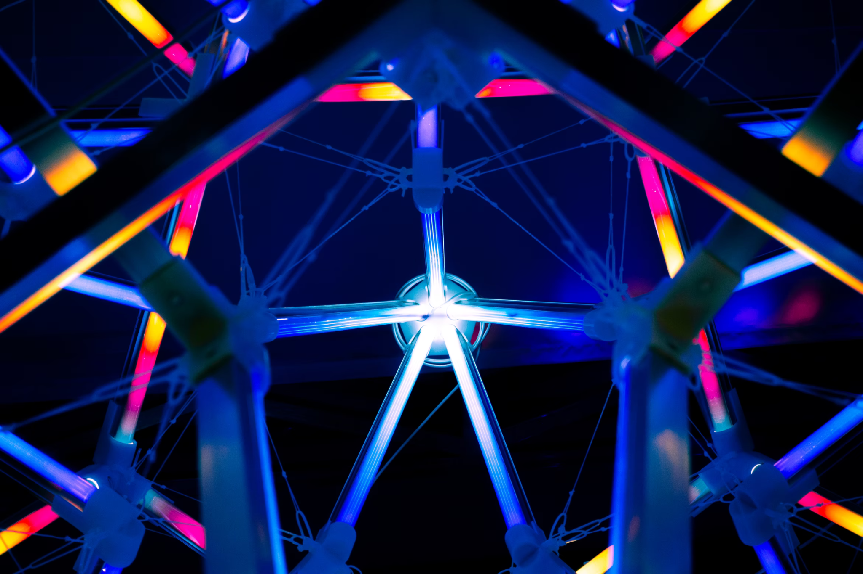


Open Science
in research projects
More better, Open Science
module 2.4
Gina Pavone 0000-0003-0087-2151
Emma Lazzeri 0000-0003-0506-046X
8 November 2021

Slide 2
Open Data
Copyright and legal aspects

Slide 3
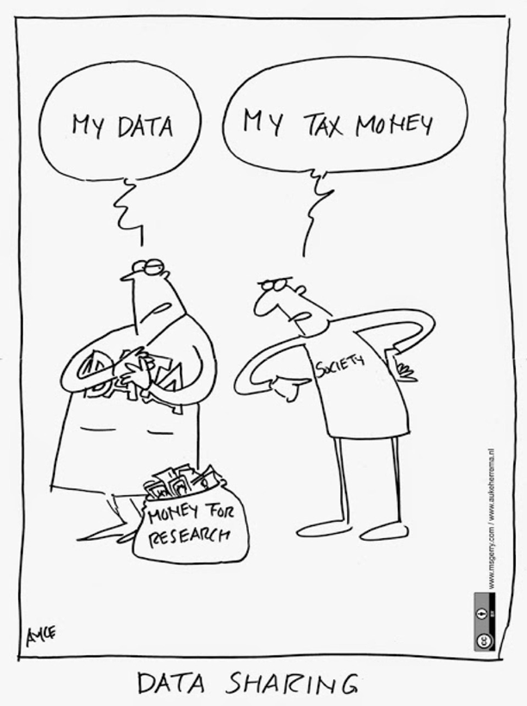




Data is not yours
Data is not intellectual work, it is fact and information
Copyright protection covers expressions and not ideas, procedures, operating methods or mathematical concepts as such.
Protection is on databases and not on data. Data are protected only and especially when they are collected and organized in a database.
The sui generis property right (only in Europe) covers not only the reproduction and dissemination of the database, but also the extraction and reuse of substantial parts of the database.

Slide 4

Open Data
is simply
a particular kind of
FAIR Data
Photo by Serhat Beyazkaya on Unsplash

Slide 5
FAIR Data
Data follow a series of good practices to allow data access, still respecting any ethical, legal and contractual restriction.
Open Data
Data can be freely used, shared, enriched by anyone, anywhere for any purpose.

Slide 6
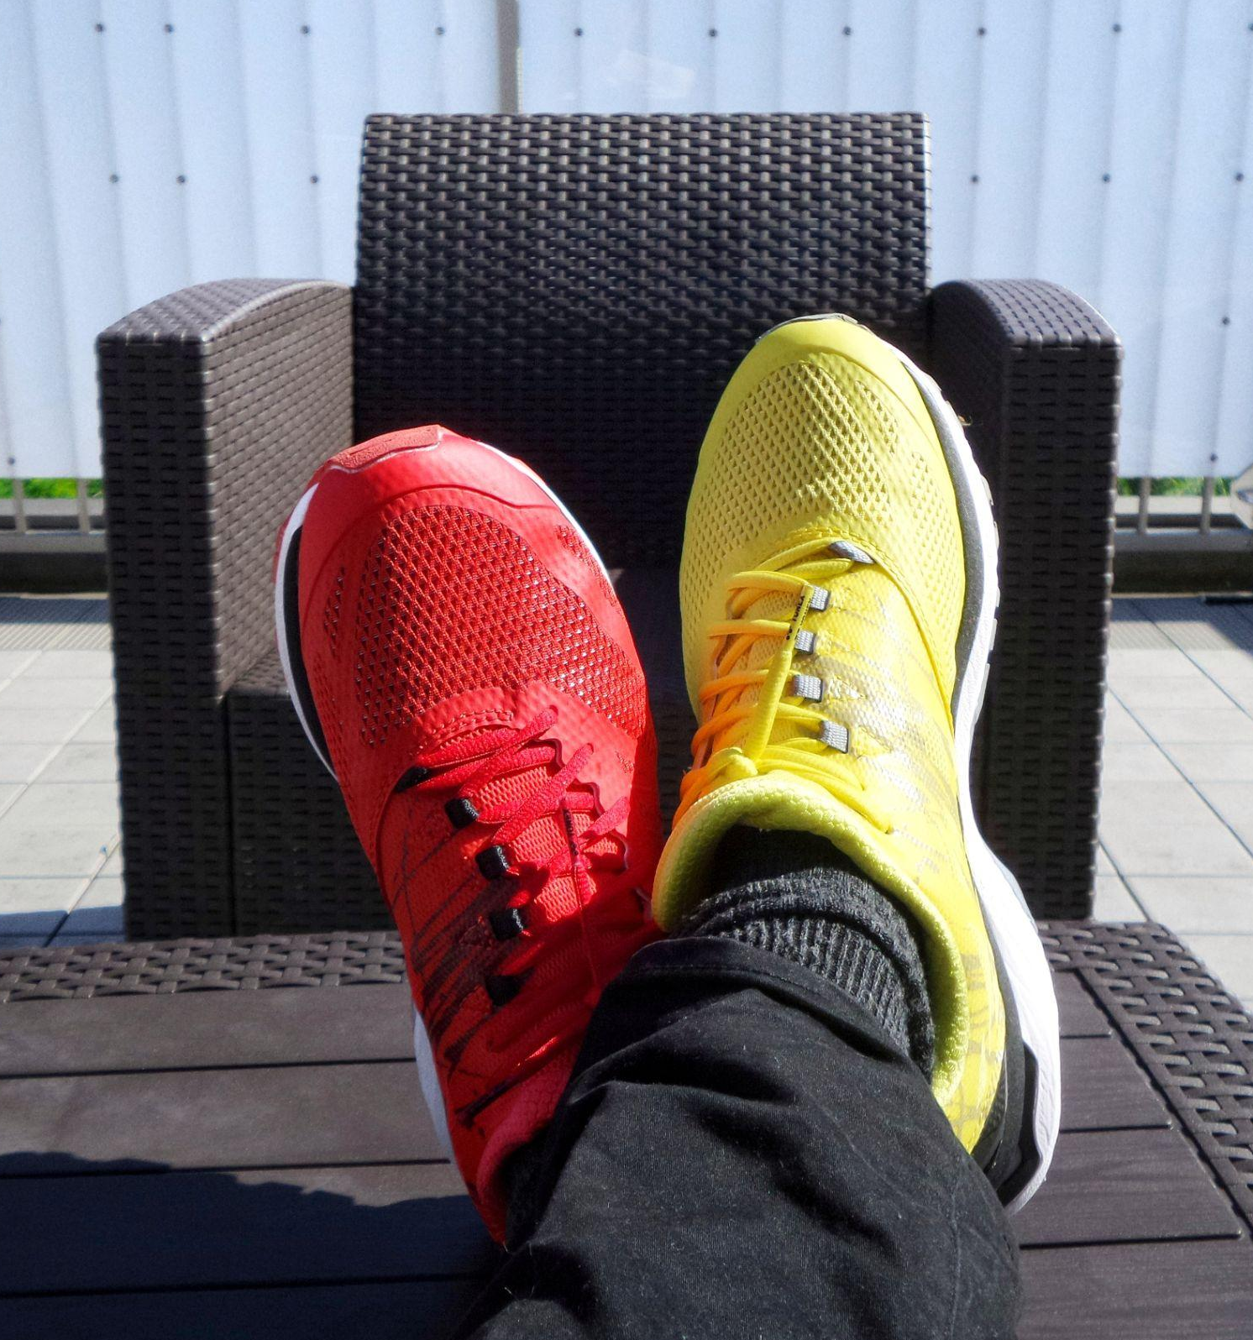




Why do we need a distinction?
Your research data could:
Contain personal information (privacy e GDPR)
Fall under copyright (in the case of a database with creative structure)
Fall under the Sui Generis right (database obtained thanks to a substantial investment)
Be protected by patent or industrial secret
Data sharing needs to respect the specific law.
Data needs to be protected against non authorised access.
Photo by Possessed Photography on Unsplash

Slide 7
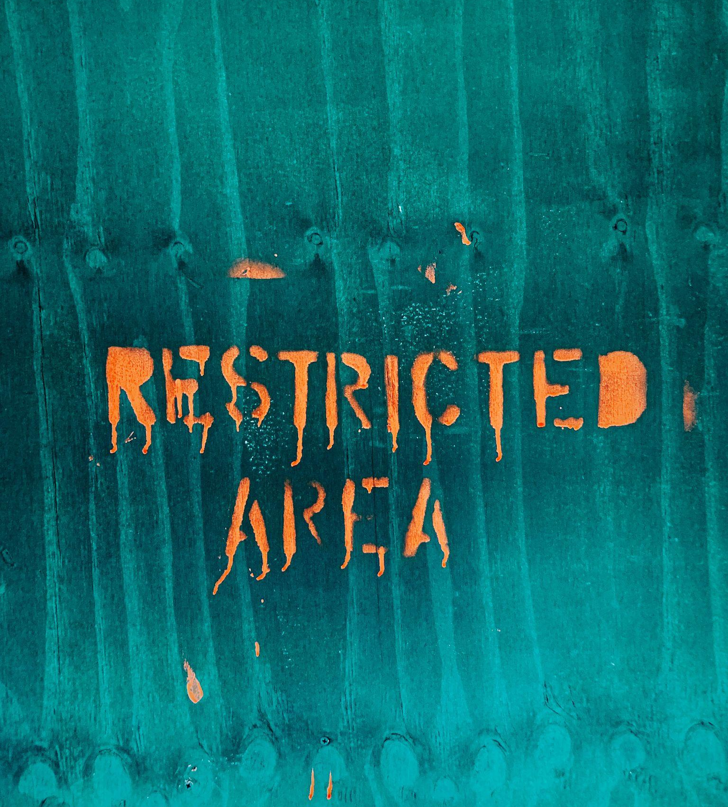
How can you adhere to FAIR principles if your data cannot be opened?
Create and share a description of your data
This way other researchers may ask for permission to access your data for reuse purposes, by giving a specific aim and following the rules defined by the law.
Restrict access to the record payload (attachment, files,…)
Photo by Jon Tyson on Unsplash

Slide 8
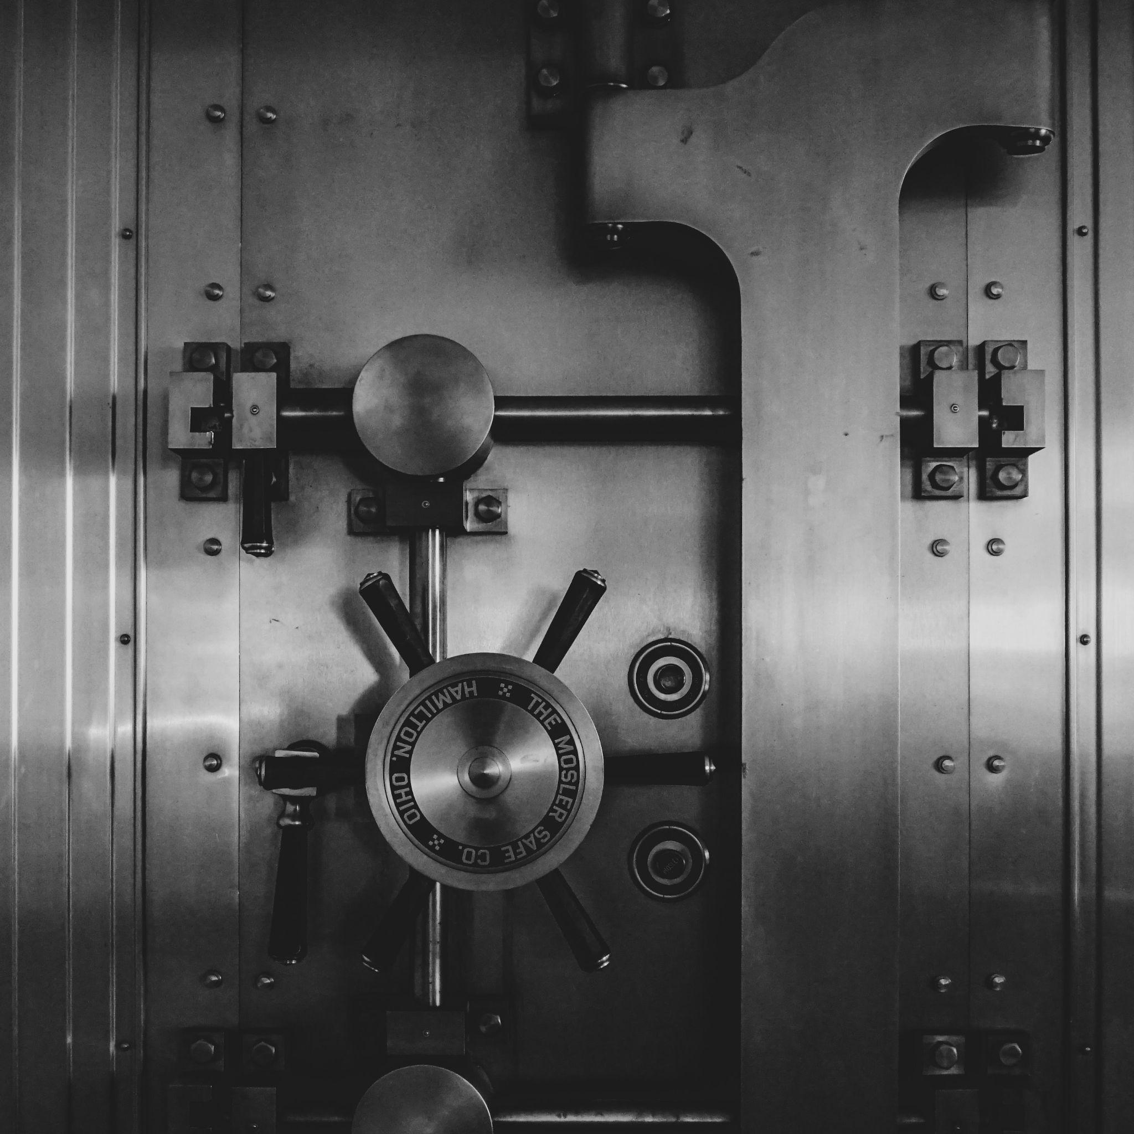


An important difference
Deposit: upload a digital object (data, articles, …) on a platform that allows to correctly describe the object through medatada and that implements long-term preservation.
Give access: once the object has been deposited, the authors can choose the type of access that can be granted (open, restricted, closed, embargoed,…) and assigns a licence to reuse the contents (Creative Commons)
IMMAGINE
Photo by Jason Dent on Unsplash
IMMAGINE

Slide 9
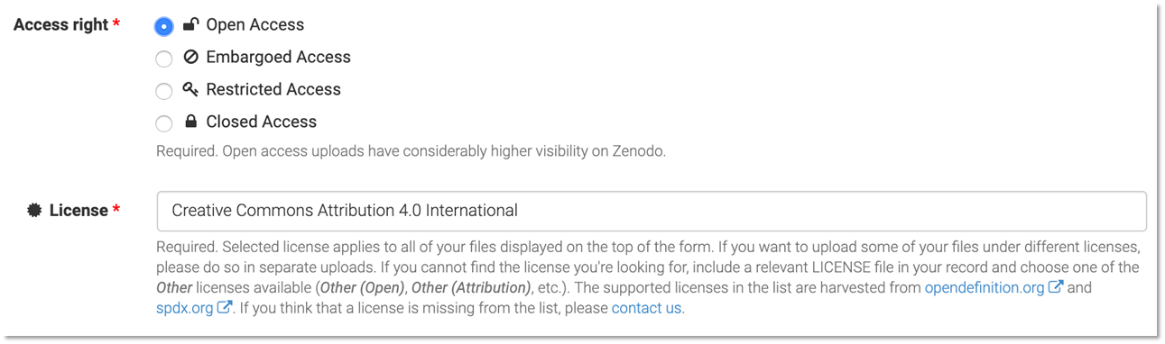
Access Right: Open Access
This should be the default access right
Always assign a licence for reuse

Slide 10
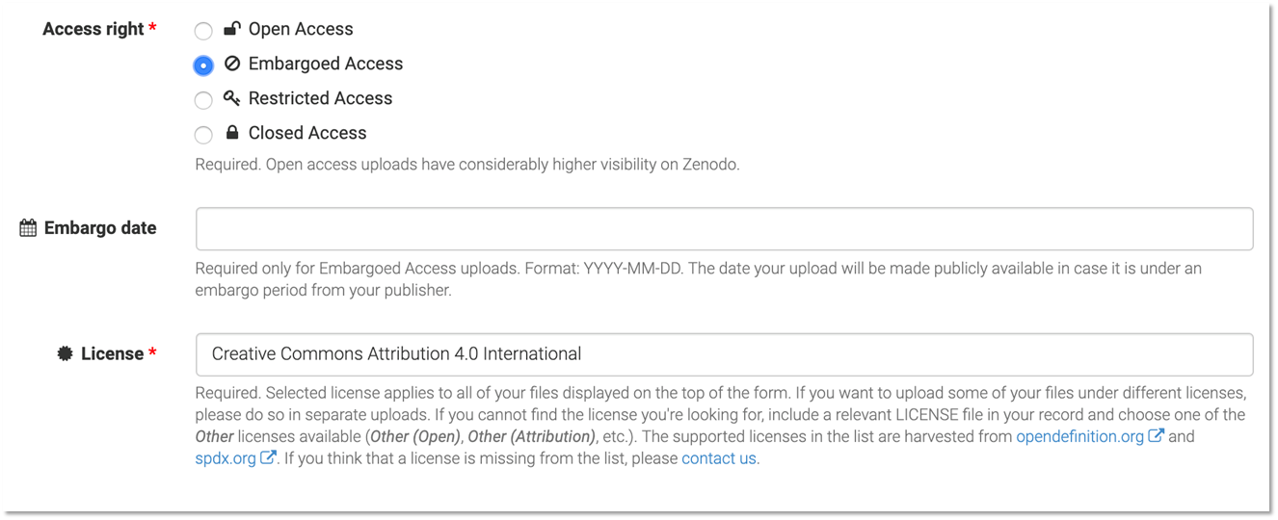
Access Right: Embargoed Access
Use it when you have a valid reason to delay access
Always assign a licence for reuse
Note: metadata is always accessible to everyone

Slide 11
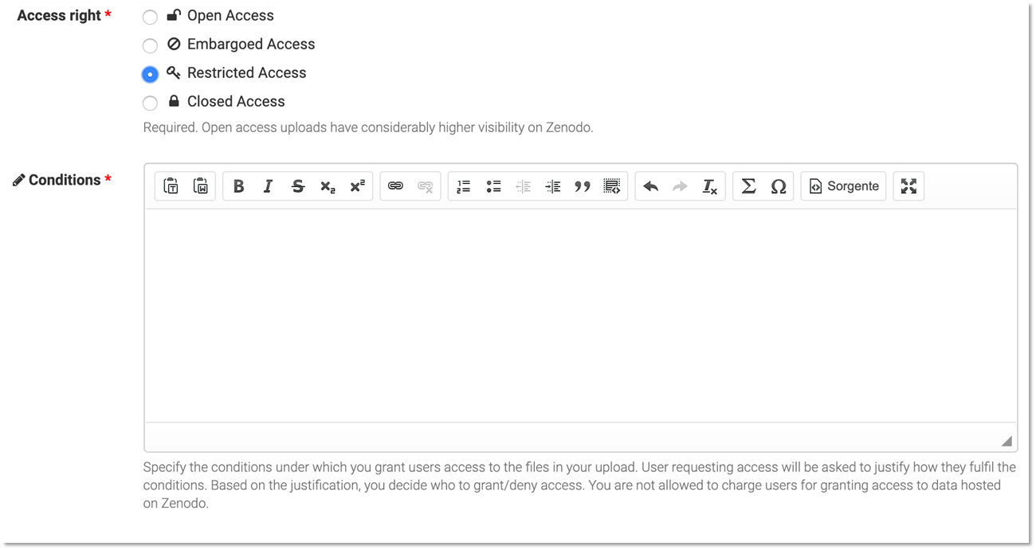
Access Right: Embargoed Access
Use it when you have a valid reason to restrict the access
Always specify conditions under which you grant access (who, how, why can get access to your payload)
Note: metadata is always accessible to everyone

Slide 12
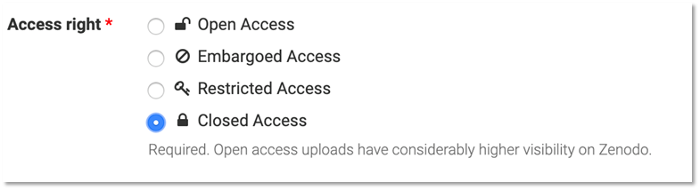
Access Right: Closed Access
Are you really sure you need closed access?
consider closed or embargoed access instead!

Slide 13
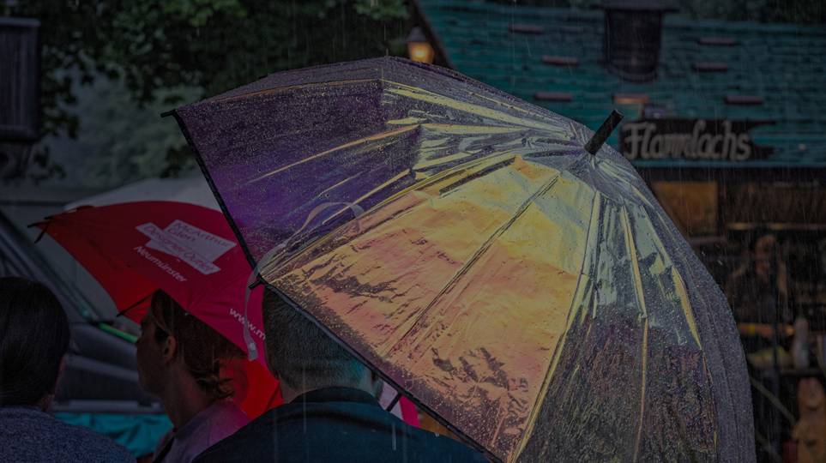
How do I know if my research data is protected?

Slide 14
Some consideration on data protection
Copyright is a property right in certain types of original literary, artistic and scientific works.
Copyright does not protect ideas.
Confidentiality protects confidential information. This might be imposed by a contract or if the information is marked confidential. Use of confidential information might give rise to a claim for compensation if confidentiality is breached.
Data Subject Rights arise in information that identifies individuals and are recognised by data protection laws in the EU.
Patents are registered rights in novel inventions of products or processes.
Some research data may not benefit from any legal protection, although moral and ethical considerations may apply.

Slide 15
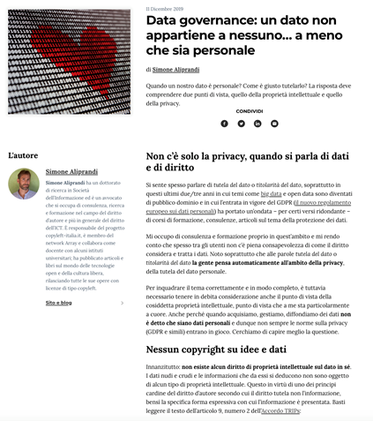
Data is not yours!
Data is not intellectual work, no copyright applies!
Copyright protection covers expressions and not ideas, procedures, operating methods or mathematical concepts as such.
Protection is on databases and not on data. The data are protected only and especially when they are collected and organized in a database.
The sui generis database right (only in Europe) covers not only the reproduction and dissemination of the database, but also the extraction and reuse of substantial parts of the database.

Slide 16
Data and law protection
Raw data are not protected by copyright
Database is defined as a collection of independent works, data or other materials arranged in a systematic or methodical way
Copyright protects the structure, selection or arrangement of the database contents, not the data
Sui generis database right: protects the substantial effort in obtaining data (not creating). Note: the right owner is often the institution.

Slide 17
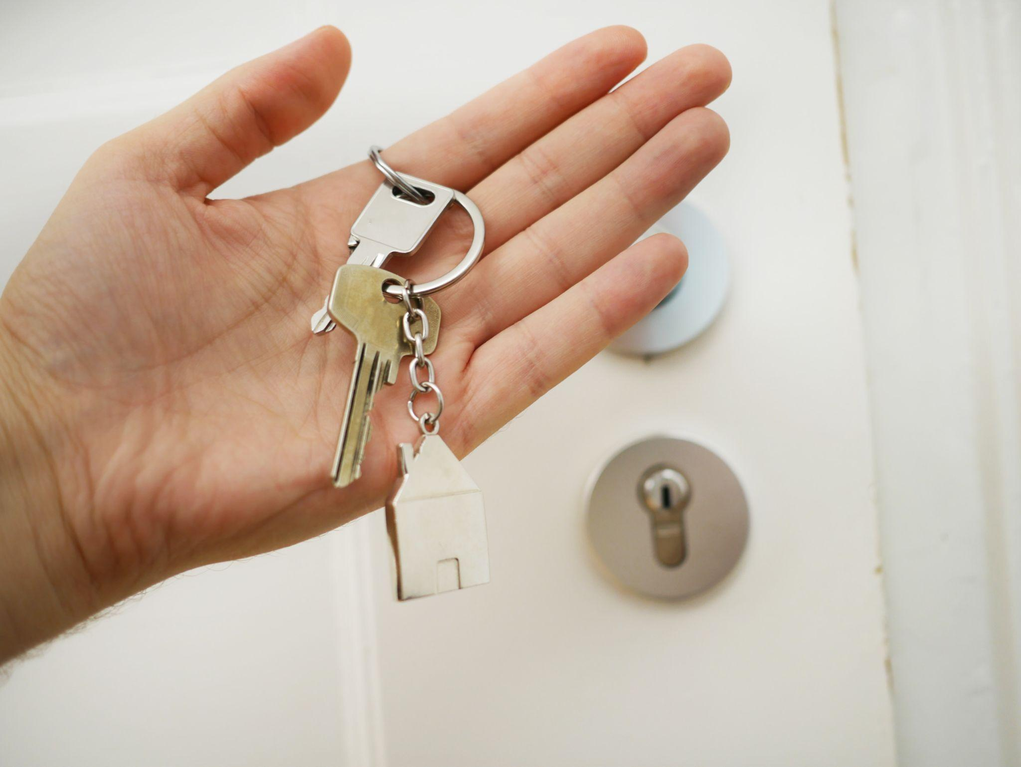
Authors and rights owners
Are you the author of the data you collected?
Yes, in case you can prove it (deposit with clear date, DOI, … use a data repository!)
Do you own any rights on the raw data you collected?
No, data is facts/information and none can own rights on it!
Photo by Maria Ziegler on Unsplash

Slide 18
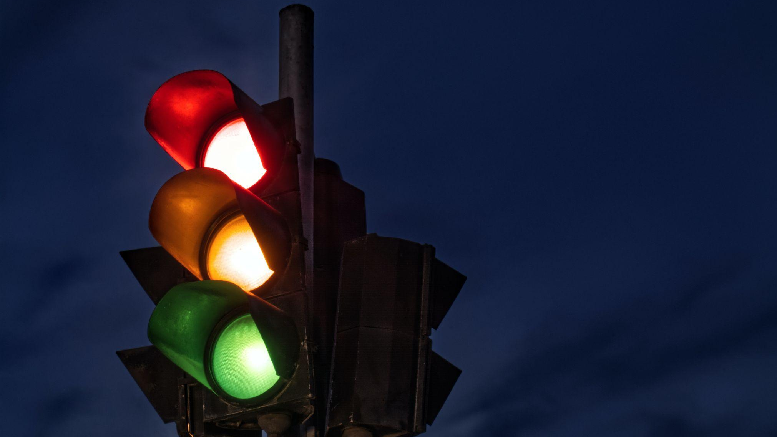
Licenses
Tell other what they can do with your data

Slide 19
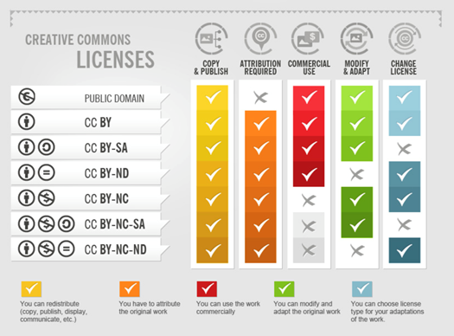
Creative Commons
Not all of us are legal experts capable of writing proper licenses.
Creative Commons and Public Domain create legal certainty for everyone, who wants to use works, that are licensed respectively.
It is important to follow and understand the different meanings of the licenses and follow the rules for using them.
CC-Infographic by Foter under CC-BY-SA 3.0 license.

Slide 20
Types of CC Licenses
Public Domain
Works are not covered by copyright
CC-0 (no rights reserved)
Allows creators to give up their copyright and put their works into the worldwide public domain
CC-BY (Attribution)
This license allows reusers to distribute, remix, adapt, and build upon the material in any medium or format, so long as attribution is given to the creator

Slide 21
Types of CC Licenses
CC-BY-SA (Attribution – ShareAlike)
This license allows reusers to distribute, remix, adapt, and build upon the material in any medium or format, so long as attribution is given to the creator. The license allows for commercial use. If you remix, adapt, or build upon the material, you must license the modified material under identical terms.
CC-BY-ND (Attribution – NonDerivative)
This license allows reusers to copy and distribute the material in any medium or format in unadapted form only, and only so long as attribution is given to the creator. The license allows for commercial use.
CC-BY-NC (Attribution – NonCommercial)
This license allows reusers to distribute, remix, adapt, and build upon the material in any medium or format for noncommercial purposes only, and only so long as attribution is given to the creator.

Slide 22
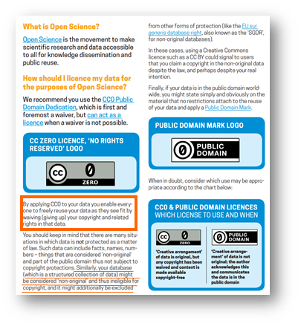
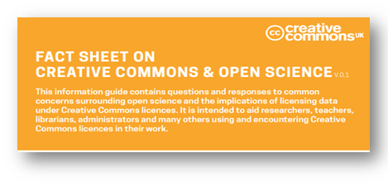
Licensing your Research Data:
Creative Commons
https://doi.org/10.5281/zenodo.840651

Slide 23
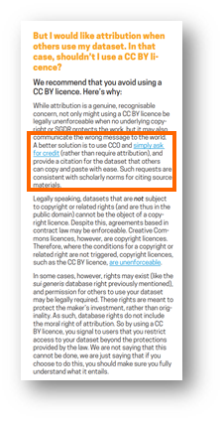
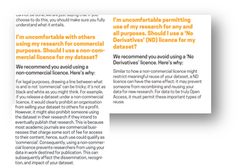
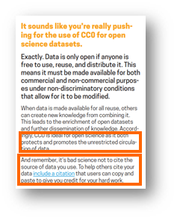
Licensing your Research Data: Creative Commons
Use a CC0 or public domain, then ask for credit
Provide a citation that researchers using your data can simply copy and paste to give you credit for your work
Remember that it’s bad science not to cite the source
CC0 does not mean academic unpoliteness
https://doi.org/10.5281/zenodo.840651

Slide 24
References
Simone Aliprandi, Data governance: un dato non appartiene a nessuno… a meno che sia personale, 11 Dicembre 2019, https://www.apogeonline.com/articoli/data-governance-un-dato-non-appartiene-a-nessuno-a-meno-che-sia-personale-simone-aliprandi/?fbclid=IwAR2LaXV6b6m8aaJ7SeFKVAidbTlB9C4_-mQPirLxs3m5DxAs0jG8gkn8ZKg
OpenAIRE Guidelines on data protection: https://www.openaire.eu/how-do-i-know-if-my-research-data-is-protected
OpenAIRE Guideline: How do I license my research data? https://www.openaire.eu/how-do-i-license-my-research-data
OpenAIRE Guideline: Can I reuse someone else’s research data? https://www.openaire.eu/can-i-reuse-someone-else-research-data
CC-Infographic by Foter under CC-BY-SA 3.0 license.
Creative Commons UK. (2017). Fact Sheet on Creative Commons & Open Science. Zenodo. https://doi.org/10.5281/zenodo.840652

Slide 25
Figure List
Photo by Serhat Beyazkaya on Unsplash
Photo by Jon Tyson on Unsplash
Photo by Possessed Photography on Unsplash
Photo by Jason Dent on Unsplash
Photo by Peter Herrmann on Unsplash
Photo by Maria Ziegler on Unsplash
Photo by Tsvetoslav Hristov on Unsplash

Slide 26
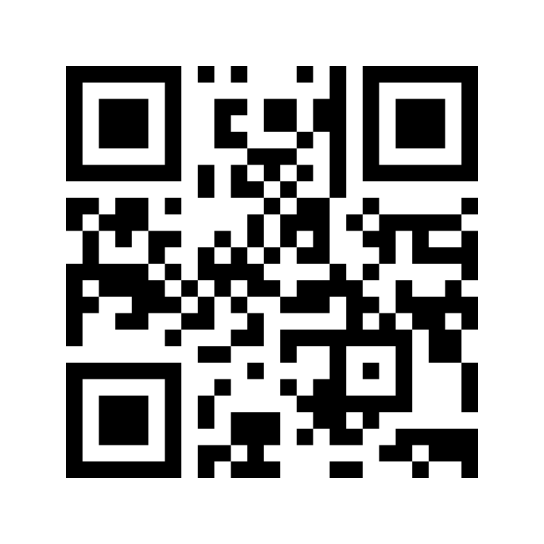
Interact with mentimeter
Please go to www.menti.com and insert code: 2641 3958
OR
use your mobile/tablet to scan the QR code

