Slide 1



Open Science
in research projects
More better, Open Science
module 2.5
Gina Pavone 0000-0003-0087-2151
Emma Lazzeri 0000-0003-0506-046X
8 November 2021

Slide 2

How to build an institutional strategy on Open Science
Image by jplenio from Pixabay

Slide 3

Why an institutional
stragety?

Slide 4

Avoid being unprepared
Contribute to build Open Science instead of chasing it!
Photo by Martin Sanchez on Unsplash
Notes:
Restare al di fuori del mondo dell’Open Science vorrà dire molto presto doversi adattare a obblighi, prassi, parametri, richieste, buone pratiche eccetera. Le istituzioni di ricerca non possono farsi trovare impreparate e in questo momento possono sfruttare un ruolo strategico di indirizzo e supporto sia per i propri ricercatori sia a livello nazionale, contribuendo a costruire il mondo della scienza aperta invece di rincorrerlo a cose fatte.

Slide 5

Benefits for the institution
Impact Scientific production is accessible by anyone at any time, easily traceable to the institution, and it can be monitored.
Economic benefit Guidelines and policies can guide researchers in rationalizing expenses - i.e. avoiding undue APCs and better planning Research Data Management Costs.
Visibility and prestige Facilitating access to research products can result in greater opportunities for involvement, for example in other projects, alongside other groups or research organizations.
Photo by ANANYA ANAND on Unsplash

Slide 6

Strategy: defining medium and long term objectives
Photo by Kaleidico on Unsplash

Slide 7

Create a working group on OS
Photo by Marvin Meyer on Unsplash
Notes:
Formare, all’interno dell’istituzione, un gruppo di lavoro che comprenda rappresentanti di governance, ufficio legale e di supporto alla ricerca, ricercatori, ufficio tecnico informatico, biblioteca. Questo gruppo avrà il compito di definire, applicare e monitorare la strategia per l’open science.

Slide 8

The working group on OS should include:
Representatives from governance
Legal and research support office
Researchers
Librarians
IT officers
This group should be responsible for defining, implementing, and monitoring the open science strategy.
Photo by Headway on Unsplash

Slide 9

Identify the regulatory framework
The reference legal aspects
Photo by Wesley Tingey on Unsplash

Slide 10

Regulations and legal framework
Outside the institution:
European Commission recommendations
European legislation on related topics (copyright, GDPR, etc.)
National legislation
Within the institution:
Policies and guidelines
Staff rights and obligations on research results
Image by Ag Ku from Pixabay

Slide 11

Identify funding mandates
European:
H2020, Horizon Europe etc
Italian:
Ministries, regions, private funds and so on
International:
I.e. Wellcome Trust, National Institute of Health etc.
Orgs promoting CoalitionS, PlanS and similar OS initiatives.
Photo by Visual Stories || Micheile on Unsplash

Slide 12

Identify the right tools
to apply the policy: repository, DMP tools, etc.
Photo by Haupes on Unsplash

Slide 13



Support and training
Create an internal support mechanism and provide an information and training campaign within the institution for research staff and more at large for all the figures involved.
Use of the repository
Tools
How to do OA

Slide 14

Create the institutional policy on Open Science
Regulate Open Access on literature and data, provide guidelines and update regularly
Photo by James Sutton on Unsplash

Slide 15

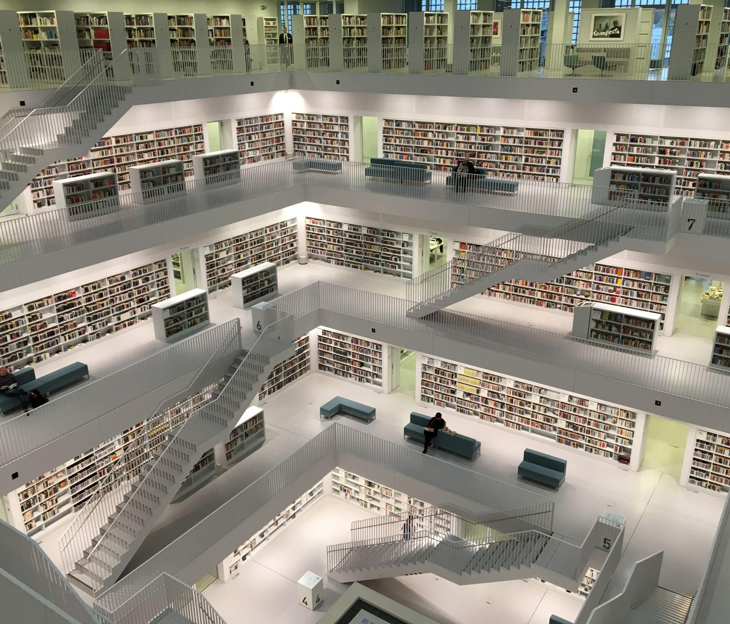

University of Siena already has OA policy and guidelines
The University of Siena has already developed a policy for literature, which and has recently been updated for data, and provides guidelines for deposit in the institutional repository
Data
Literature
Guidelines

Slide 16
Policy models
OpenAIRE model Policy (literature and data) on Open Science for Research Performing Organisations (RPOs): 10.5281/zenodo.2579629
OpenAIRE checklist for Research Performing Organisations (RPOs): 10.5281/zenodo.2578044
IOSSG model policy (data):http://wikimedia.sp.unipi.it/images/RDMpolicyresearchdata27_03_2017.pdf
There are policy models that include both data and literature, or data-specific ones

Slide 17

Monitor compliance
Monitoring helps revise institutional policy and strategy

Slide 18

Step-by-step process

Slide 19

Start now to produce reuse and impact to show in the coming years!

Slide 20
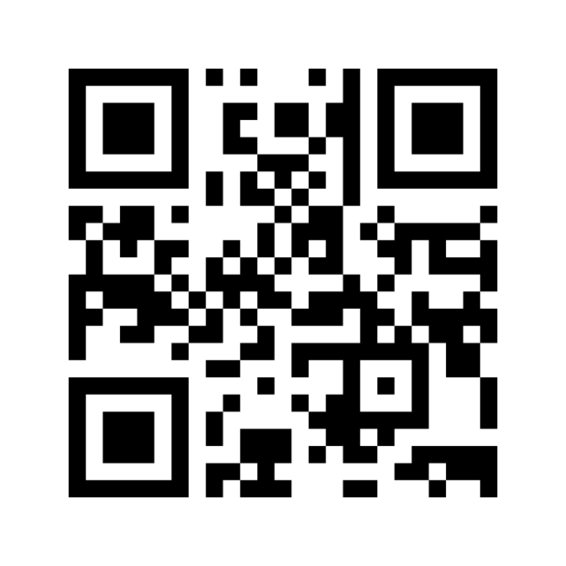
Interact with mentimeter
Please go to www.menti.com and insert code: 2641 3958
OR
use your mobile/tablet to scan the QR code

