Slide 1



Open Science
in research projects
More better, Open Science
module 3.2
Gina Pavone 0000-0003-0087-2151
Emma Lazzeri 0000-0003-0506-046X
12 November 2021

Slide 2
What the DMP in HE should include
From Horizon Europe Data Management Plan Template, version 1 , 5 May 2021 https://ec.europa.eu/info/funding-tenders/opportunities/docs/2021-2027/horizon/temp-form/report/data-management-plan-template_he_en.docx

Slide 3
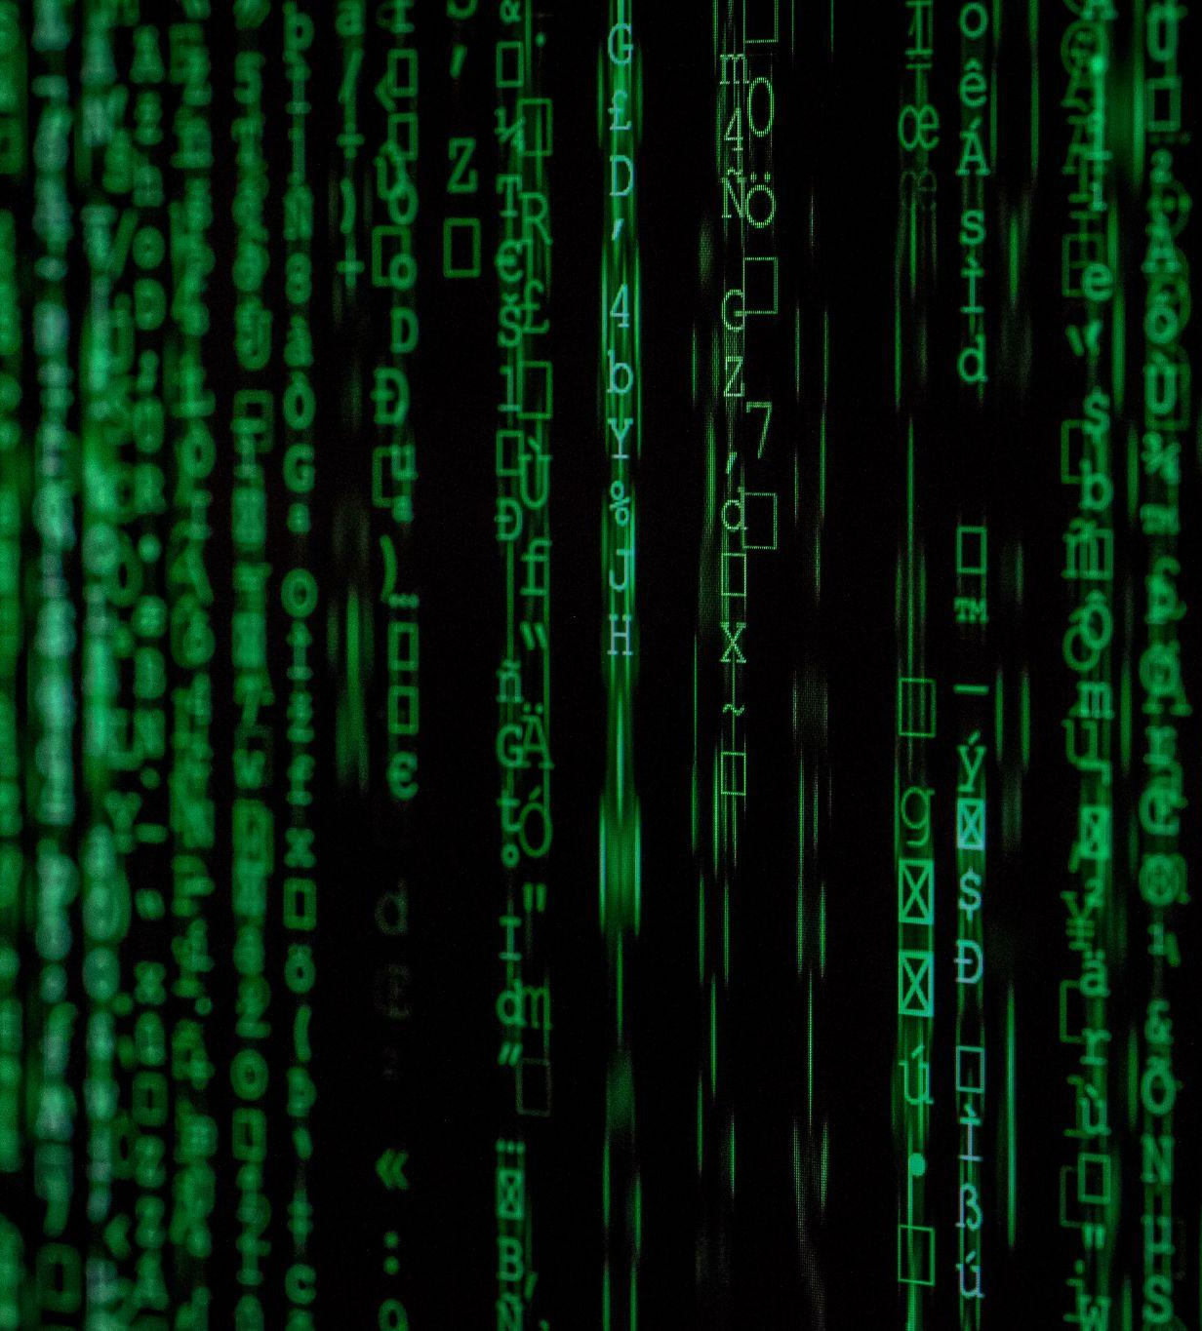
Data summary
Will you re-use any existing data and what will you re-use it for?
You can state the reasons if re-use of any existing data has been considered but discarded.
What types and formats of data will the project generate or re-use?
What is the purpose of the data generation or re-use and its relation to the objectives of the project?
What is the expected size of the data that you intend to generate or re-use?
What is the origin/provenance of the data, either generated or re-used?
To whom might your data be useful ('data utility'), outside your project?
Photo by Markus Spiske on Unsplash

Slide 4
FAIR data - Findability
Will data be identified by a persistent identifier?
Will rich metadata be provided to allow discovery?
What metadata will be created? What disciplinary or general standards will be followed?
In case metadata standards do not exist in your discipline, you outline what type of metadata will be created and how.
Will search keywords be provided in the metadata to optimize the possibility for discovery and then potential re-use?
Will metadata be offered in such a way that it can be harvested and indexed?
Making data findable, including provisions for metadata

Slide 5
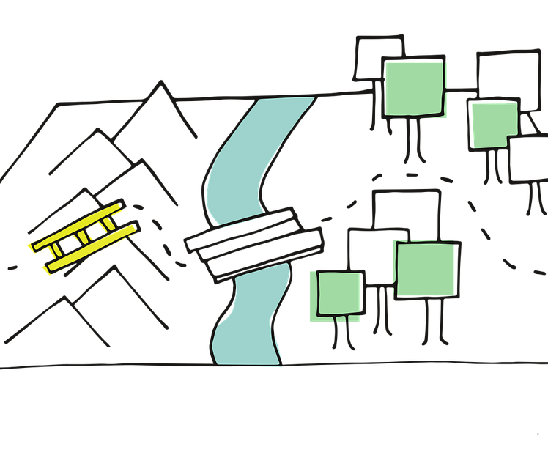
FAIR data - Accessibility part 1
REPOSITORY
METADATA
Will the data be deposited in a trusted repository?
Have you explored appropriate arrangements with the identified repository where your data will be deposited?
Does the repository ensure that the data is assigned an identifier? Will the repository resolve the identifier to a digital object?
Will metadata be made openly available and licenced under a public domain dedication CC0, as per the Grant Agreement?
If not, clarify why!
Will metadata contain information to enable the user to access the data?
How long will the data remain available and findable? Will metadata be guaranteed to remain available after data is no longer available?
Will documentation or reference about any software be needed to access or read the data be included? Will it be possible to include the relevant software (e.g. in open source code)?
Image by Manfred Steger from Pixabay

Slide 6

FAIR data - Accessibility part 2
DATA
Will all data be made openly available?
If certain datasets cannot be shared (or need to be shared under restricted access conditions), explain why, clearly separating legal and contractual reasons from intentional restrictions. Note that in multi-beneficiary projects it is also possible for specific beneficiaries to keep their data closed if opening their data goes against their legitimate interests or other constraints as per the Grant Agreement.
If an embargo is applied to give time to publish or seek protection of the intellectual property (e.g. patents), specify why and how long this will apply, bearing in mind that research data should be made available as soon as possible.
Will the data be accessible through a free and standardized access protocol?
If there are restrictions on use, how will access be provided to the data, both during and after the end of the project?
How will the identity of the person accessing the data be ascertained?
Is there a need for a data access committee (e.g. to evaluate/approve access requests to personal/sensitive data)?
Image by mohamed Hassan from Pixabay

Slide 7
FAIR data -
Interoperability
What data and metadata vocabularies, standards, formats or methodologies will you follow to make your data interoperable to allow data exchange and re-use within and across disciplines? Will you follow community-endorsed interoperability best practices? Which ones?
In case it is unavoidable that you use uncommon or generate project specific ontologies or vocabularies, will you provide mappings to more commonly used ontologies? Will you openly publish the generated ontologies or vocabularies to allow reusing, refining or extending them?
Will your data include qualified references to other data (e.g. other data from your project, or datasets from previous research)?
^{[1}
Making data interoperable
Notes:
Qualified reference is a cross-reference that explains its intent. For example, X is regulator of Y is a much more qualified reference than X is associated with Y, or X see also Y. The goal therefore is to create as many meaningful links as possible between (meta)data resources to enrich the contextual knowledge about the data. (Source: https://www.go-fair.org/fair-principles/i3-metadata-include-qualified-references-metadata/)

Slide 8

FAIR data - reusability
How will you provide documentation needed to validate data analysis and facilitate data re-use (e.g. readme files with information on methodology, codebooks, data cleaning, analyses, variable definitions, units of measurement, etc.)?
Will your data be made freely available in the public domain to permit the widest re-use possible? Will your data be licensed using standard reuse licenses, in line with the obligations set out in the Grant Agreement?
Will the data produced in the project be useable by third parties, in particular after the end of the project?
Will the provenance of the data be thoroughly documented using the appropriate standards?
Describe all relevant data quality assurance processes.
Further to the FAIR principles, DMPs should also address research outputs other than data, and should carefully consider aspects related to the allocation of resources, data security and ethical aspects.

Slide 9
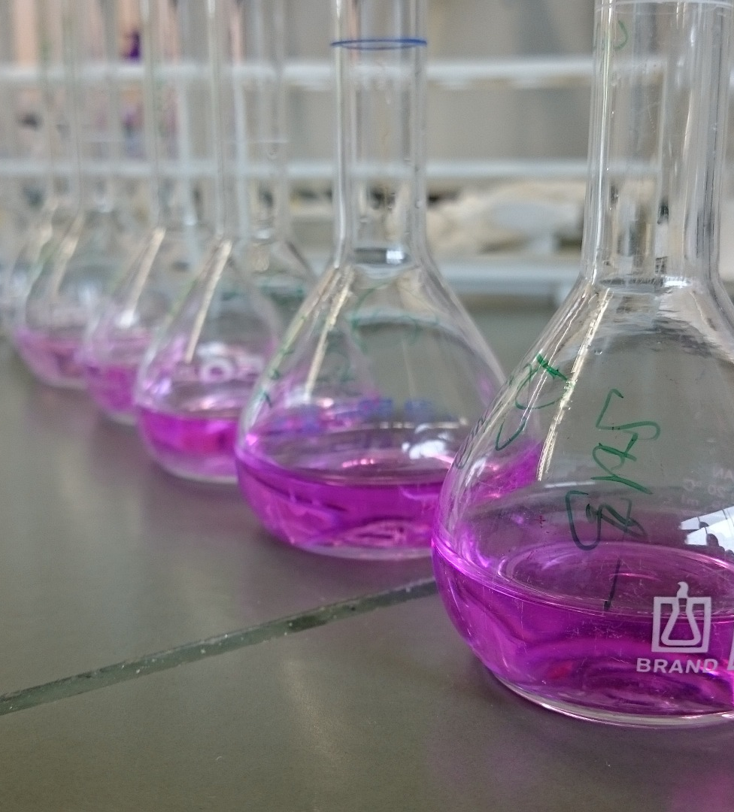
Other research outputs
Consider and plan for the management of other research outputs that may be generated or re-used throughout the projects. Be they either digital (e.g. software, workflows, protocols, models, etc.) or physical (e.g. new materials, antibodies, reagents, samples, etc.).
Consider which of the FAIR principles can apply to the management of other research outputs.
Strive to provide sufficient detail on how their research outputs will be managed and shared, or made available for re-use, in line with the FAIR principles.
Image by Phe Schlay from Pixabay

Slide 10

Allocation of resources
What will the costs be for making data or other research outputs FAIR in your project (e.g. direct and indirect costs related to storage, archiving, re-use, security, etc.) ?
How will these be covered?
Note that costs related to research data/output management are eligible as part of the Horizon Europe grant (if compliant with the Grant Agreement conditions)
Who will be responsible for data management in your project?
How will long term preservation be ensured?
Discuss the necessary resources to accomplish this (costs and potential value, who decides and how, what data will be kept and for how long)?
Image by Steve Buissinne from Pixabay

Slide 11
Data Security, ethics and other issues
Security
Ethics
Other issues
What provisions are or will be in place for data security (including data recovery as well as secure storage/archiving and transfer of sensitive data)?
Will the data be safely stored in trusted repositories for long term preservation and curation?
Are there, or could there be, any ethics or legal issues that can have an impact on data sharing? These can also be discussed in the context of the ethics review. If relevant, include references to ethics deliverables and ethics chapter in the Description of the Action (DoA).
Will informed consent for data sharing and long term preservation be included in questionnaires dealing with personal data?
Do you, or will you, make use of other national/funder/sectorial/departmental procedures for data management? If yes, which ones (please list and briefly describe them)?

Slide 12
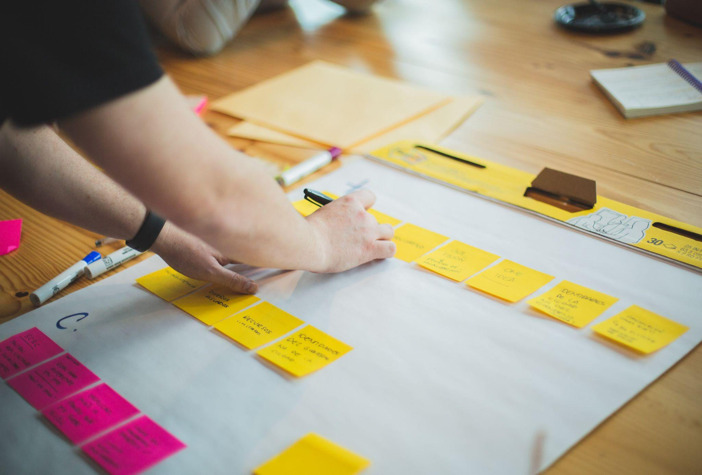
DMP in HE: when?
Proposal stage: concept of FAIR data management and draft of future DMP - recommended
Approved project: Beneficiaries must submit a DMP as a deliverable to the granting authority in accordance with the Grant Agreement (normally by month 6) - mandatory
see HE Annotated model grant agreement, annex 5
Photo by Brands&People on Unsplash

Slide 13

Mandatory updates
An updated DMP deliverable must also be produced mid-project (for projects longer than twelve months) and at the end of the project (where relevant). - see HE Annotated model grant agreement, annex 5
Image by Gerd Altmann from Pixabay

Slide 14
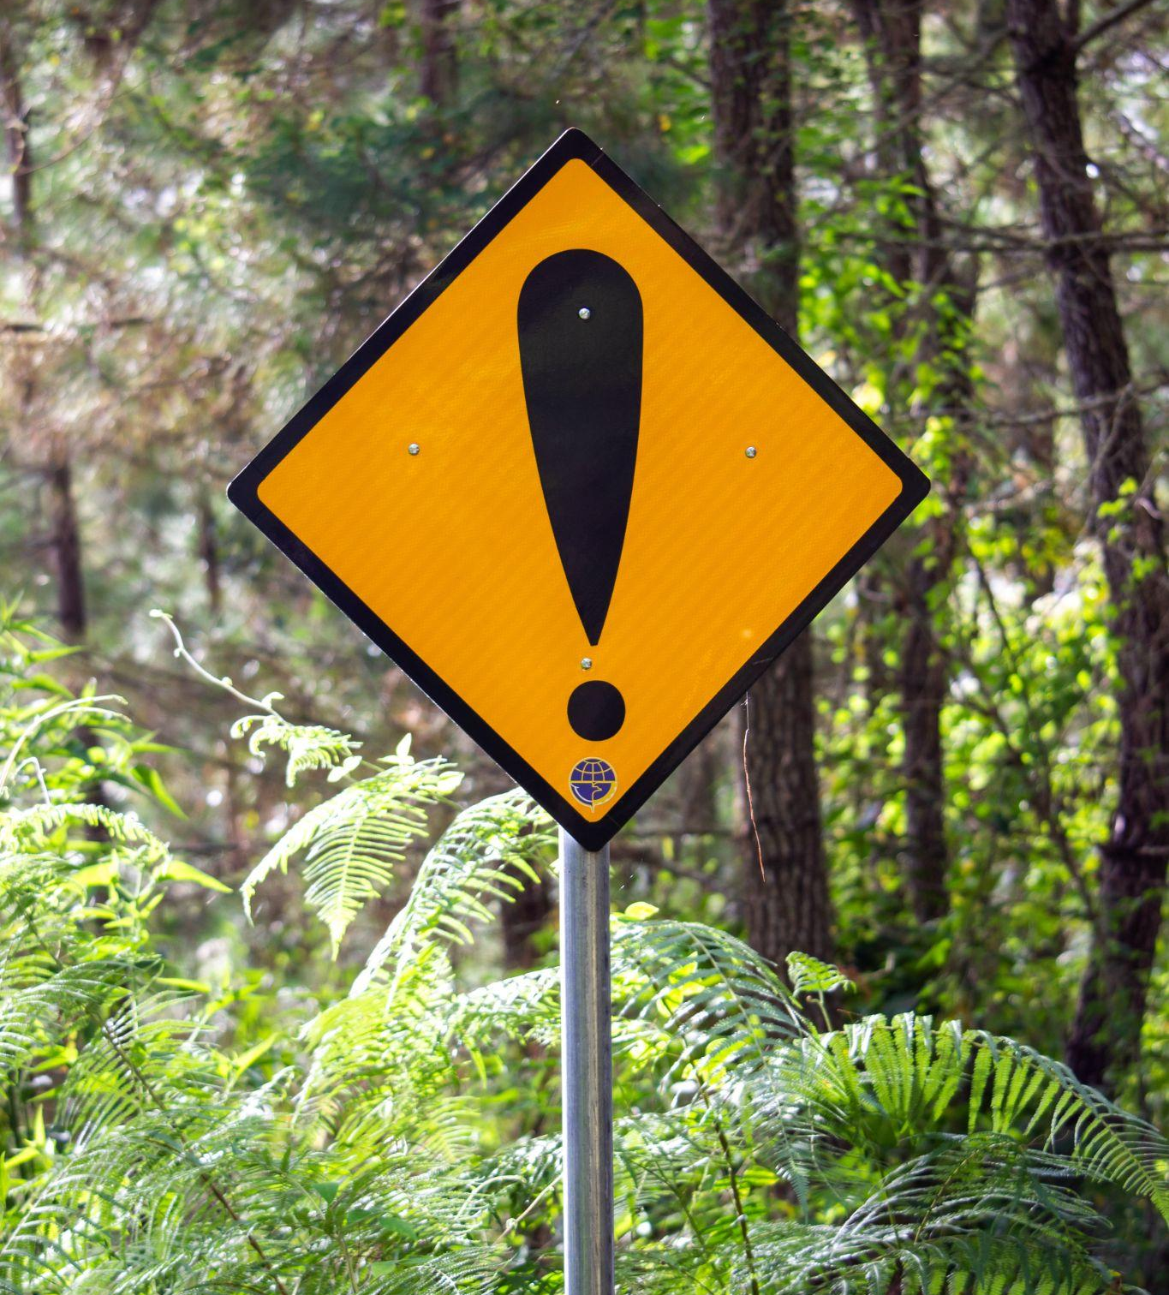
Beware!
The project will be evaluated also on the capability of properly managing data!
Photo by Muhammad Daudy on Unsplash

Slide 15
HE, DMP best practices
Beneficiaries should maintain the DMP as a living document and update it over the course of the project whenever significant changes arise. I.e.: the generation of new data, changes in data access provisions or curation policies, attainment of tasks (e.g. datasets deposited in a repository, etc.), changes in relevant practices (e.g. new innovation potential, decision to file for a patent), changes in consortium composition.
Beneficiaries are encouraged to encode their DMP deliverables as non-restricted, public deliverables, unless there are reasons (legitimate interests or other constraints) not to do so. In the case they are made public, it is also recommended that open access is provided under a CC BY licence to allow a broad re-use.

Slide 16
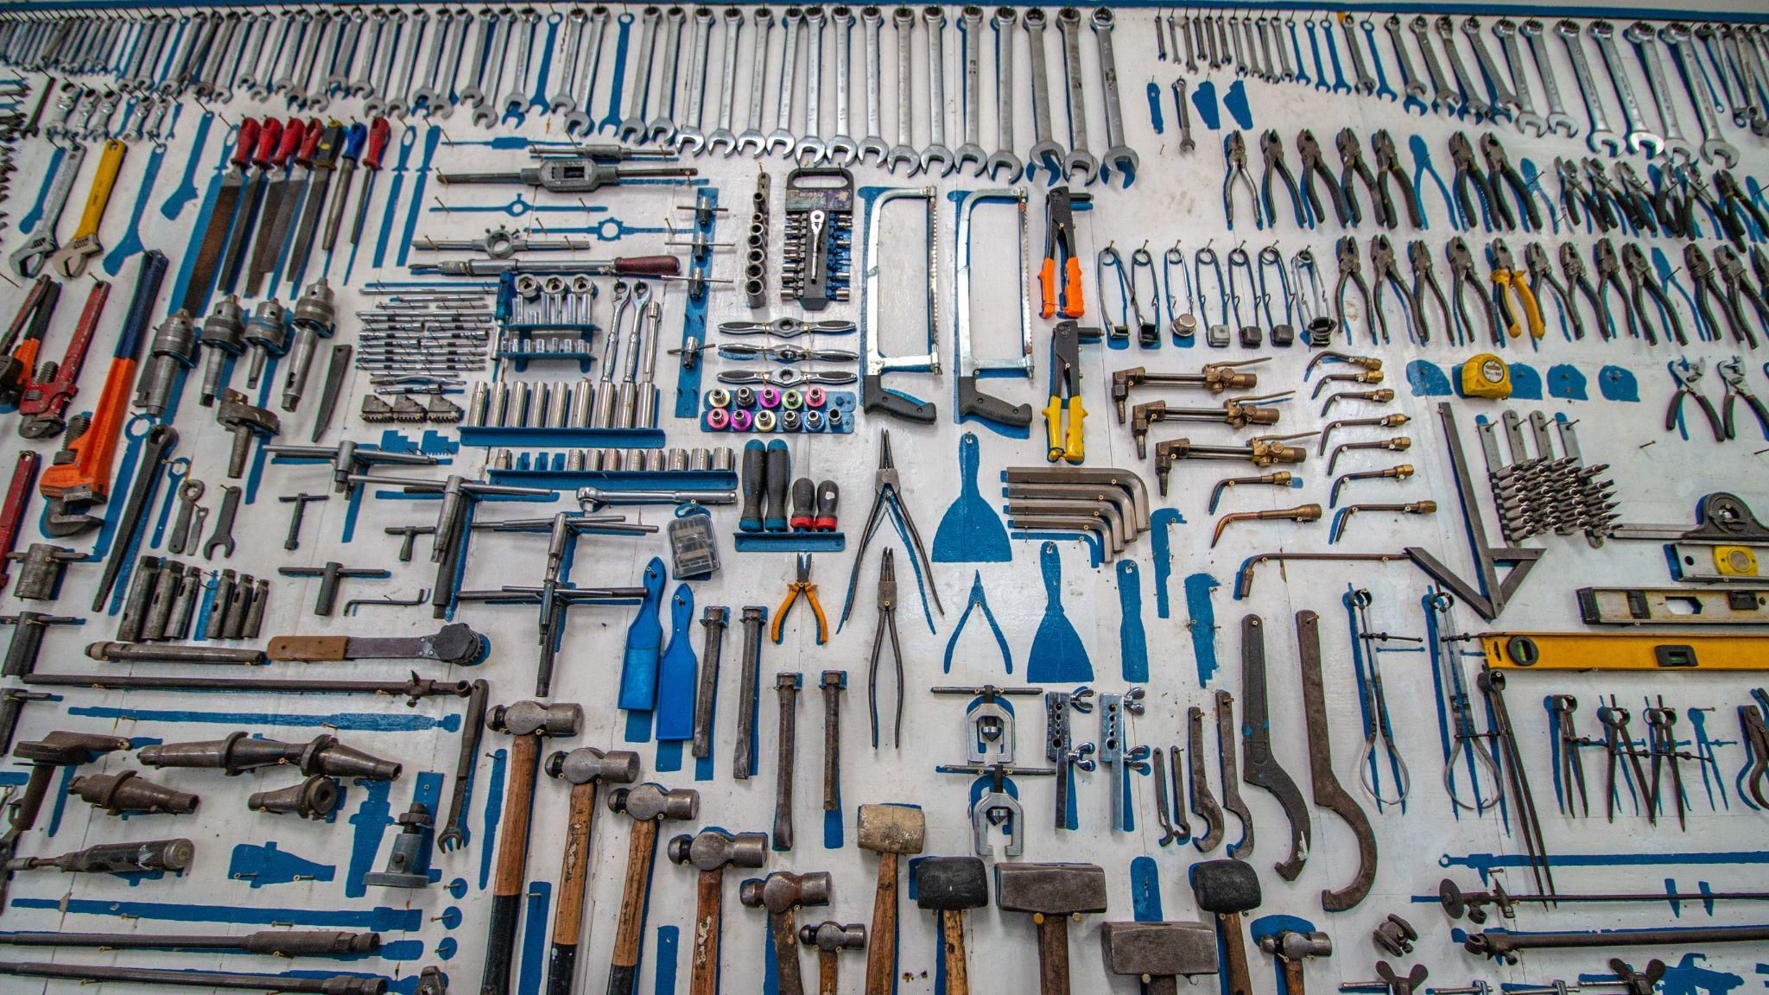
Resources and tools for DMP

Slide 17
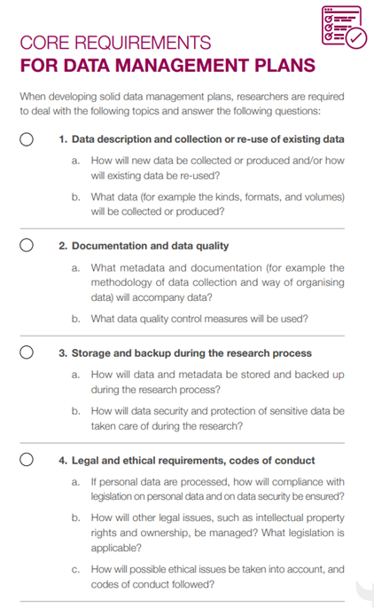
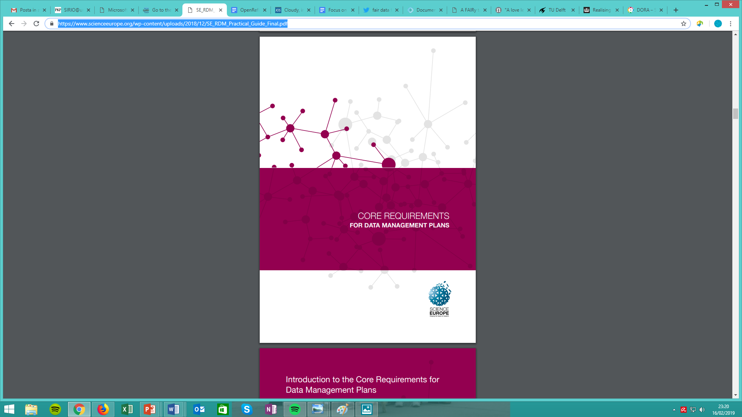
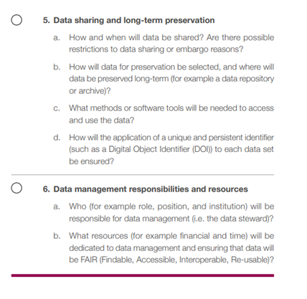
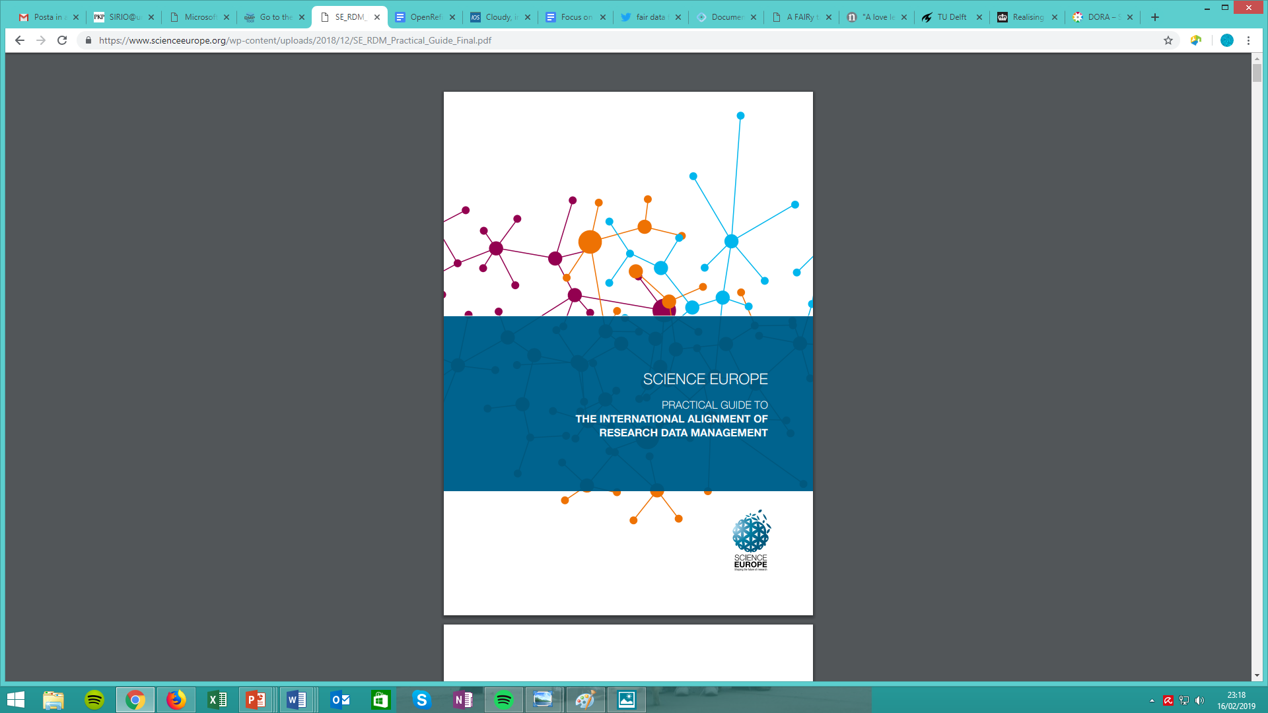
Core Requirements
Science Europe, Practical Guide to the International Alignment of Research Data Management - Extended Edition, 2021, 10.5281/zenodo.4915861
Notes:
Science Europe is the association representing major public organisations that fund or perform excellent, ground-breaking research in Europe.

Slide 18
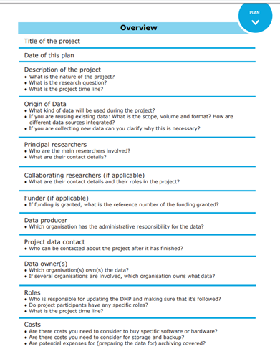
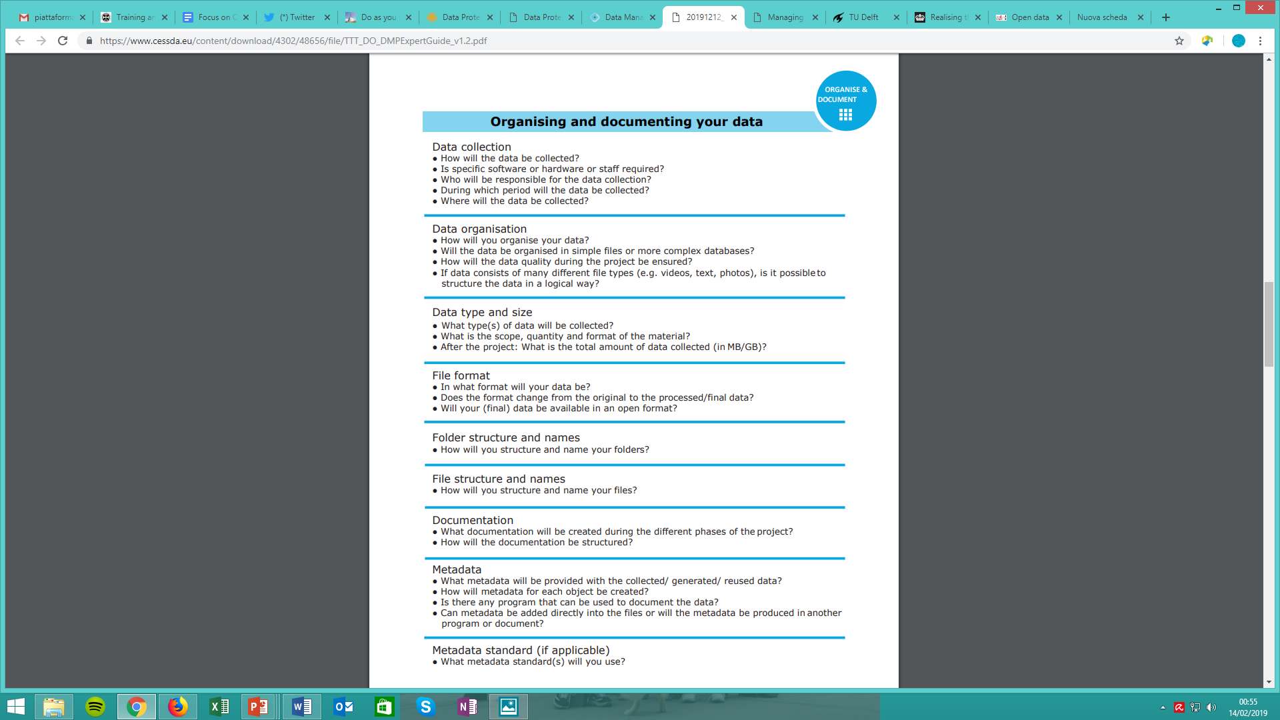

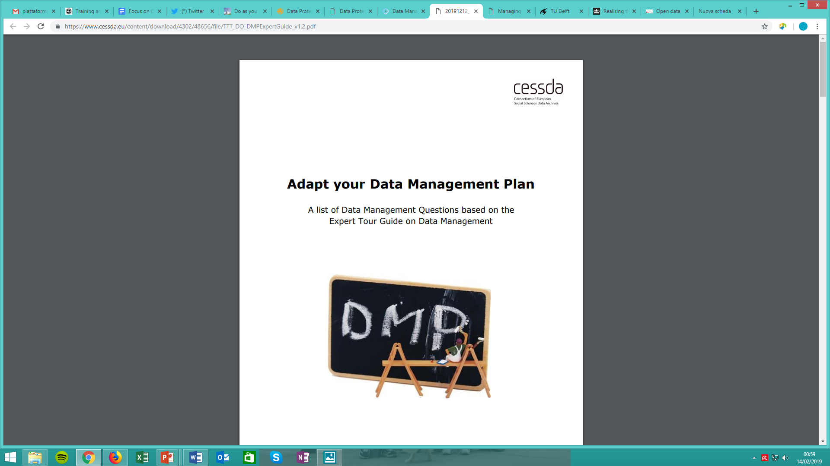
CESSDA DMP Expert Guide
https://www.cessda.eu/content/download/4302/48656/file/TTT_DO_DMPExpertGuide_v1.2.pdf

Slide 19
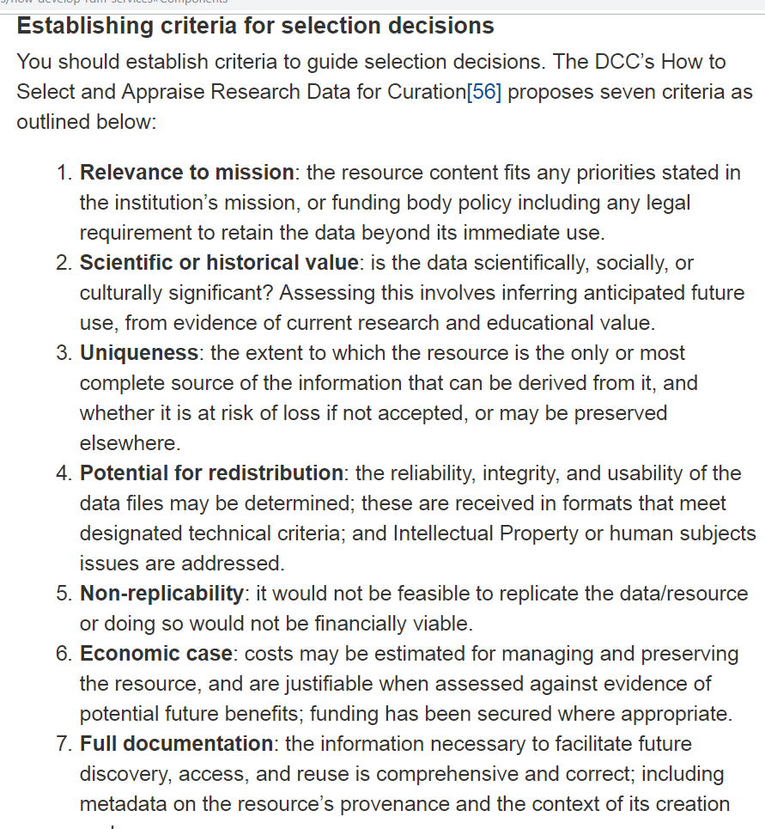
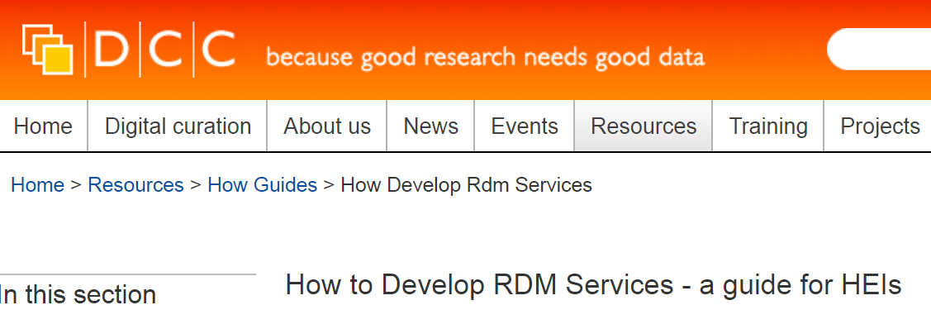
DCC guides
https://www.dcc.ac.uk/guidance/how-guides
https://www.dcc.ac.uk/guidance/how-guides/five-steps-decide-what-data-keep
Notes:
The Digital Curation Centre (DCC) is a centre of expertise in digital information curation with a focus on building capacity, capability and skills for research data management.

Slide 20
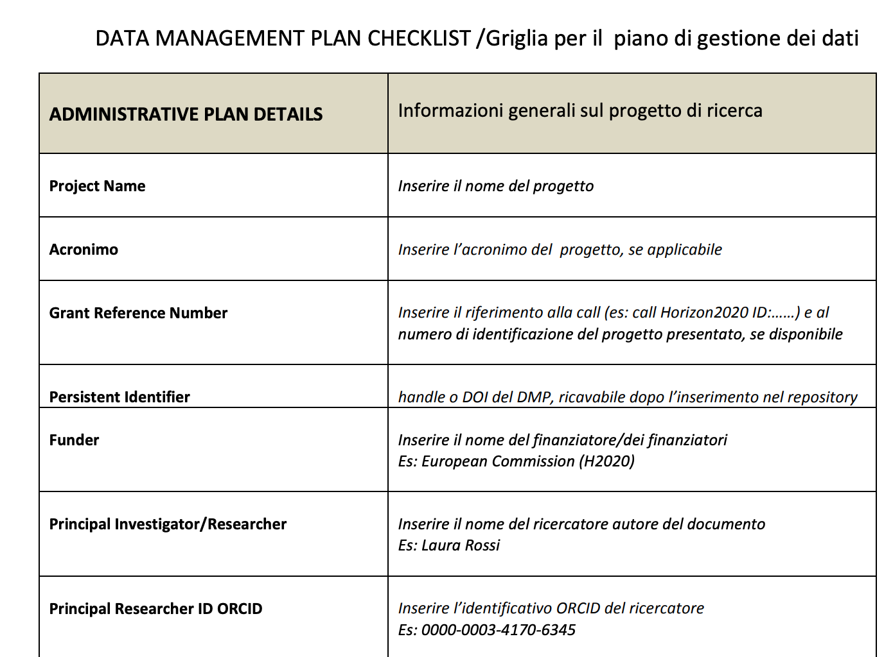
Nel maggio 2017 un gruppo di lavoro informale sui dati della ricerca (costituito da Politecnico di Milano, Università di Milano, Università di Torino, Università di Trento, Università Ca’ Foscari Venezia) ha redatto una checklist con una griglia in lingua italiana per l'elaborazione di un Data Management Plan.
http://wikimedia.sp.unipi.it/images/Grigliapianodigestionedatiricerca.pdf

Slide 21
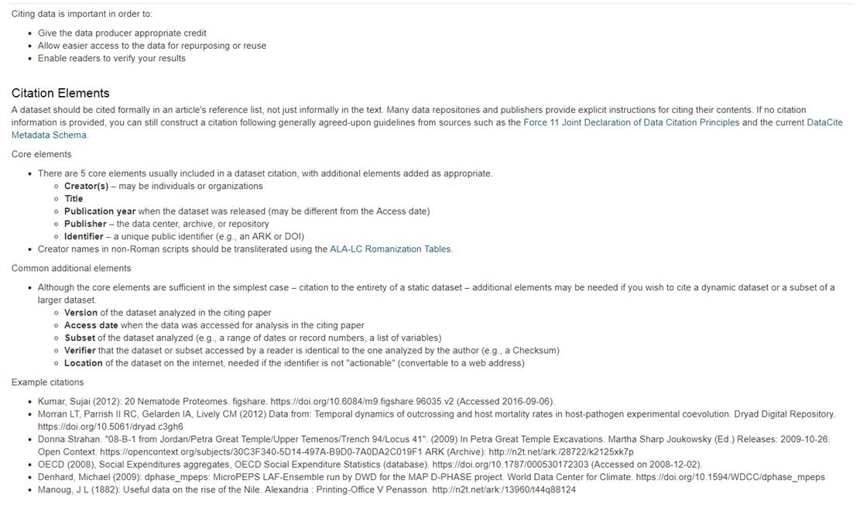
Citing
data
https://dmptool.org/general_guidance#metadata-data-documentation

Slide 22
Useful links
Zenodo - CERN-OpenAIRE OA repository - catch all
www.zenodo.org
Choose a license - Creative Commons
https://creativecommons.org/choose/?lang=en
https://chooser-beta.creativecommons.org/
DMP examples by subject - LIBER
https://libereurope.eu/dmpcatalogue/
Tools to create your DMP
https://www.openaire.eu/argos/
https://dmponline.dcc.ac.uk/
https://argos.openaire.eu/splash/
Re3Data
https://www.re3data.org/
Metadata standard Directory - Research Data Alliance
https://rd-alliance.github.io/metadata-directory/

Slide 23
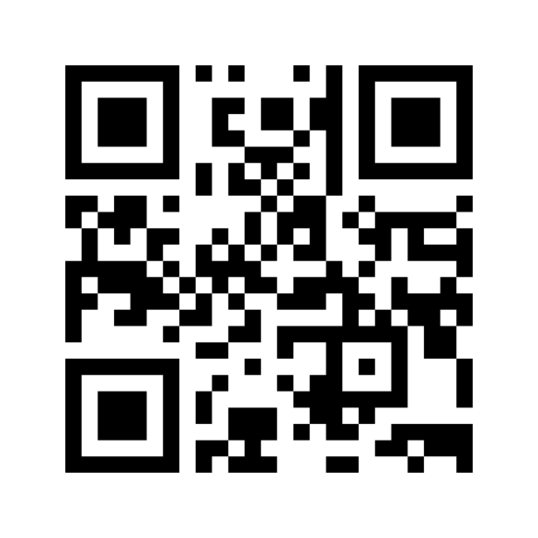
Interact with mentimeter
Please go to www.menti.com and insert code: 2641 3958
OR
use your mobile/tablet to scan the QR code

