Slide 1



Open Science
in research projects
More better, Open Science
module 3.3
Gina Pavone 0000-0003-0087-2151
Emma Lazzeri 0000-0003-0506-046X
12 November 2021

Slide 2
Open Science as
the new normal
Open Science in Horizon Europe and ERC funded projects

Slide 3



In Horizon Europe the project proposal is evaluated under the Open Science Perspective
Notes:
Horizon Europe is the EU's funding programme for research and innovation, it covers the years from 2021 to 2027

Slide 4
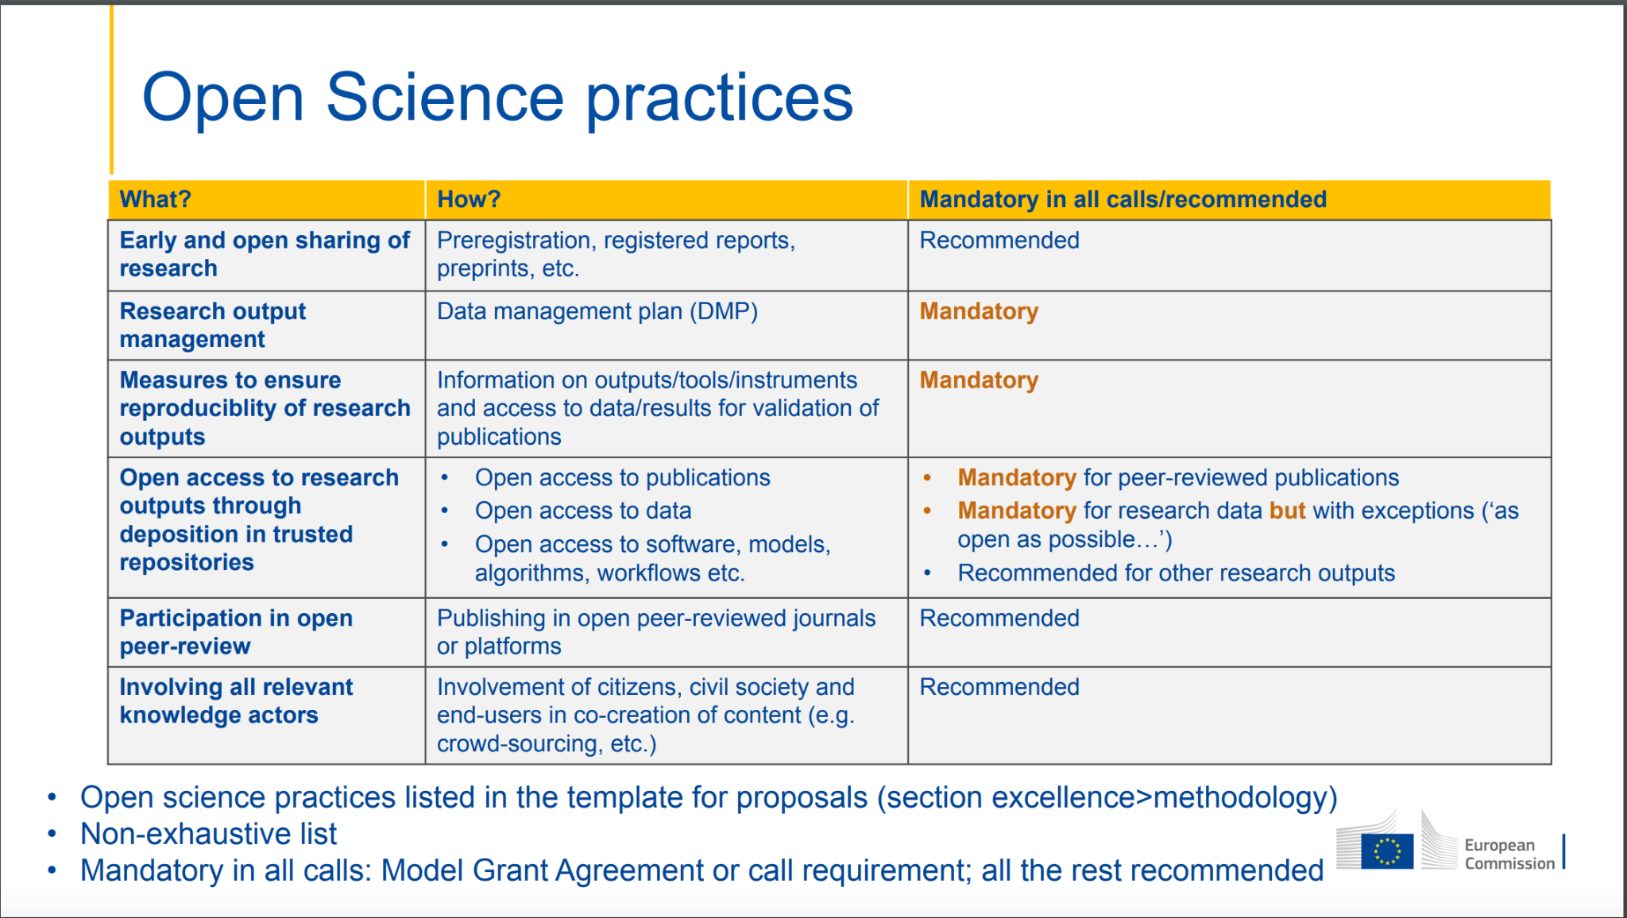
Alea Lopez de San Roman, Dagmar Meyer, Emilie Hermans, & Ellen Leenarts. (2021, September 22). Horizon Europe train-the-trainer workshop. Open Science Fair 2021 (OSFair2021). Zenodo. https://doi.org/10.5281/zenodo.5549524

Slide 5
Open Science practices in Horizon Europe
early and open sharing of research (i.e. preregistration, registered reports, pre-prints, or crowd-sourcing)
research output management including research data management
measures to ensure reproducibility of research outputs
open access to research outputs (e.g. publications, data, software, models, algorithms, and workflows) through deposition in trusted repositories
participation in open peer-review
involving all relevant knowledge actors including citizens, civil society and end users in the co-creation of R&I agendas and contents (such as citizen science)

Slide 6
Open Access to scientific publications in HE - 1
Beneficiaries must ensure OA to peer-reviewed scientific publications relating to their results. In particular, they must ensure:
at the latest upon publication, deposition of the AAM or VoR in a trusted repository + immediate open access via the repository under CC BY or equivalent (CC BY-NC/CC BY-ND are allowed for long-text formats)
information via the repository about any research output/tools/instruments needed to validate the conclusions of the scientific publication
Metadata must be open under CC 0 or equivalent, in line with the FAIR principles and provide information about the licensing terms and persistent identifiers, amongst others.

Slide 7
Trusted repository
Certified repositories (e.g. CoreTrustSeal, nestor Seal DIN31644, ISO16363) or disciplinary and domain repositories commonly used and endorsed by the research communities and internationally recognised.
General-purpose or institutional repositories that:
  assign persistent unique identifiers to contents
  contents are accompanied by quality metadata to enable discovery, reuse and citation (ie provide information about provenance and licensing; metadata are machine- actionable and standardized).
  facilitate mid- and long-term preservation of the deposited material.

Slide 8
Open Access to scientific publications in HE - 2
•Beneficiaries (or authors) must retain sufficient intellectual property rights to comply with the OA requirements
•Publication in venue of choosing but publication fees are reimbursable only if publishing venue is full open access (publication fees in hybrids not reimbursed)

Slide 9
Os in the Horizon Europe
project proposal

Slide 10
Os in excellence and
quality of implementation sections
“In Horizon Europe, open science practices are considered in the evaluation of proposals, under ‘excellence’ in particular under methodology and under the ‘quality and efficiency of implementation’ award criterion. Proposers should address open science practices in the relevant section on open science under methodology.
See Horizon Europe programme guide: https://ec.europa.eu/info/funding-tenders/opportunities/docs/2021-2027/horizon/guidance/programme-guide_horizon_en.pdf
Horizon Europe moves beyond open access to open science

Slide 11


Mandatory and recommended OS practices
In HE both mandatory and recommended OS practices will be evaluated in the project proposal phase.
“Proposers will have to provide concrete information on how they plan to comply with the mandatory open science practices. Failure to sufficiently address this, will result in a lower evaluation score.
Recommended open science practices are incentivised through their evaluation at the proposal stage.
Photo by Wesley Armstrong on Unsplash
Image by Philip Uglow from Pixabay

Slide 12
‘Excellence’, part B (Project proposal – Technical description)
“proposers should describe how open science practices (mandatory and recommended, as appropriate) are implemented as an integral part of the methodology and show how their implementation is adapted to the nature of their work, therefore increasing the chances of the project delivering on its objectives.
If open science practices are not applicable to the proposal, justifications should be provided sp that, if evaluators agree, open science will not be taken into consideration in the evaluation.
What to describe in the methodology section
See Horizon Europe programme guide: https://ec.europa.eu/info/funding-tenders/opportunities/docs/2021-2027/horizon/guidance/programme-guide_horizon_en.pdf
Notes:
Please note that this question does not refer to outreach actions that may be planned as part of communication, dissemination and exploitation activities. These aspects should instead be described below under ‘Impact’.

Slide 13

What to include in the methodology section
Open Science Practices
Research data Management and management of other research outputs
FAIR aspects of RDM
Curation and storage/preservation costs; person/team responsible for data management and quality assurance.

Slide 14
‘Capacity of participants and consortium as a whole’ , part B
“Proposers should describe how the consortium brings together the necessary disciplinary and interdisciplinary knowledge.
Proposers should show how this includes expertise and/or track record in open science practices, relevant to what is planned for the project.
Os in the description of the consortium
See Horizon Europe programme guide: https://ec.europa.eu/info/funding-tenders/opportunities/docs/2021-2027/horizon/guidance/programme-guide_horizon_en.pdf

Slide 15
Part A of the proposal
“Proposers are asked to list up to five relevant publications, widely used datasets or other achievements of consortium members that they consider significant for the action proposed.
Publication should be OA (if they are not, deposit them retroactively) and data should be FAIR and ‘as open as possible, as closed as necessary’.
The significance of publications will not be evaluated on the basis of the Journal Impact Factor of the venue they are published in, but on the basis of a qualitative assessment provided by the proposers for each publication.
Os in the application form of the proposal
See Horizon Europe programme guide: https://ec.europa.eu/info/funding-tenders/opportunities/docs/2021-2027/horizon/guidance/programme-guide_horizon_en.pdf

Slide 16
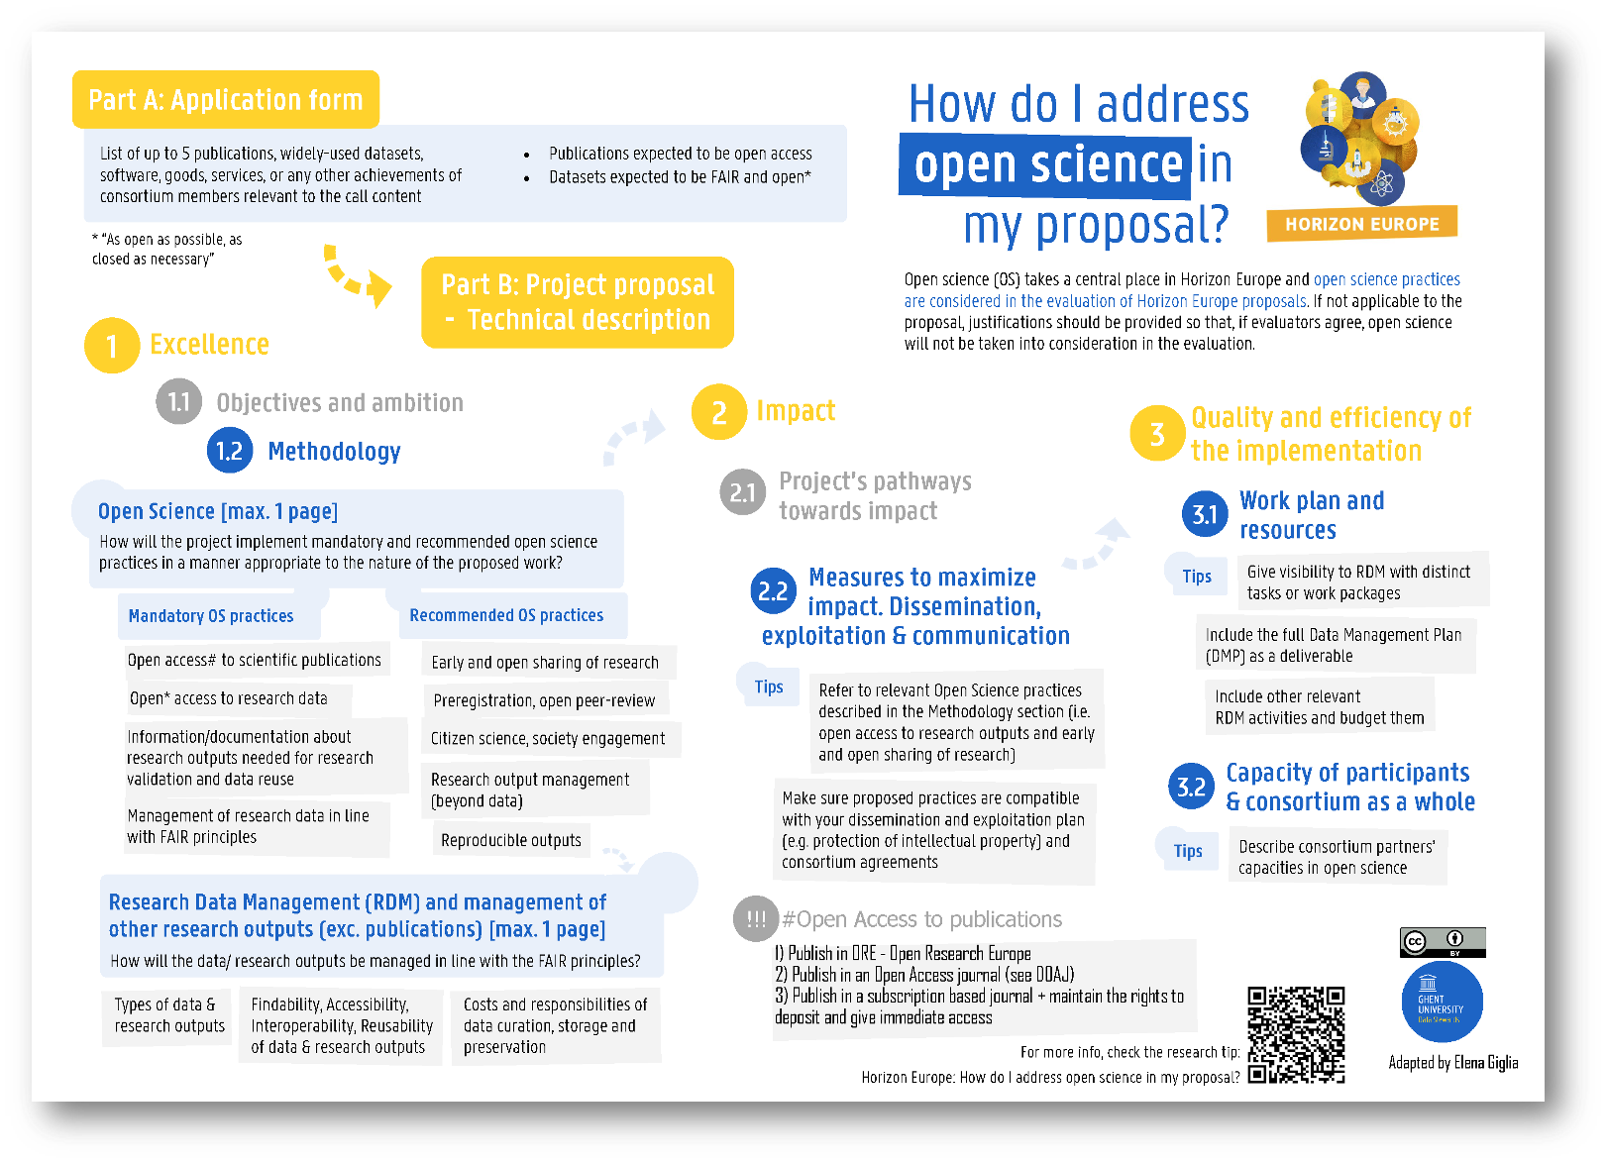

Slide 17
Open Science and Horizon Europe at the European Research Council

Slide 18

OS in the ERC proposal
No explicit evaluation of open science practices;
No requirement to describe open science practices explicitly / separately in the proposal.
Where open science practices improve the quality of the research design and methodology, their use will (implicitly) positively affect assessment of ‘scientific excellence’.
--
In July 2021, ERC formally endorsed the San Francisco Declaration on Research Assessment (DORA), in line with the ERC’s commitment to research assessment principles that recognize the intrinsic quality of researchers’ work and the value and impact of all research outputs.
.
Alea Lopez de San Roman, Dagmar Meyer, Emilie Hermans, & Ellen Leenarts. (2021, September 22). Horizon Europe train-the-trainer workshop. Open Science Fair 2021 (OSFair2021). Zenodo. https://doi.org/10.5281/zenodo.5549524

Slide 19
Horizon Europe: what is required for ERC grantees?
open access to peer-reviewed scientific publications
At the latest at the time of publication, a machine-readable electronic copy of the published version (VoR), or the final peer-reviewed manuscript accepted for publication (AAM), must be deposited in a trusted repository for scientific publications.
Immediate OA through a repository and CC licence (CC-BY) or equivalent. Exclusion of commercial uses and/or derivative works possible only for book and monographs (but not book chapters).
The authors of the publication must retain sufficient intellectual property rights to allow compliance with the requirements of the grant agreement.
Information must be provided via the repository about any research outputs or any other tools and instruments needed to validate the conclusions of the scientific publication.
Metadata in CC-0 or equivalent licence and in line with FAIR principles

Slide 20
Horizon Europe: what is required for ERC grantees?
Research data
Establish a DMP as a deliverable of the project within the first six months of your project and regularly update it. Note that no DMP is needed at the application stage.
As soon as possible and within the deadlines set out in the DMP, deposit the data in a trusted repository.
Ensure open access to the deposited data as soon as possible and within the deadlines and conditions set out in the DMP, via the repository. CC-0, CC-BY or equivalent licence ( unless justified otherwise in the DMP.)
Detailed metadata of research outputs (in line with FAI

Slide 21
Cost eligibility in HE for ERC grantees
Publishing fees (APCs or Book Processing Charges) in full OA venues are reimbursable
Publication fees for hybrid or subscription journals are not eligible for reimbursement from your ERC grant.

Slide 22
Reference documents
Horizon Europe Annotated Model Grant Agreement: https://ec.europa.eu/info/funding-tenders/opportunities/docs/2021-2027/common/guidance/aga_en.pdf
Horizon Europe Standard Application form: https://ec.europa.eu/info/funding-tenders/opportunities/docs/2021-2027/horizon/temp-form/af/af_he-ria-ia_en.pdf
Horizon Europe Programme Guide: https://ec.europa.eu/info/funding-tenders/opportunities/docs/2021-2027/horizon/guidance/programme-guide_horizon_en.pdf

Slide 23
Open Science in Horizon Europe explained
Webinar: How to prepare a successful proposal in Horizon Europe (24 March 2021)
Open Science at 00:53:00
Q&A (including on Open Science) from 1:09:0
Webinar: A successful proposal for Horizon Europe: Scientific-technical excellence is key, but don’t forget the other aspects (21 April 2021)
Presentation: Open Science

Slide 24

Photo by Alexas_Fotos on Unsplash

