Slide 1



Open Science
in research projects
More better, Open Science
module 3.4
Gina Pavone 0000-0003-0087-2151
Emma Lazzeri 0000-0003-0506-046X
12 November 2021

Slide 2
Research Infrastructures and EOSC

Slide 3
R&I, two main pillars in the Eu strategy:
both converging to the European Open Science Cloud
Research Infrastructures
ESFRI - the European Strategy Forum on Research Infrastructures
Open Science
Broad commitment on Open Science in the Horizon Europe funding program

Slide 4
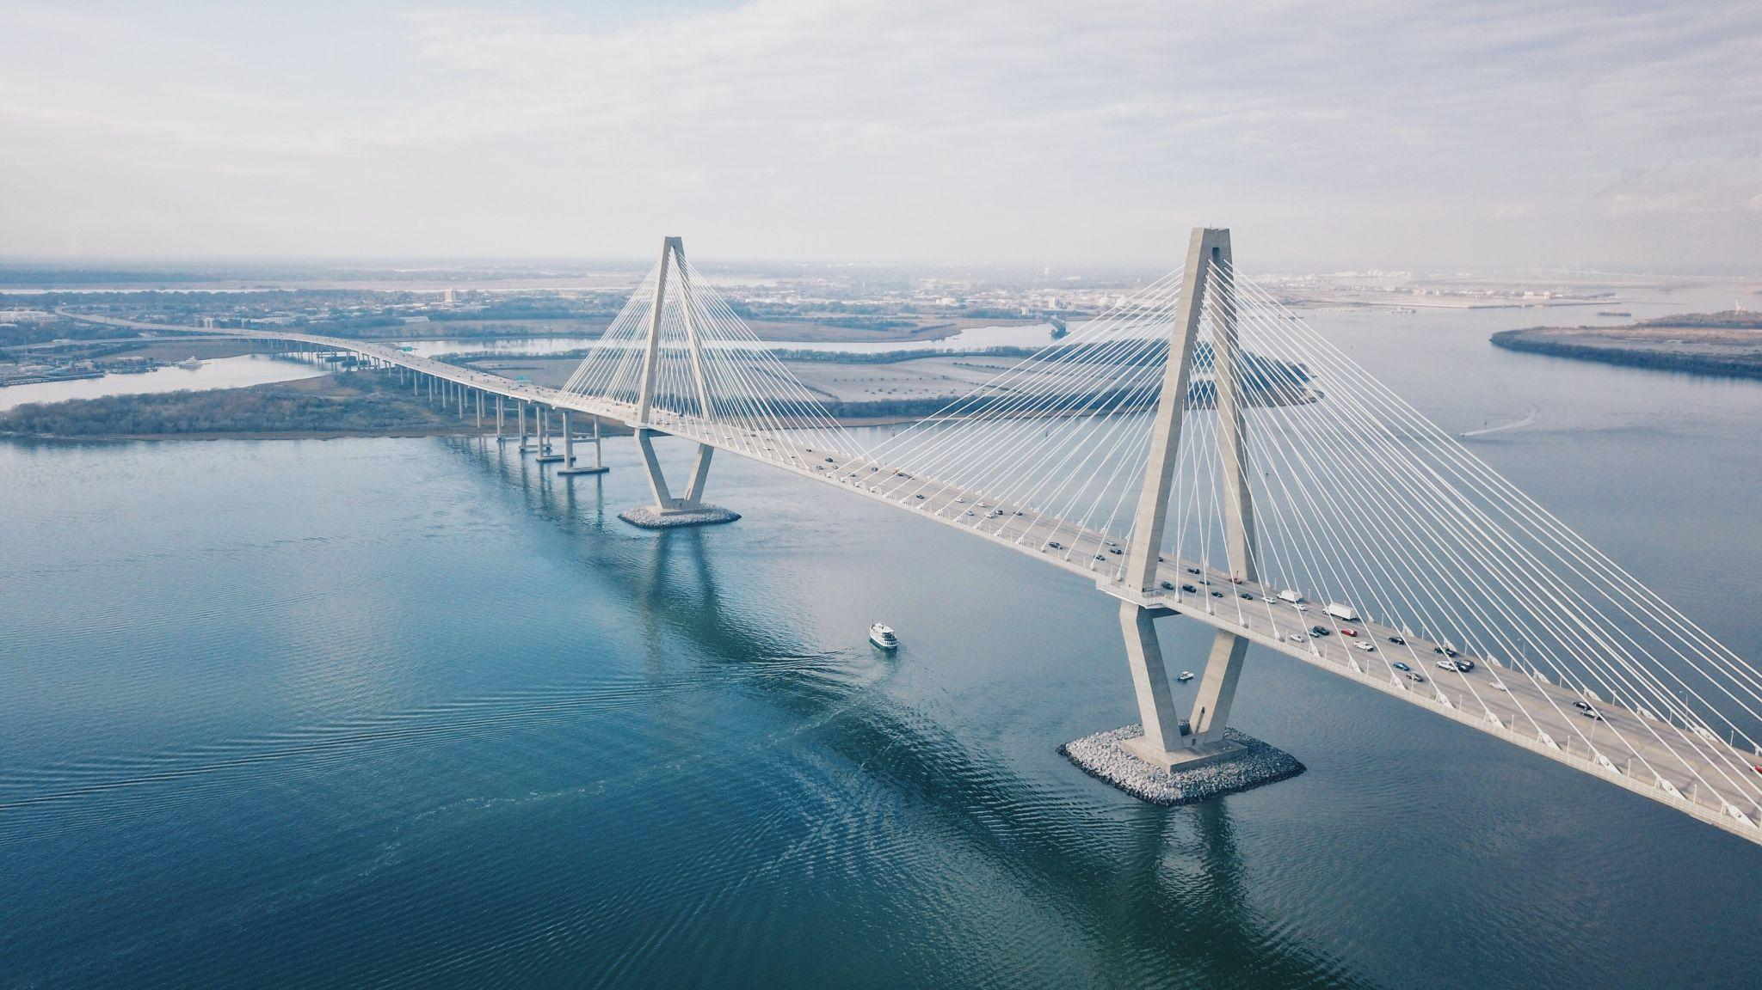
What Research Infrastructures are

Slide 5

Research Infrastructures
Facilities that provide resources and services for research communities to conduct research and foster innovation.
Photo by Erik van Dijk on Unsplash

Slide 6
Research Infrastructure make Science happen!

Slide 7
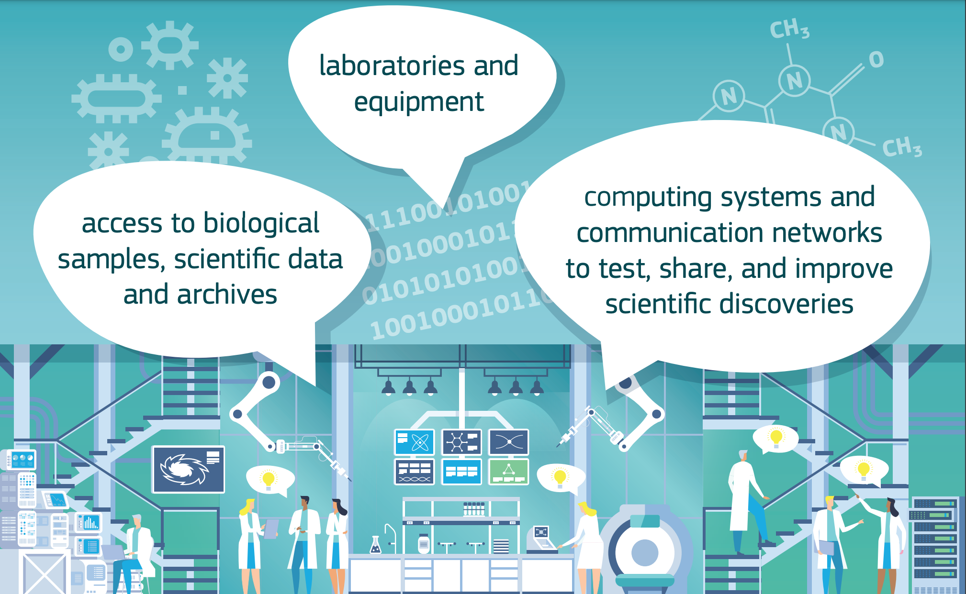
https://publications.europa.eu/en/publication-detail/-/publication/6702e82f-e4c3-11e9-9c4e-01aa75ed71a1/language-en/format-PDF/source-106123556

Slide 8

For research and beyond!
The can be used for example for education or public services.
They may be single-sited, distributed, or virtual.

Slide 9
Research Infrastructures include:
major scientific equipment or sets of instruments
collections, archives or scientific data
computing systems and communication networks
any other research and innovation infrastructure of a unique nature which is open to external users
any other tools that are essential to achieve excellence in research and innovation.

Slide 10
Research Infrastructures models:
RI are implemented along different organisational models, including central sources and laboratories for experiments and measurement sessions, coordination and management of geographically distributed observatories or laboratories, remotely accessible resources for computing, data banks, physical sample repositories, surveys and longitudinal studies.
From the definition of RI in ESFRI glossary

Slide 11
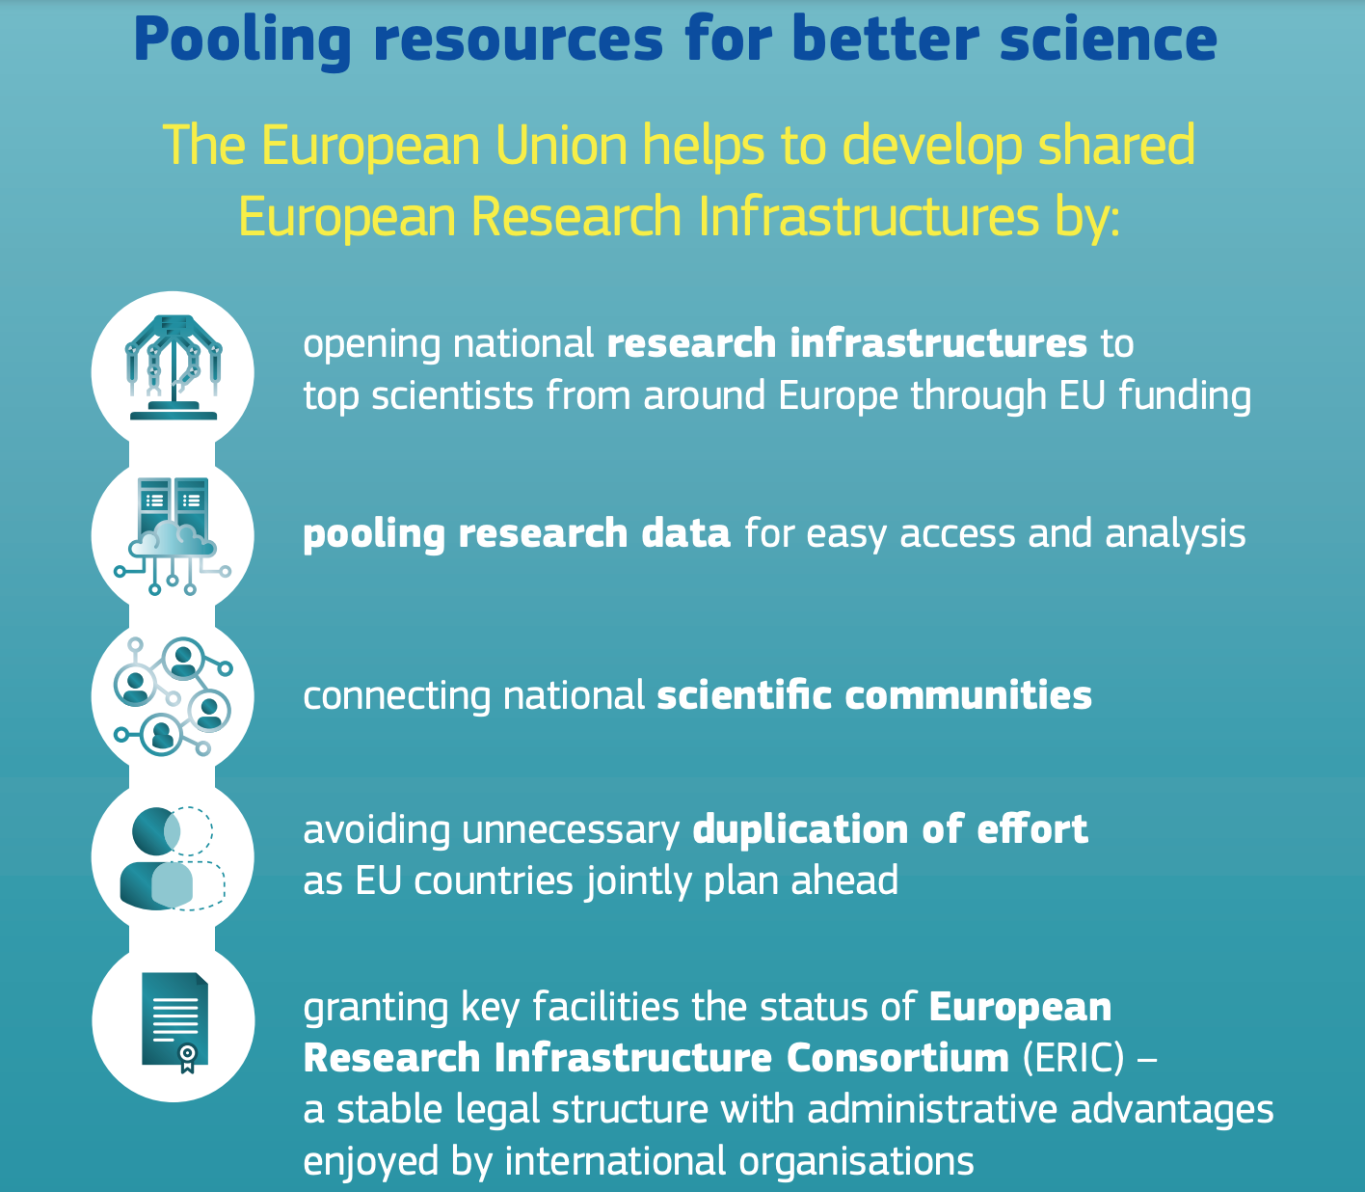
It is all about collaboration!
Scientists need easy access to state-of-the-art infrastructures to test their ideas
Research infrastructures make science happen (Infographic)

Slide 12
Examples of RIs
EPOS: Viable solutions to tackle solid Earth grand challenges
ESS: The world’s next-generation neutron science facility
ELIXIR: A distributed infrastructure for Life science information
SHARE: A survey on Health, ageing and retirement in Europe

Slide 13

ESFRI
Photo: cover image of the ESFRI White Paper 2020, by 123RF - Kran Kanthawong

Slide 14
European Strategy Forum on RIs -
ESFRI
Established in 2002, with a mandate from the EU Council to support a coherent and strategy-led approach to policy-making on research infrastructures in Europe
The ESFRI delegations are composed of two Delegates per Member State/Associate State, representing the Minister(s) responsible for Research in each of those States.
Policy-making on Research Infrastructures in Europe.

Slide 15
ESFRI objectives and vision
support a coherent and strategy-led approach to policy-making on research infrastructures in Europe
facilitate multilateral initiatives leading to the better use and development of research infrastructures, at EU and international level
overcoming the limits due to fragmentation of individual policies
optimize the organization of RIs landscape

Slide 16
ESFRI action for Open Science
“Develops and facilitates the implementation of RIs into hubs of competence in Europe, where science, education and innovation meet to advance new collaborative models and provide solution-oriented advances based on Open Science principles.”
See ESFRI White Paper 2020, cfr Mission

Slide 17
The European Open Science Cloud

Slide 18
What the EOSC is
A federated and open multi-disciplinary environment where they can publish, find and re-use data, tools and services for research, innovation and educational purposes.
seamless access
FAIR management
reliable reuse of research data and all other digital objects produced along the research life cycle (e.g. methods, software and publications)
Intended for European researchers, innovators, companies and citizens

Slide 19
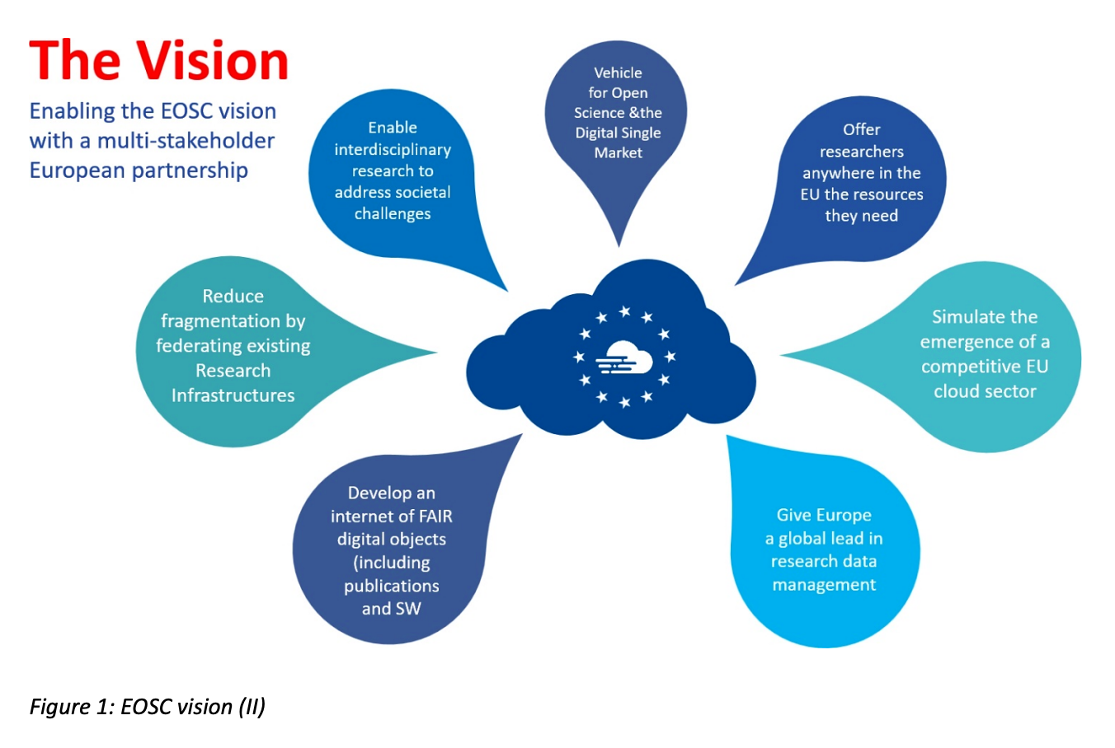
https://ec.europa.eu/info/publications/european-open-science-cloud-eosc-strategic-implementation-plan_en
Notes:
SW = software

Slide 20

The main aim
To develop a ‘Web of FAIR Data and services' for science in Europe upon which a wide range of value-added services can be built.
Photo by Alina Grubnyak on Unsplash

Slide 21
The EU Council recognizes the EOSC as
The pilot action to deepen the new European Research Area (ERA)
The science, research and innovation data space which will be fully articulated with the other sectoral data spaces defined in the European strategy for data.
https://eosc.eu/about-eosc

Slide 22

Fully deployment of the EOSC
will lead to higher research productivity, new insights and innovations, as well as improved reproducibility and trust in science.

Slide 23
Implementing the EOSC
Ongoing integration process since 2015
In the initial phase of implementation (2018-2020), the European Commission invested around €250 million to prototype components of the EOSC through calls for projects under Horizon 2020
A co-investment (with in kind and financial contributions) by the EU and non-EU partners of at least €1 billion is foreseen for the next 7 years.

Slide 24
EOSC governance partnership
Tripartite governance partnership:
the EU represented by the European Commission,
the participating countries represented in the EOSC Steering Board
the research community represented by the EOSC Association

Slide 25
The EOSC Association
Setup in July 2020 as an AISBL (association internationale sans but lucratif) under Belgian law. ICDI was one of the four founding members.
The aim is to provide a single voice for advocacy and representation for the broader EOSC stakeholder community.
Already 150 members and 50 observers, essentially from public organisations having a research mandate in Europe. The aim is to extend the membership.
Italy participates with 23 research organizations:
https://www.eosc.eu/general-assembly?field_country_value=Italy&field_status_value=All&field_type_of_organisation_value=All&page=0

Slide 26
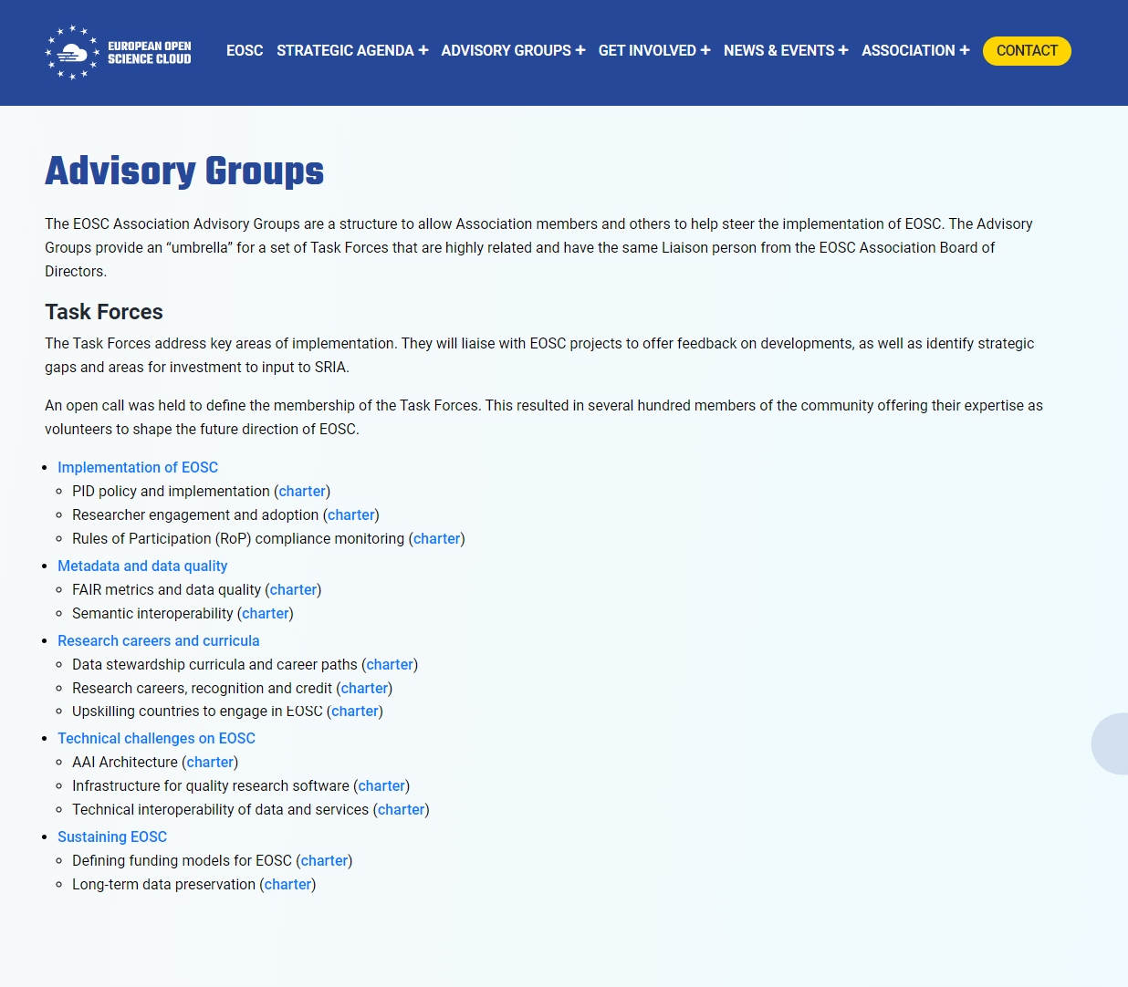
Advisory Groups and Task Forces
An opportunity to make the difference
https://www.eosc.eu/advisory-groups

Slide 27
Links
https://ec.europa.eu/research/openscience/index.cfm?pg=open-science-cloud
www.eoscsecretariat.eu
https://www.eosc-portal.eu/
www.eosc.eu

Slide 28

Interact with mentimeter
Please go to www.menti.com and insert code: 2641 3958
OR
use your mobile/tablet to scan the QR code

