Slide 1



Open Science
in research projects
More better, Open Science
module 1.2
Gina Pavone 0000-0003-0087-2151
Emma Lazzeri 0000-0003-0506-046X
5 November 2021

Slide 2
No burden for authors
Scientific publishing without APCs on authors
Notes:
Nessun onere per gli autori

Slide 3
Problems to solve
Paywalls
Overcoming the model of commercial scientific communication
Copyright
Authors must be free to disseminate their work
1
3
2
APCs
Do not encourage the false myth of paying to publish
4
Licences
Release products under licenses that allow reuse

Slide 4
Concrete examples
Several initiatives to achieve
Open Access by overcoming the APCs
charged to authors

Slide 5
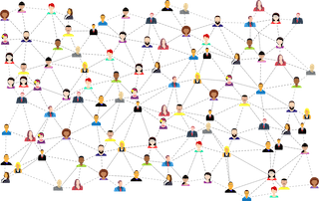

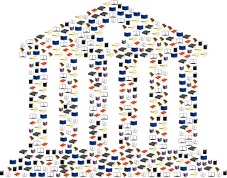
Publishing without APCs on authors
Institutional publishing
Community driven initiatives
Funded publishing platforms
Milano University Press (Unimi)
SCOAP3
Archeologia e calcolatori
Wellcome Open Research
Open Research Europe
B. & M Gates Foundation

Slide 6
Community driven initiatives

Slide 7
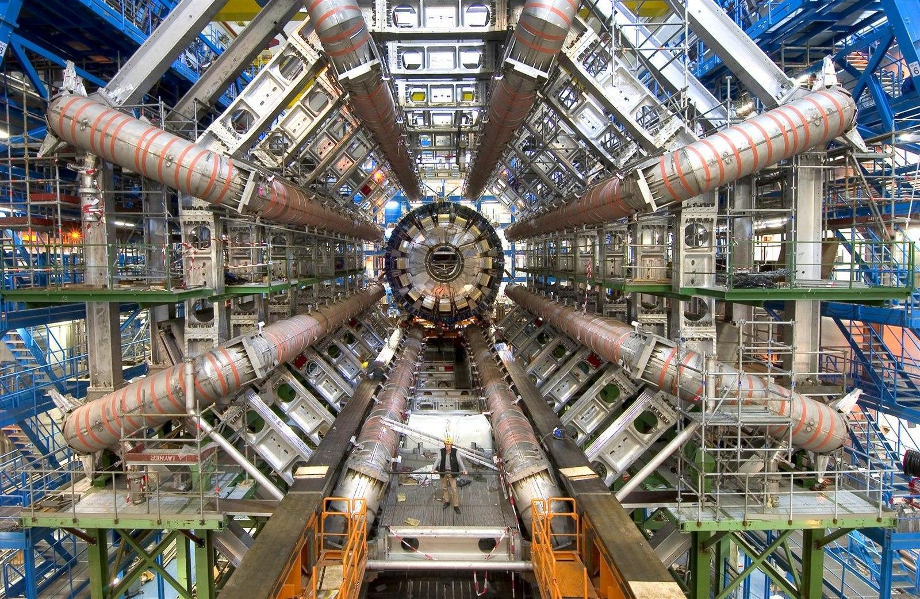
SCOAP³
https://commons.wikimedia.org/wiki/File:ATLAS.jpg

Slide 8

What: an initiative to create an open access publishing model for a specific discipline, High Energy Physics (HEP)
How: SCOAP3 has converted key journals in the field of High-Energy Physics to Open Access at no cost for any authors. SCOAP3 centrally pays publishers for costs involved in providing Open Access, publishers, in turn, reduce subscription fees to all their customers, who can re-direct these funds to contribute to SCOAP3.
Who: SCOAP3 is a partnership of over three thousand libraries, key funding agencies and research centers in 44 countries and 3 intergovernmental organisations. https://scoap3.org/participating-countries/
List of journals, initiative on books, dedicated repository

Slide 9
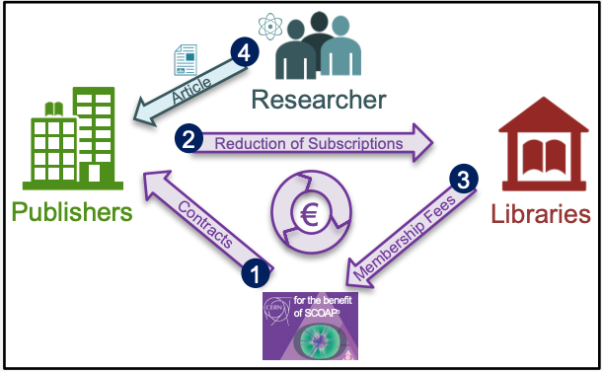
Scoap³: how does it work?
1. SCOAP³ centrally pays participating publishers for the costs involved in providing Open Access.
2. These publishers in turn reduce subscription fees to all their customers
3. customers redirect these savings to SCOAP³.
4 Contributions are pooled in a SCOAP³ common fund: each country contributes financially in a way commensurate to its scientific output in the field.
https://scoap3.org/wp-content/uploads/2018/09/Facts-Figures_EN.pdf
Notes:
Le APC sono pagate centralmente da SCOAP³, grazie a un fondo comune istituito da biblioteche, consorzi, enti di ricerca ed agenzie di finanziamento.

Slide 10
Scoap³ achievements
Scientists may publish in SCOAP3 journals without any financial barriers. Copyright stays with the authors.
All articles appear in the SCOAP3 repository for further distribution, as well as being Open Access on publishers’ websites.

Slide 11
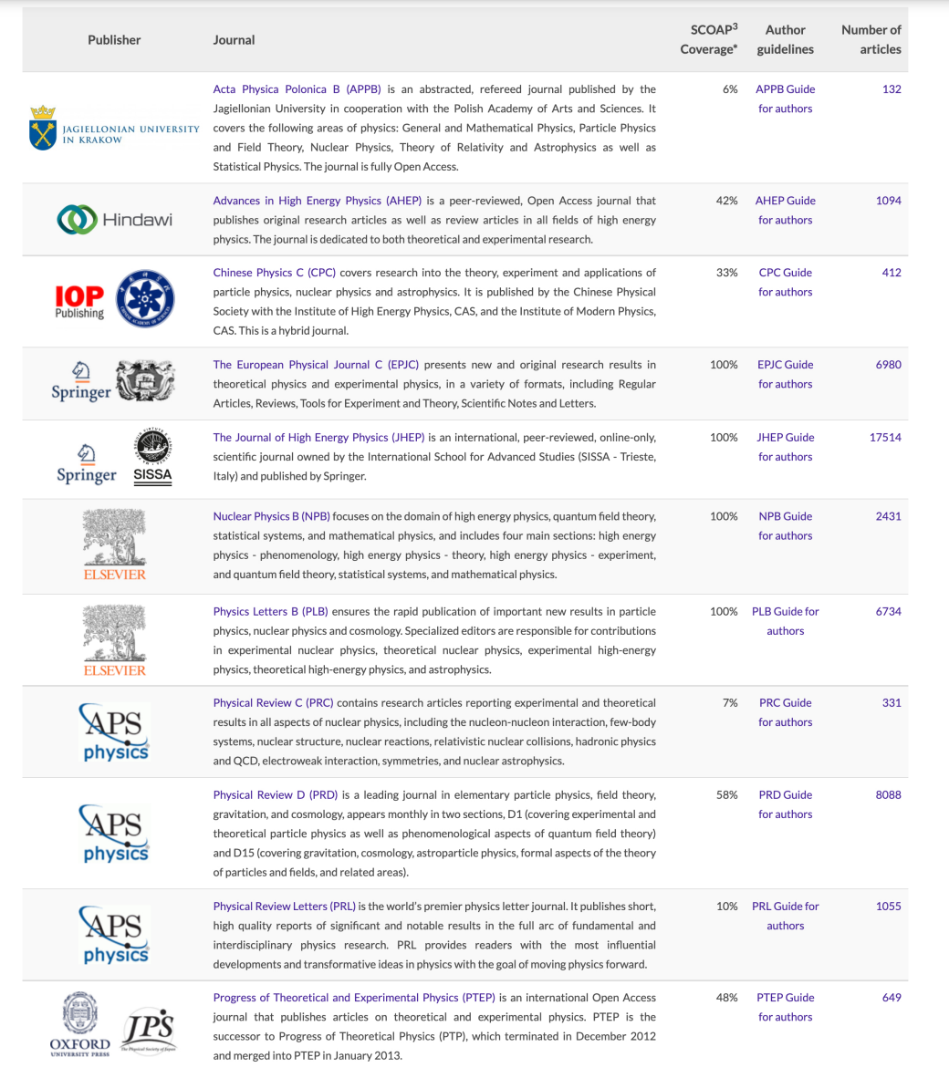
Scoap³ journals, transparence on costs with publishers
Benefits for authors:
immediate Open Access;
no direct cost;
no administrative burden;
automatic compliance with national and institutional Open Access mandates and policies;
retain copyright.

Slide 12
46.100 articles
published in almost 8 years of activity
Scoap³ has started in 2014 and is supporting about 7000 articles per year

Slide 13
Archeologia e calcolatori: OA in archeological data
Established in 1990, Archeologia e Calcolatori is a scientific journal focusing on computing and information technology applied to archaeology.
OA Journal: articles presented with full metadata on the journal's website and freely available for consultation.
Use of DOIs (persistent identifiers)
Use of the OAI-PMH protocol for the journal repository
https://zenodo.org/record/3752915#.YYJH0J5KjPY

Slide 14
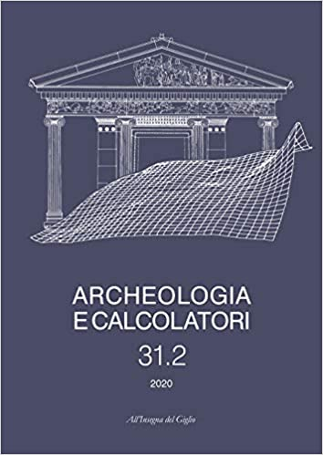
Journal of Archeological computing
Since 2005 Archeologia e Calcolatori has joined the Open Archives Initiative, adopting the OAI-PMH protocol. It is registered in the list of OAI Data Providers and OAIster contributors and in the Directory of Open Access Journals (DOAJ).
http://www.archcalc.cnr.it/index.php

Slide 15
30 years
of activity od “Archeologia e calcolatori”, always following the principles of Open Science

Slide 16
Institutional publishing

Slide 17
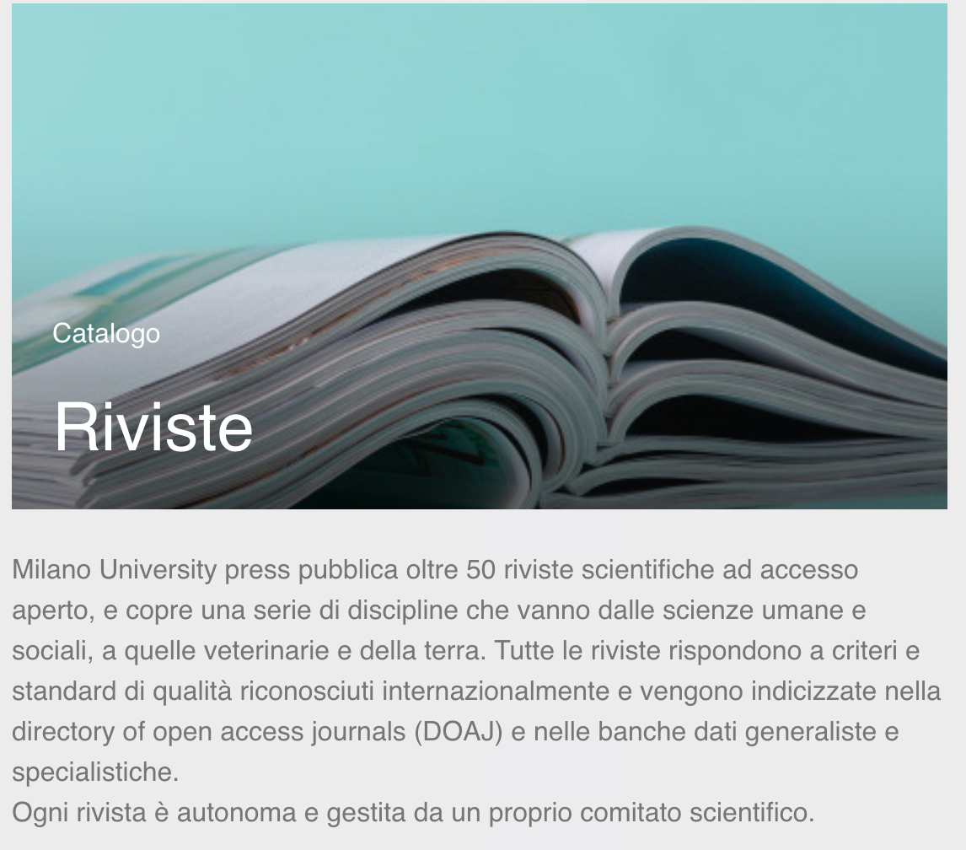
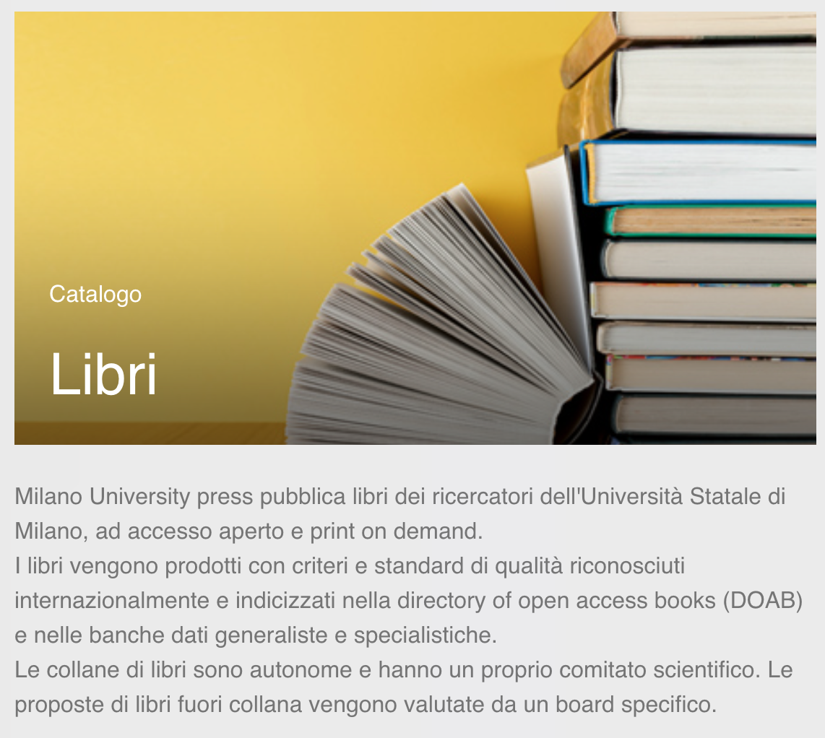
Milano University Press

Slide 18
The OA publisher of University of Milan
Two branches:
Journals https://riviste.unimi.it/
Books https://libri.unimi.it/index.php/milanoup
Diamond Open Access: no costs for readers nor for authors

Slide 19
50
open access journals published by Milano University Press, all indexed in the Directory of Open Access Journals (DOAJ)

Slide 20
Funded publishing platforms

Slide 21
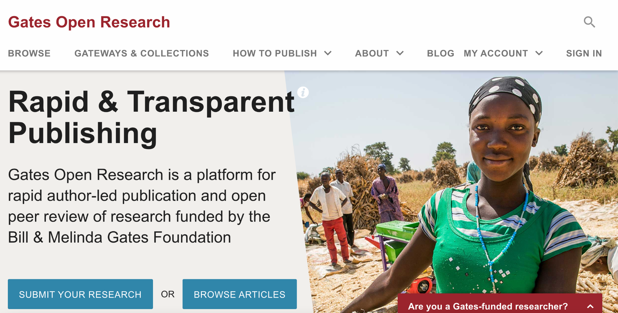
Bill and Melinda Gates Foundation
https://gatesopenresearch.org/

Slide 22
Gates Open Research
Fully transparent, author-driven model (the authors are solely responsible for the content of their article)
The source data underlying the results must be made available as soon as an article is published (data must be deposited in a repository)
Open Peer Review (after publication)
Articles and other types of content (posters, slides and documents) are published under a CC BY license
The publishing platform for Gates funded (or co-funded) researchers

Slide 23
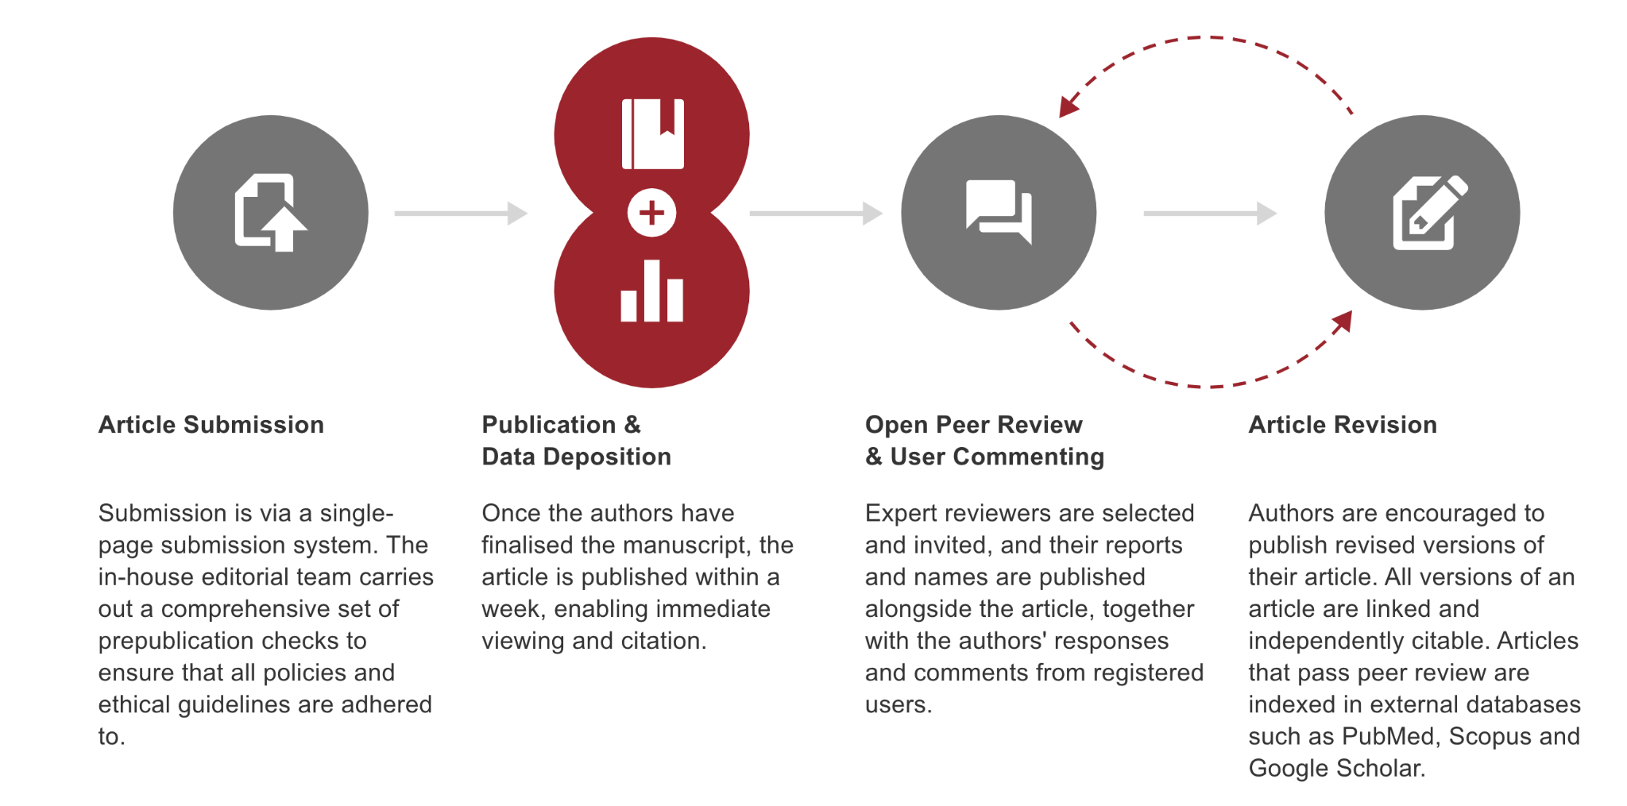
Gates Open Research
https://gatesopenresearch.org/about

Slide 24
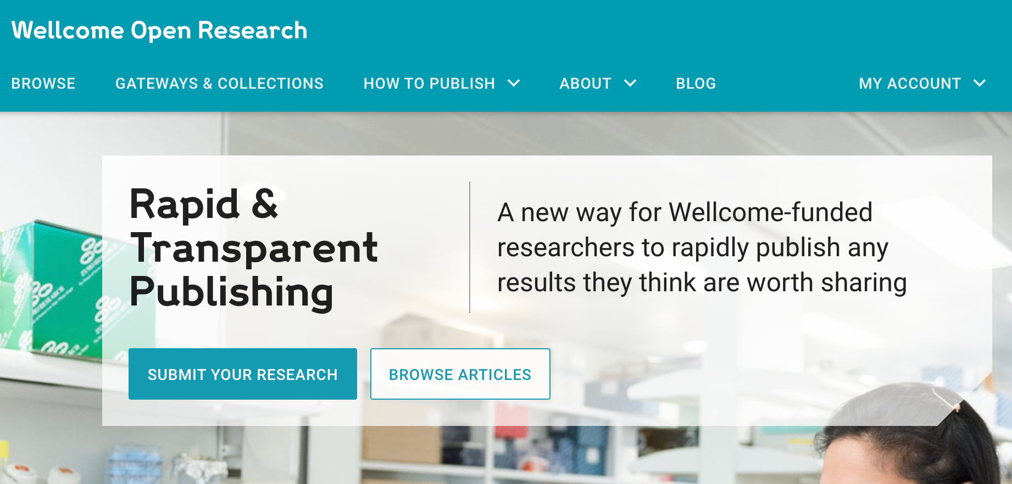
Wellcome Open Research
Principles and procedures similar to those of Gates Open research
https://wellcomeopenresearch.org/

Slide 25
Wellcome Open Research
“Wellcome Open Research is an Open Research platform: all articles are published open access; the publishing and peer-review processes are fully transparent; and authors are asked to include detailed descriptions of methods and to provide full and easy access to the source data underlying the results in order to improve reproducibility.”
The publishing platform for Wellcome
funded (or co-funded) research
https://wellcomeopenresearch.org/about

Slide 26
Oltre 1.100
the articles, all freely accessible and reusable, published by the Wellcome Open Research platform

Slide 27

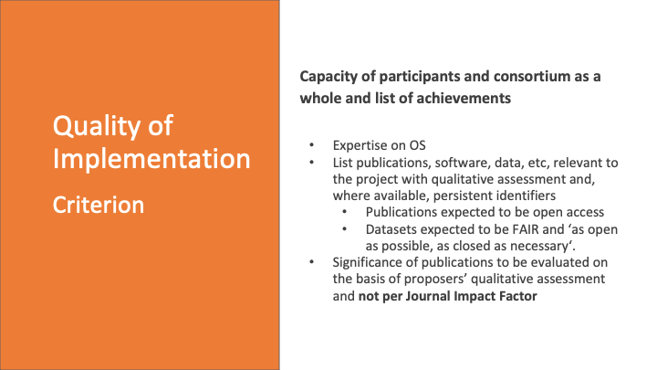

Slide 28
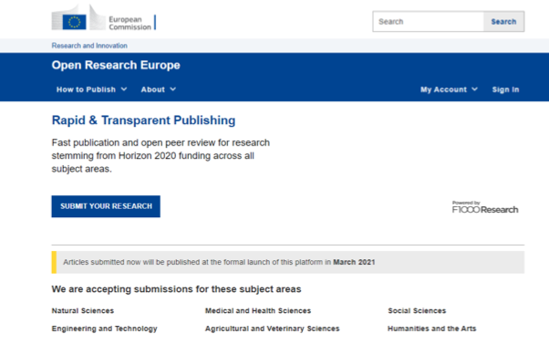
Open Research Europe (ORE)
Public Procurement – 5.8 Million EUR contract signed in March 2020 with F1000 Research for 4 years
Global Young Academy, LIBER and Eurodoc as collaborators/subcontractors for communication and sustainability
OpenAIRE are a partner to help with syndication and communication of ORE
https://open-research-europe.ec.europa.eu

Slide 29
Why a publishing platform?
High-quality, reliable and efficient publishing venue for Horizon research
High scientific standards, and swift and transparent processes
Expert Scientific Advisory Board
No cost to authors/beneficiaries i.e. non-APC platform
Optional, venue where grantees can publish post-grant the results of their work, while respecting their open access obligations

Slide 30
The platform as a publishing service
Original peer-reviewed articles first posted as preprints
Stemming from Horizon 2020-funded research (and later, Horizon Europe)
Immediate open access
With content licensed for re-use
Open peer review
Open reviewer identities, published reviews, post-publication comments
Connected to the scholarly ecosystem
PIDs, connection to repositories, open data and software, interoperable technologies, preservation of content, TDM, etc.

Slide 31
The platform as a publishing service
New generation metrics
Each article will have a dedicated metrics page
Explicit, accessible and transparent on business processes and publication policies
All published on the site for everyone to see
Aligned with the EC policy and principles
Takes the burden off researchers as it is fully compliant
Following example of other funders, such as the Wellcome Trust (Wellcome Open Research) and others

Slide 32
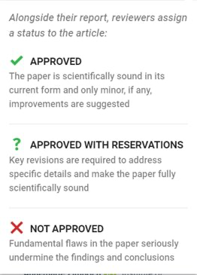
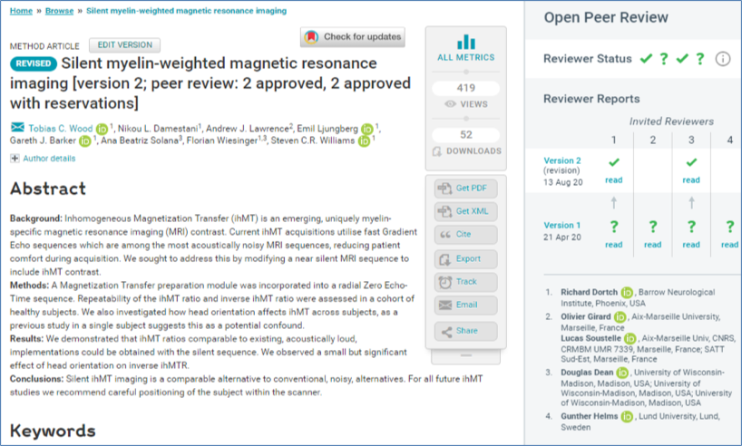
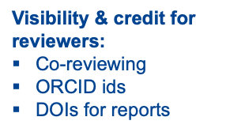
ORE Open Peer Review Example
https://wellcomeopenresearch.org/articles/5-74

Slide 33

Interact with mentimeter
Please go to www.menti.com and insert code: 9468 8822
OR
use your mobile/tablet to scan the QR code

