Slide 1



Open Science
in research projects
More better, Open Science
module 1.3
Gina Pavone 0000-0003-0087-2151
Emma Lazzeri 0000-0003-0506-046X
5 November 2021

Slide 2
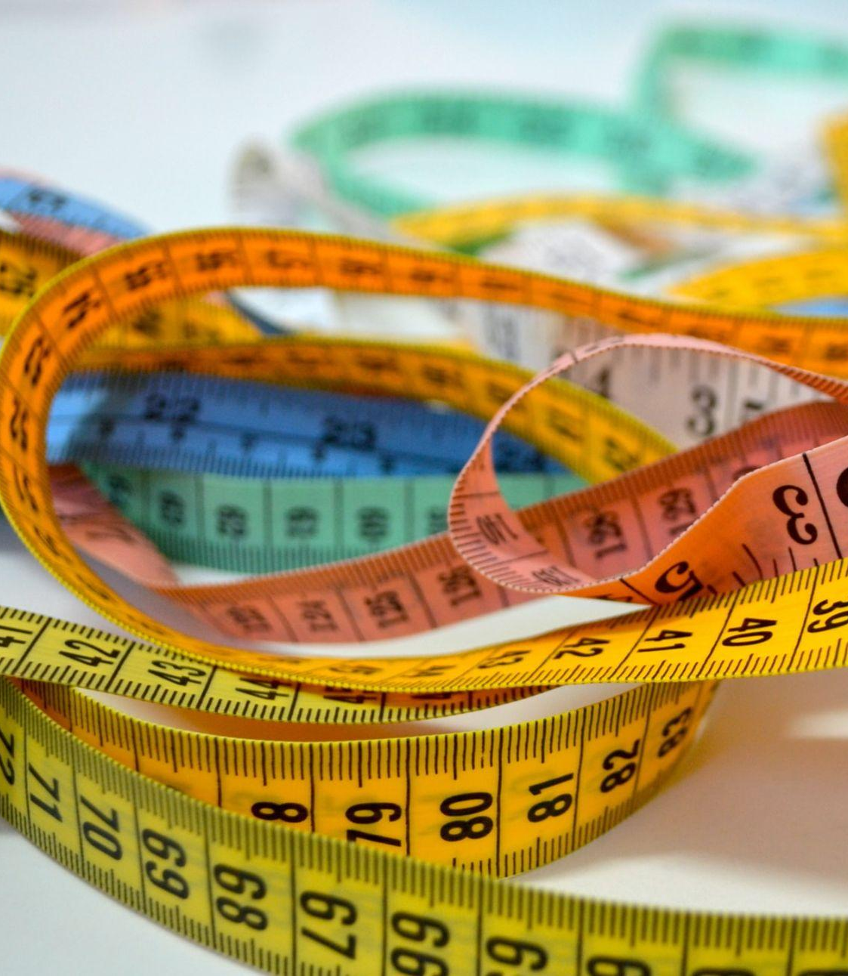
Research evaluation
Based on bibliometric indexes or,
for non-bibliometric sectors, on selected «fascia A» list of journals
Photo by patricia serna on Unsplash

Slide 3
What are we evaluating?
Researchers are evaluated by looking at the Impact Factors of the Journals where they publish papers
Commercial publishers are responsible for assessing ranking (Impact Factor) of the Scientific Journals

Slide 4
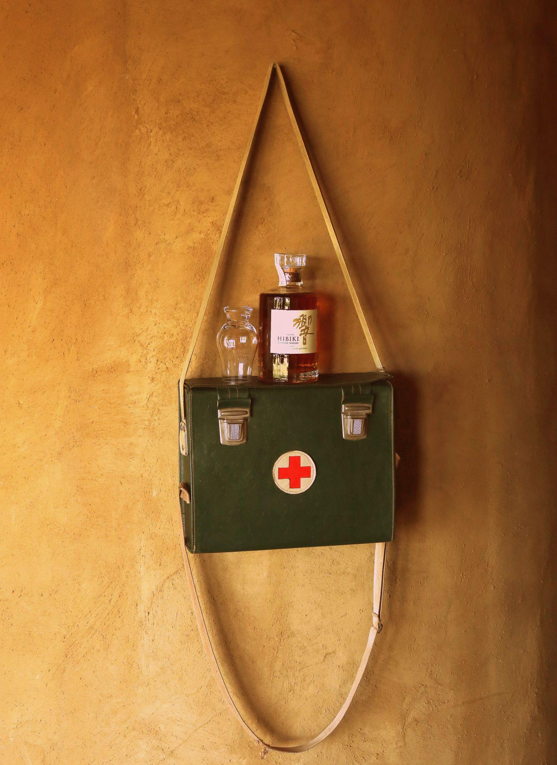
Researcher’s
survival kit?
many many publications
high citation rate
“important” venus (read: high IF)
But this does not in itself imply excellence in research!
Photo by Garo Uzunyan on Unsplash
Notes:
Do we want this?

Slide 5
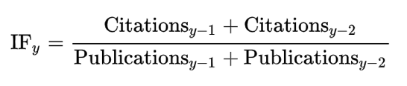
The two most important bibliometric indexes
Journal Impact Factor
For a given year, the two-year jif is the ratio between the number of citations received in that year for publications in that journal that were published in the two preceding years and the total number of "citable items" published in that journal during the two preceding years
H-index
For a researcher:
the maximum value of h such that the given author has published h papers that have each been cited at least h times.
As an example, an h-index of 10 means that among all publications by one author, 10 of these publications have received at least 10 citations each.

Slide 6
What do JIF and H-index measure?
Journal Impact Factor
Impact Factor is a measure of the frequency with which the average article in a journal has been cited in a particular year.
H-Index
H-index tries to estimate productivity and impact of a research.

Slide 7
Citation index criticism - part 1
Early career researchers are penalised
The citation context is not considered (e.g. negative citation)
They are influenced by the limitation of the citational databases (which are all owned by big scientific publishers and not publicly available)
It can be manipulated by both authors and reviewers (self and cross citations)
DORA, 2013, https://sfdora.org/read/
McKiernan, et al, 2019. https://elifesciences.org/articles/47338
Niles, et al, 2019. https://www.biorxiv.org/content/10.1101/706622v1
Alder, et al, 2008. https://www.mathunion.org/fileadmin/IMU/Report/CitationStatistics.pdf

Slide 8
Citation index criticism - part 2
It does not take into account the number of authors in a paper and their contribution
It does not take into account research multidisciplinarity (i.e. citation conventions differ widely among different fields)
It does not facilitate science freedom
DORA, 2013, https://sfdora.org/read/
McKiernan, et al, 2019. https://elifesciences.org/articles/47338
Niles, et al, 2019. https://www.biorxiv.org/content/10.1101/706622v1
Alder, et al, 2008. https://www.mathunion.org/fileadmin/IMU/Report/CitationStatistics.pdf

Slide 9
“Researchers will do anything to publish papers in some journals, including even creating fake authors”
“ [...] publishing papers in certain journals is the only way to earn grants, tenure, and promotions”
Gaming the Metrics: Misconduct and Manipulation in Academic Research https://direct.mit.edu/books/book/4598/Gaming-the-MetricsMisconduct-and-Manipulation-in

Slide 10
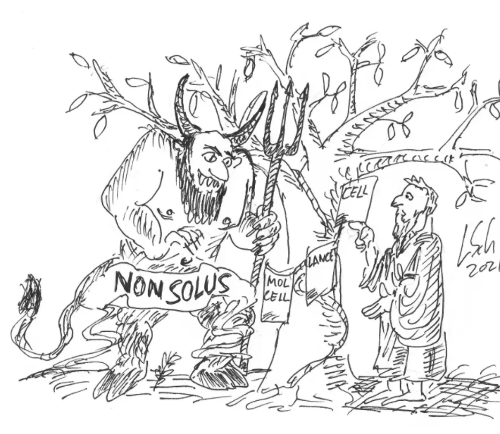
Not only researchers’ fault
A major publisher (Elsevier) buys a well known scientific journal: The Journal of Biological Chemistry (JBC). This is what happens:
online articles reformatted and images available in low resolution only
in that type of journal that means less readable, less easy to double-check images
resistance to correction/retraction
https://forbetterscience.com/2021/10/12/how-jbc-sold-its-soul-to-the-devil/?fbclid=IwAR3OMFpos_8hDdGhmV-6tE_xzMgYrEYoPLF3sC9LOrKrJ9sDoRu6qShjS7k

Slide 11
Yet to many still take
for granted that “prestigious journal = good paper”
Think on the example of hydroxychloroquine in COVID-19 research: high-profile, peer-reviewed journal articles were retracted!

Slide 12
But….good news!
Things
are changing!

Slide 13
A change in the approach

Slide 14
Competition
Collaboration and sharing

Slide 15

Many funders are embracing OS
European Commission
European Research Council
In Italy Mur with the National Open Science plan (about to be published)
Many other across Europe and worldwide
Image by Nattanan Kanchanaprat from Pixabay

Slide 16

The Declaration on Research Assessment (DORA)
https://sfdora.org/

Slide 17
“There is a pressing need to improve the ways in which the output of scientific research is evaluated by funding agencies, academic institutions, and other parties”.
https://sfdora.org/

Slide 18
Basic principles of DORA recommendations:
the need to eliminate the use of journal-based metrics, such as Journal Impact Factors, in funding, appointment, and promotion considerations;
the need to assess research on its own merits rather than on the basis of the journal in which the research is published;
https://sfdora.org/read/

Slide 19

And again…
good news!
The DORA case studies: a list of institutions that have already introduced changes in academic career assessment
https://sfdora.org/dora-case-studies/

Slide 20
What is going on at
European Level

Slide 21
Two main pillars:
both converging to the European Open Science Cloud
Research Infrastructures
ESFRI - the European Strategy Forum on Research Infrastructures
Open Science
Broad commitment on Open Science in the Horizon Europe funding program

Slide 22
The European Open Science Cloud
Ambition: provide European researchers, innovators, companies and citizens with a federated and open multi-disciplinary environment where they can publish, find and re-use data, tools and services for research, innovation and educational purposes.
An environment for hosting and processing research data to support EU science.
https://eosc-portal.eu/about/eosc

Slide 23
SRIA - Strategic Research and Innovation Agenda
The Strategic Research and Innovation Agenda (SRIA) agreed by the EOSC Association and the European Union is based on three main objectives:
Ensure that Open Science practices and skills are rewarded and taught, becoming the ‘new normal’
    recognise Open Science activities in research career assessments
Enable the definition of standards, and the development of tools and services, to allow researchers to find, access, reuse and combine results
Establish a sustainable and federated infrastructure enabling open sharing of scientific results
Memorandum of Understanding for the Co-programmed European Partnership on the European Open Science Cloud - EOSC MoU – Draft of 11 February 2021 https://eosc.eu/sites/default/files/20210215_EOSC_MoU_FinalDraft.pdf

Slide 24
What is going on in Italy

Slide 25
The Italian National Plan for Research 2021-2027
National Plan for Research Infrastructures (Piano nazionale per le infrastrutture di ricerca), already published.
National Plan for Open Science (Piano nazionale per la scienza aperta) about to be published.
“Programma Nazionale per la Ricerca (PNR) 2021-2027”
Notes:
I piani nazionali del PNR 2021-27 sono dedicati il primo (Piano nazionale per le infrastrutture di ricerca) al potenziamento e al consolidamento del complesso delle infrastrutture di ricerca di livello nazionale ed europeo, il secondo (Piano nazionale per la scienza aperta) ad approfondire le tematiche di diffusione di processi compatibili con il più ampio accesso possibile ai dati e ai risultati della ricerca (open science) e dell’innovazione (open innovation). p. 2 https://www.mur.gov.it/sites/default/files/2021-01/Pnr2021-27.pdf

Slide 26
The Italian National Plan for Research Infrastructures
RIs are intended as promoters of Open Science by providing FAIR and Open data and thus contributing to the European Open Science Cloud”
Piano nazionale per le infrastrutture di ricerca PNIR) 2021-2027, already published: https://www.mur.gov.it/sites/default/files/2021-10/Decreto%20Ministeriale%20n.1082%20del%2010-09-2021%20-%20PNIR%202021%20-%202027.pdf

Slide 27
The Italian National Plan for Open Science
It pursues the evolution of research practices, validation and evaluation of results.
see 6.2 in https://www.mur.gov.it/sites/default/files/2021-01/Pnr2021-27.pdf
About to be published

Slide 28


